Slide 1
Our New Website

Slide 2
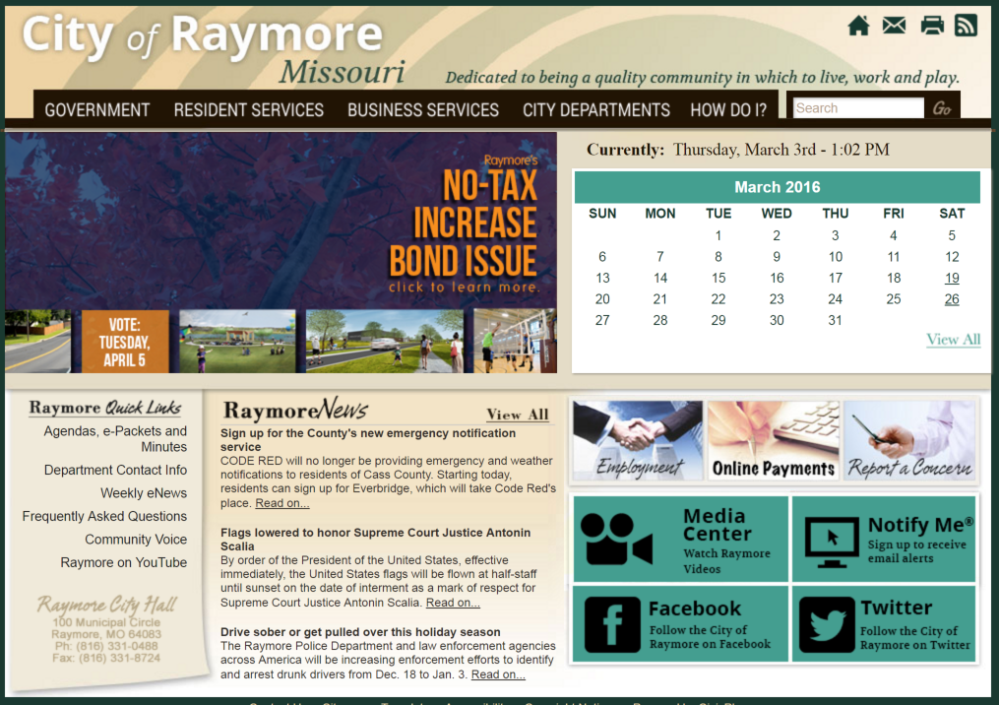
Current Website

Slide 3
Project Goals
We met with <staff and council> before the project to determine major project goals.
These included:
<Insert specific goals gathered at the beginning of the project from stakeholders>
Creating an information portal
Quality of execution
Being better than other websites

Slide 4
Project Goals
We also conducted a User Experience analysis of our existing website and received feedback from the community about what they would like to see on the new website.
This process included:
Qualitative Study
Conducting a survey to compile feedback from the community
Quantitative Study
Reviewing our website analytics files to identify use patterns
Capturing heat maps to learn how the community uses our website

Slide 5
Community Feedback
Likes?
<fill in with survey results>
Dislikes?
<fill in with survey results>
Information is difficult to find
Tough to find out about community events
Other feedback?
<fill in with anything else of relevance from your survey>
Several surveys indicated Adult Sports League information was hard to find
There were numerous requests for online tax payments

Slide 6
How the Community Uses Our Website
The User Experience (UX) Analysis allowed us to understand how our community is actually using the website. We learned:
Search is very frequently used
Our homepage buttons were not used or accessed
Where Users Clicked
Where Users Looked

Slide 7
Most Frequently Visited Pages
We reviewed our website analytics data to identify what content our community accessed most often. Our top pages include:
<insert the list from your usability report>
Home
Parks & Rec
Paying utility bills
Sports programs
Weekly eNews
Archive
City departments
Employment opportunities
Police
Youth baseball/softball leagues

Slide 8
New Website Layout
We developed the new website layout to serve the needs of the community that were uncovered through the process:
<Insert key takeaways>
45% of our traffic is mobile, so the homepage is a long-scroll format to optimize the viewing experience
Community surveys indicated our residents prefer to search, so a search bar was added as a primary way to access content
The Most Requested buttons provide immediate access to our top four pages, as determined by our website analytics data

Slide 9
New Website Design
We conducted surveys to develop the direction for the website’s design.
The surveys revealed the primary goals:
<Insert key takeaways>
Reinvent the city’s image
Represent Raymore as a progressive, growing city
Highlight community programs in parks and the arts
Promote economic development efforts
Flexible enough to incorporate new branding down the road
Mood Board

Slide 10
New Website Design

Slide 11
Mobile-Friendly Design
<Nearly half> of our website traffic is mobile, the new website will also automatically resize to fit all mobile devices.

Slide 12
Questions?
<insert your contact information>

