Slide 1
Website Redesign Project Kick-Off
Project Name
Date
Your Name, Project Manager
yourname@visioninternet.com
310-656-3100 x extension

Slide 2
Today’s Agenda
Introductions. Introduce ourselves and start to get to know each other.
Project scope. Discuss the overall project scope and confirm your key priorities.
Implementation process. Walk through Vision’s website implementation process, identifying key deliverables and turnaround times expected by both teams.
Project roles and client approval process. Describe my role and other key team roles. Discuss your approval processes and plan for any timing constraints.
Working together. Discuss and agree on how we will communicate and work together.
Next steps. Introduce the UX Consulting phase.

Slide 3
Today’s Goals & Objectives
Confirm your priorities and expectations about the implementation process
Create a solid foundation for our working relationship
Answer your questions
Clarify the next steps

Slide 4
Introductions
Name
Title and responsibilities
Project role
Any additional information that might help us work together, such as:
  Work Schedule? Upcoming time off?
  Previous experience with web development?
  CMS experience level?

Slide 5

Project Scope & Priorities
  Scope
    Unique components or services included in the contract
  Priorities that will make this project successful for you, such as:
    Design, functionality?
    Target launch date?

Slide 6
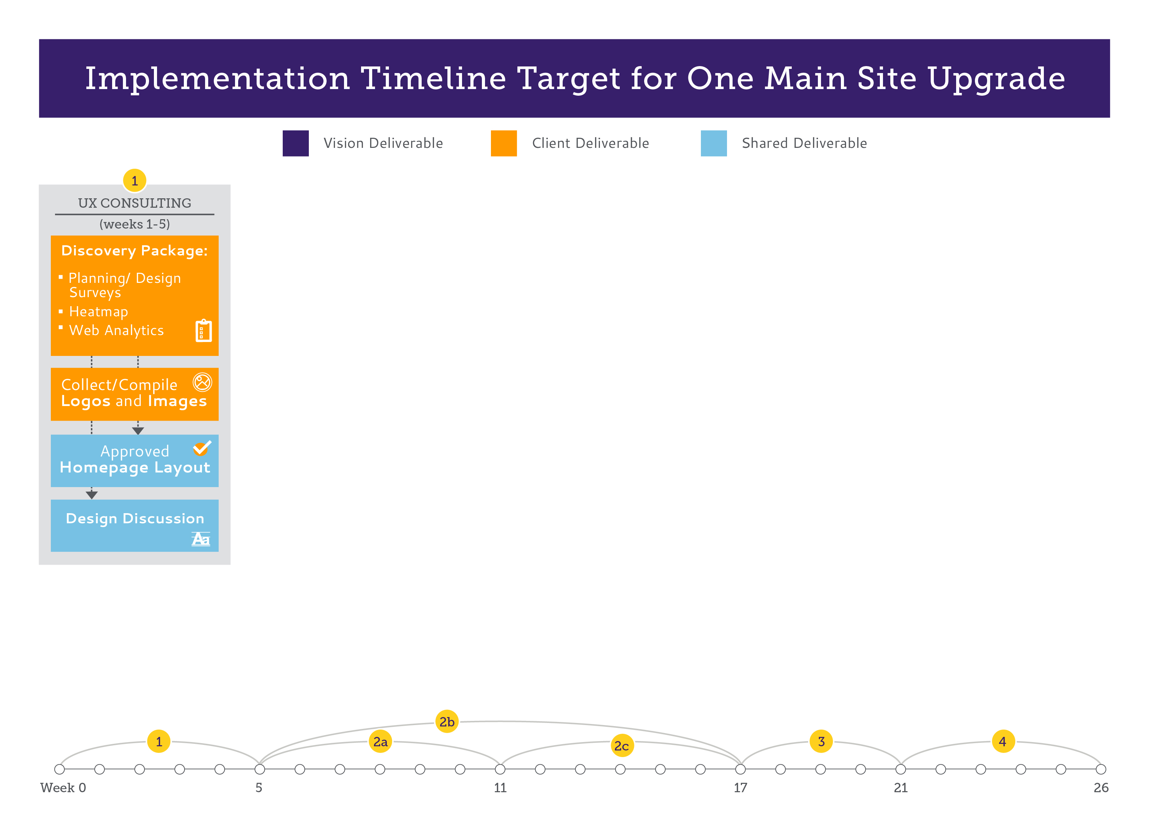
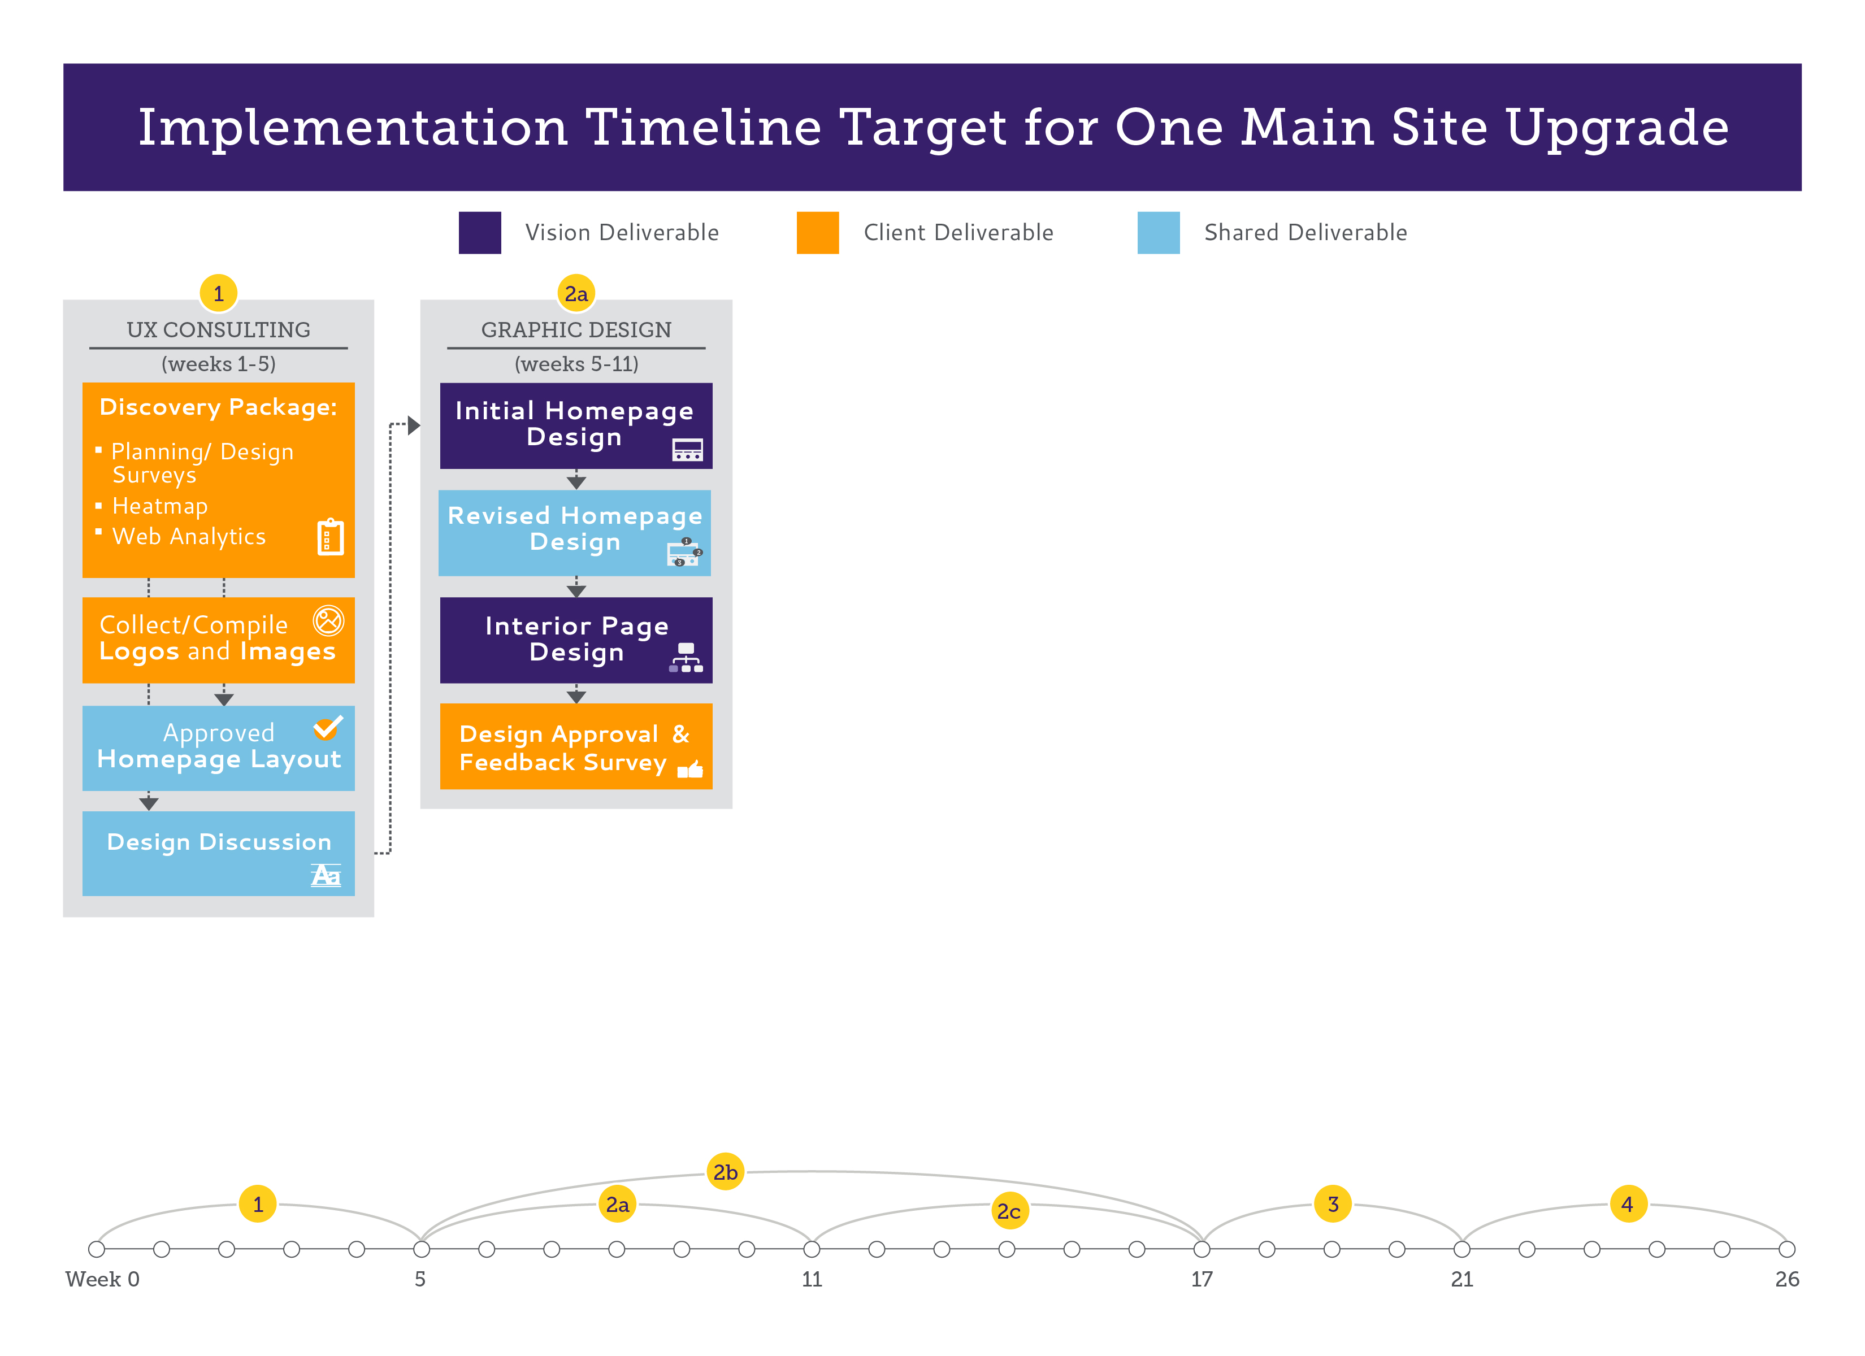
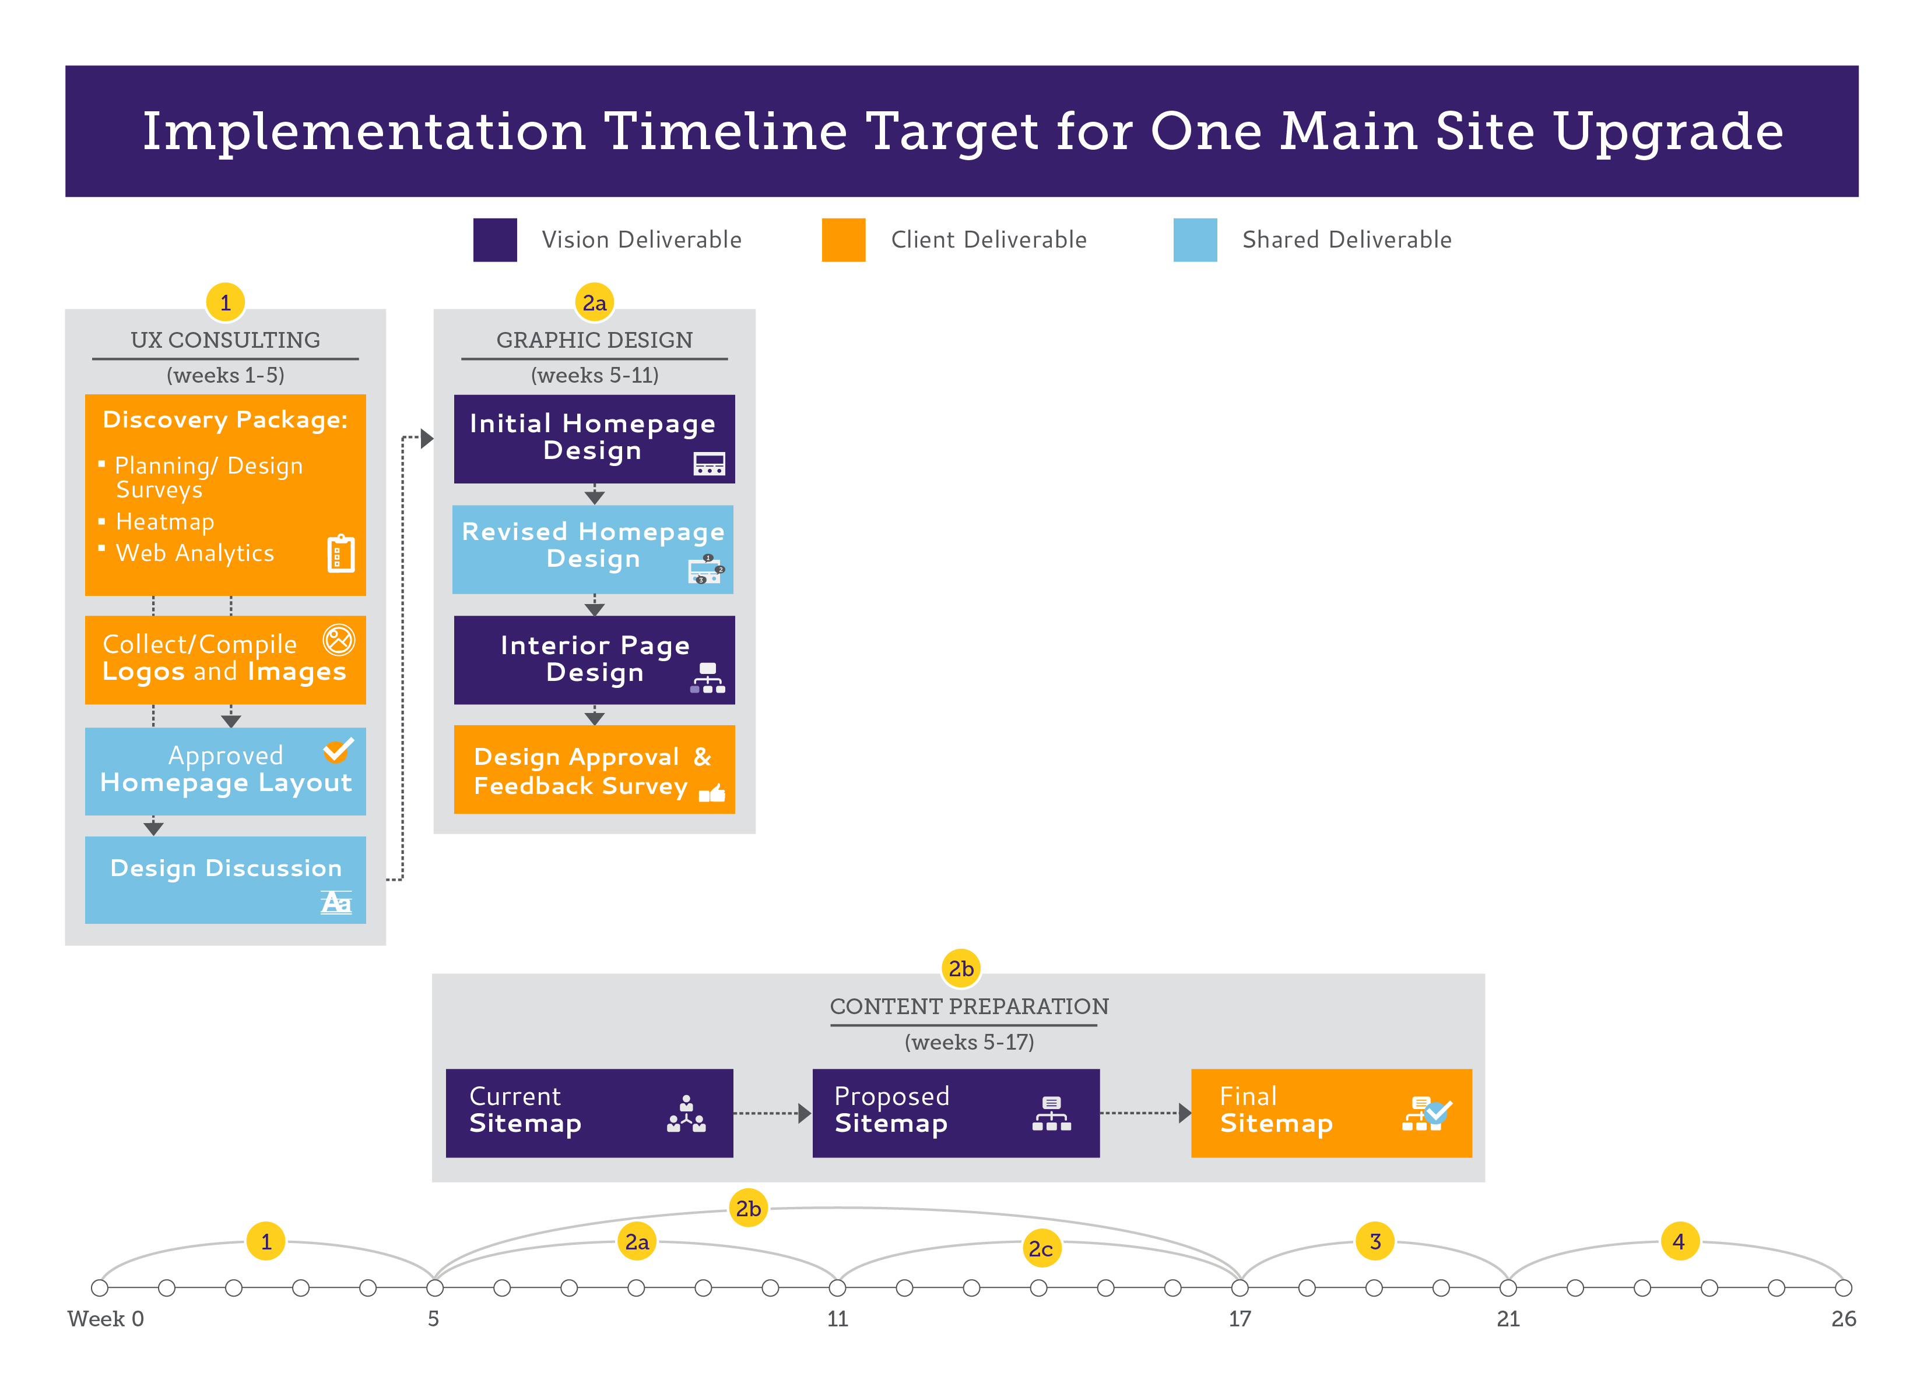
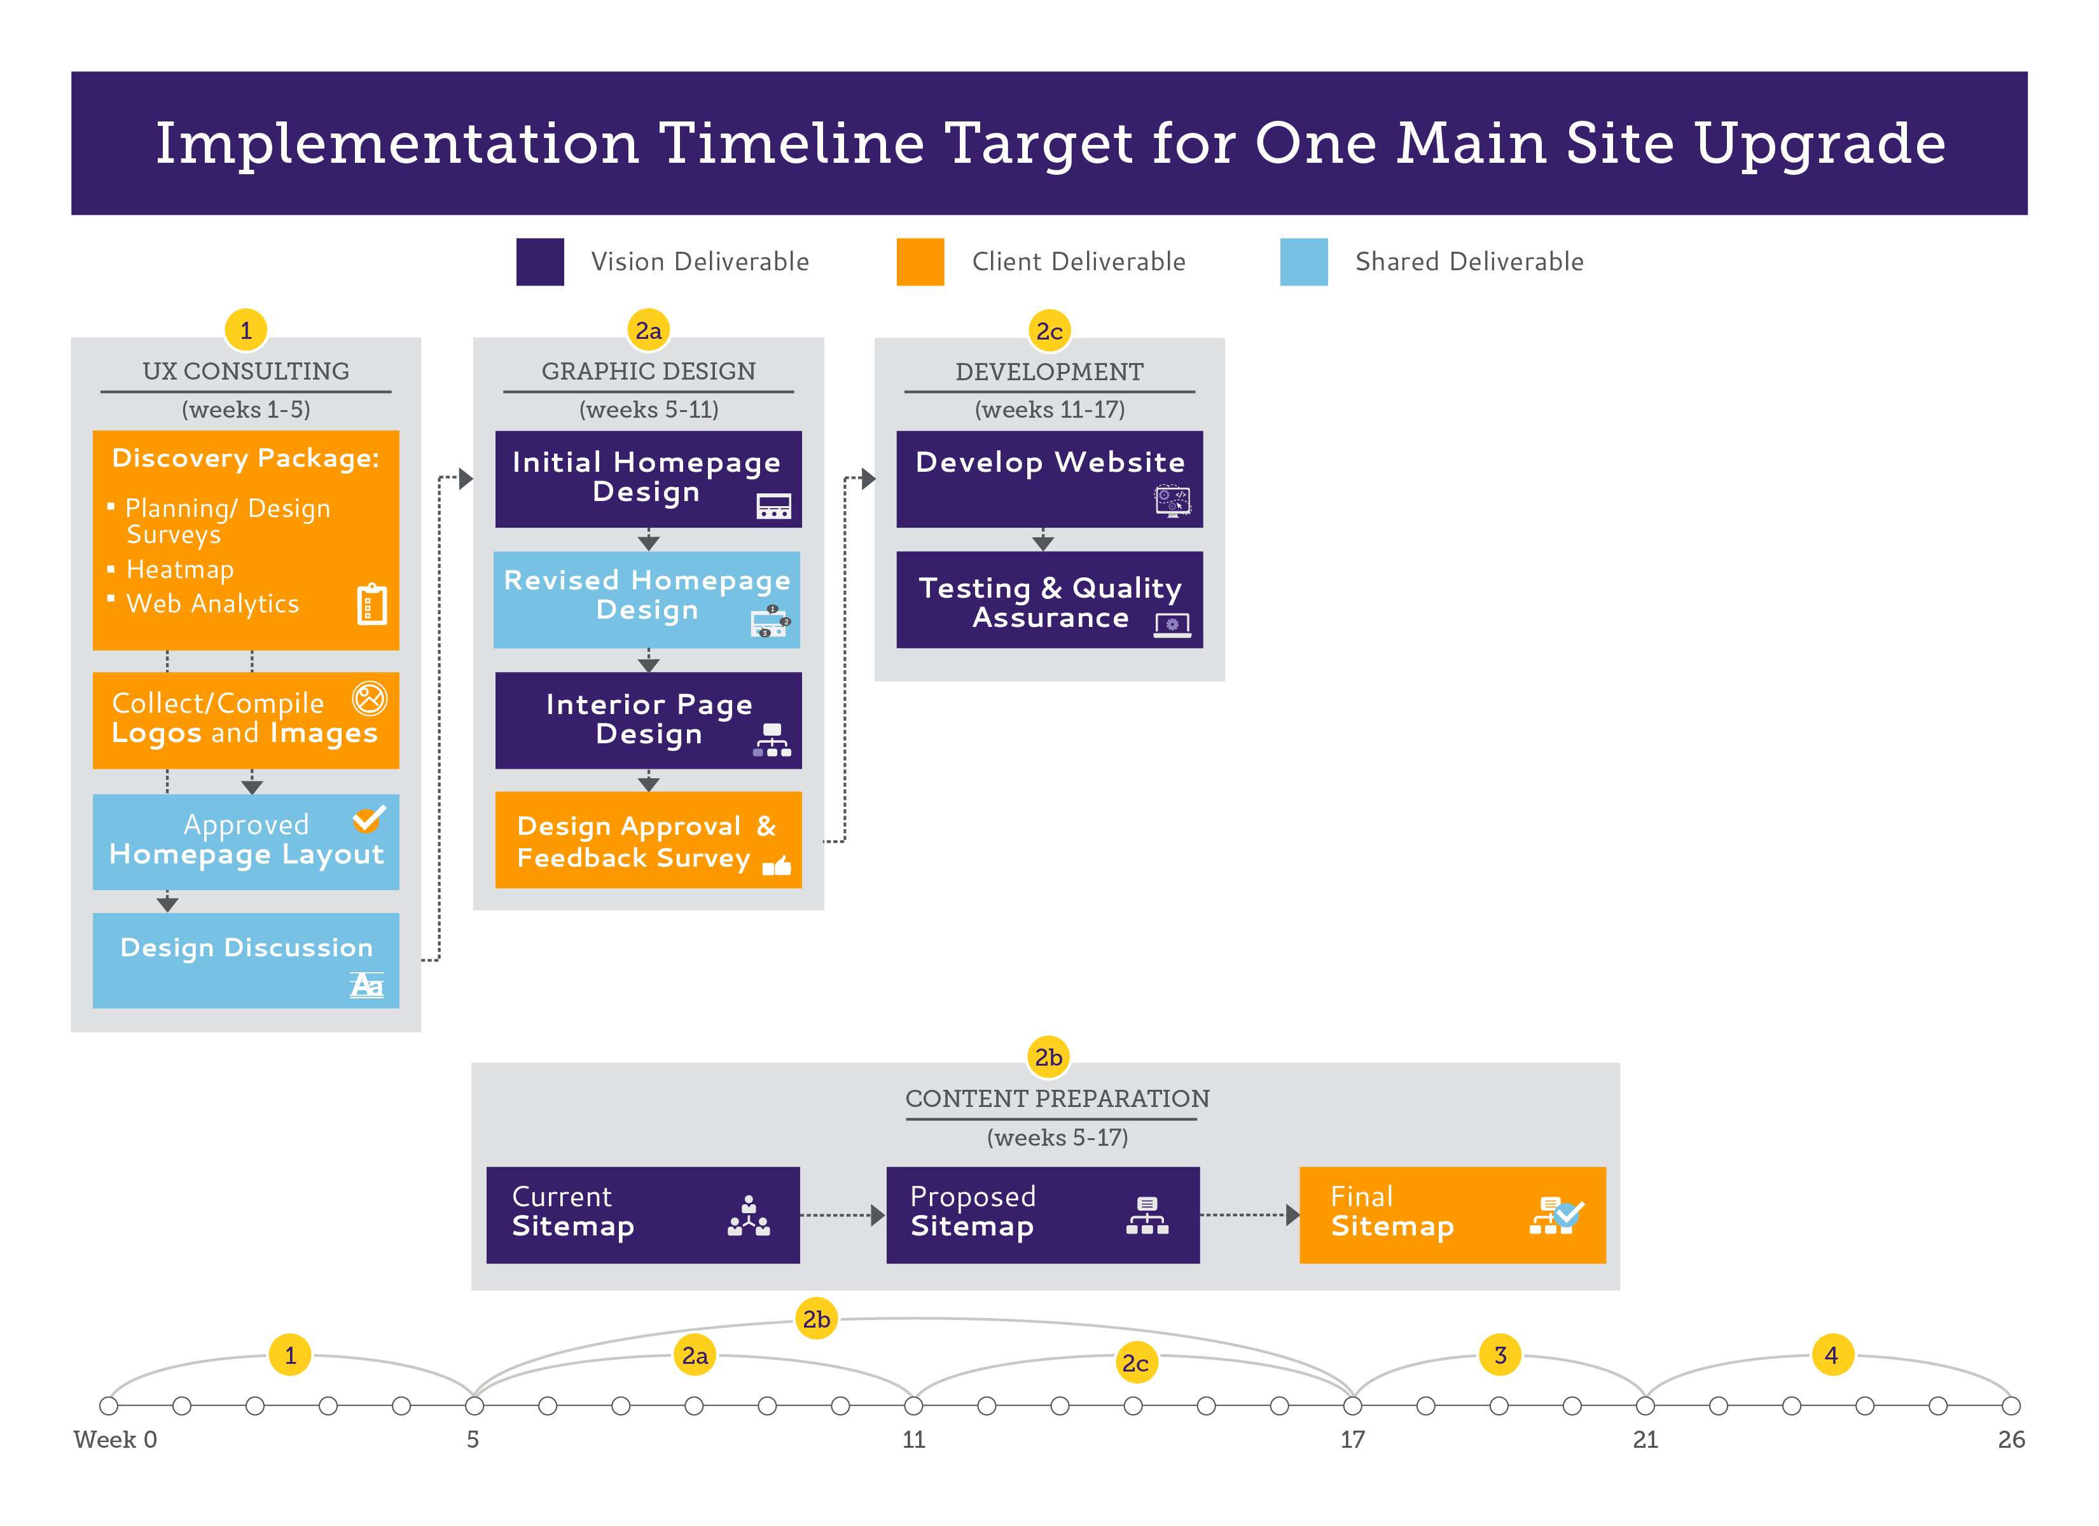
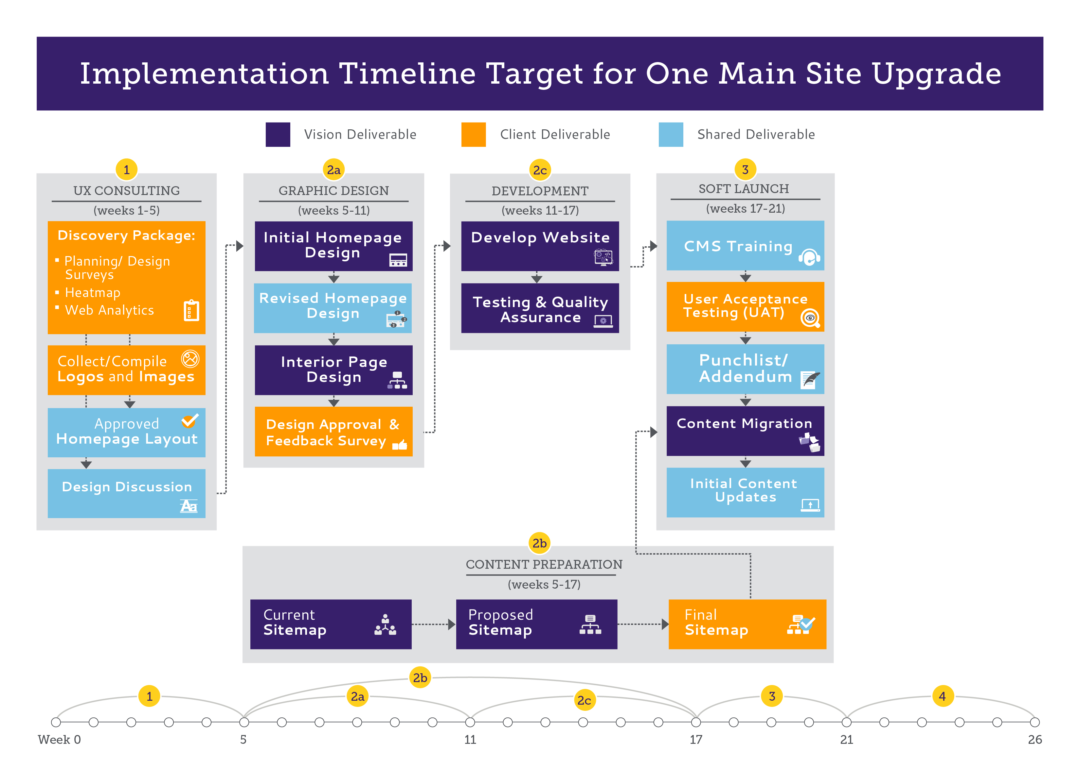
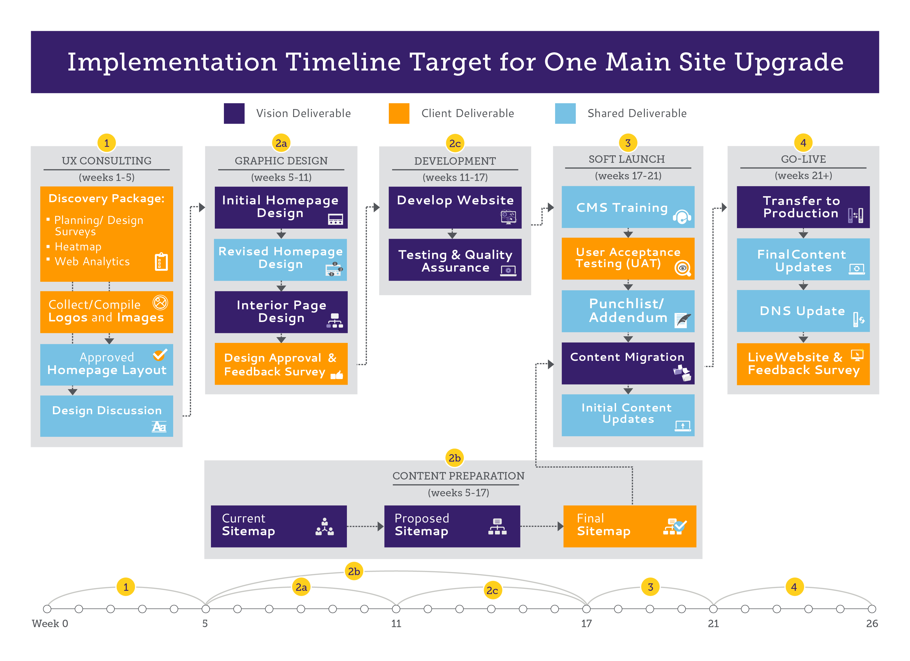
3. Implementation Timeline

Slide 7
Implementation Process: A Closer Look
UX Consulting
UX Manager will email you to begin this phase
Planning surveys should be filled out by your core team
Design surveys should be filled out by key stakeholders
Graphic Design
Commit to a turnaround time (recommended 2 business days max)
Once the homepage design is signed off on, any changes to the design will result in Extra Work as per your contract
Content Migration
Review number of pages contracted for compared to total number in site
We do migration but do not rewrite or reformat content

Slide 8
Implementation Process: A Closer Look
Customizations
Our CMS is highly configurable to your meet needs, and it is in both of our best interests to avoid customizing the platform beyond these configurations.
If any requests become a customization, I will let you know and help you accomplish your needs without customization
Soft Launch
If you already have an existing website, you will be updating both sites in parallel once we migrate content and before we go live with the new site
Launch
For a successful launch, we recommend launching the new website on a Monday, Tuesday, or Wednesday during business hours for maximum support

Slide 9
Roles in the Vision Team
My Role as Project Manager
My job is to guide the development of your site: to ensure we understand your priorities and needs, to set and meet overall project expectations, keep the project within scope, and coordinate Vision’s internal resources.
Other key members of the Vision team:
UX - Ensures that your website will have a solid architecture that will maximize engagement with your residents and website users
Designers
Production team and Developers
Training - Teaches your super users and web editors on how to use the CMS
Technical Support and Customer Success - Support team who will take care of you on an ongoing basis after we have implemented your site

Slide 10
Client Roles & Approval Process
Key Roles:
Sponsor:
Sign-off Decision Maker:
IT Contact:
Content & Assets Coordinator:
Approval Process:
Helps to understand your decision-making and approval process in order to anticipate any timing related needs before they arise for tasks such as:
  Finalizing your site map
  Finalizing home page and interior page designs
  Going live

Slide 11
Working Together
Our communication tools:
Email or phone for ongoing communication
FTP, DropBox or another tool as desired for file sharing
InVision for collaboration throughout the design phase
Our communication standards:
In-office: 1 business day maximum for emails and phone calls (even if we don’t have an answer)
Out-of-office: will notify you in advance and provide an alternate contact for time sensitive questions
You may also contact our Manager of Project Implementation, David Rodriguez, at drodriguez@visioninternet.com or (310) 656-2100 x 388
Project status updates every 2 weeks by email
Our requests of you:
Design feedback
Satisfaction surveys

Slide 12
Next Step
Next Step: Begin the UX phase
Pearland Deliverables:
2 surveys due by date: Website planning and design
Insert Google Analytics and heat mapping code to current website ASAP
Timeline:
This process takes 3 weeks to:
  complete the surveys
  engage with the right people internally
  gather enough web traffic history through the analytics tools
After these 3 weeks, we will hold our consulting workshop on date

Slide 13
In Closing
Thank you for your time today!
Any other questions? Are the next steps clear?
Follow-up with summary email
Talk to you soon!

