Slide 1
Client Content Migration Guide

Slide 2
Contents
Overview 3
What is Content Migration?
When does content migration occur?
How is it done?
What are the tools?
Current Sitemap 4
Proposed Sitemap 5
Determining the Proposed Sitemap
Filling out the Proposed Sitemap
Description of the Components
Additional Information and Best Practices
Content Migration Template 9
Setting Up the Box Folder 10
3rd Party Integrations 11
iFrames
HTML Templates

Slide 3
Overview
What is Content Migration?
Content migration is the most time consuming part of many website projects. During this phase, Vision migrates the agreed upon scope of content, as is, from the live website to your new website.
When does content migration occur?
The Content Migration phase begins simultaneously with the graphic design phase and is completed at the same time as the development phase. The goal of the Development phase & the Content Migration phase is to deliver a complete website prototype hosted on a development server, including all pages that were migrated based on selection during the Content Preparation Phase.
How is it done?
Vision delivers a Content Migration sitemap with a Current Sitemap and a Proposed Sitemap to your team. Your team will then work on finalizing the page on the Proposed Sitemap tab by re-arranging, deleting, or creating any pages as you see fit. In the Proposed Sitemap, you will tell Vision which pages to migrate over to the new website, and Vision will migrate the pages during the Development Phase. After the website has been prototyped, any remaining content to be migrated will be done by your team.
What are the tools?
The Content Migration sitemap is delivered as an excel spreadsheet. To migrate new pages of content, you will fill out a Content Migration Template word document and upload it, along with any document or image attachments, to Box, an online file sharing application.

Slide 4
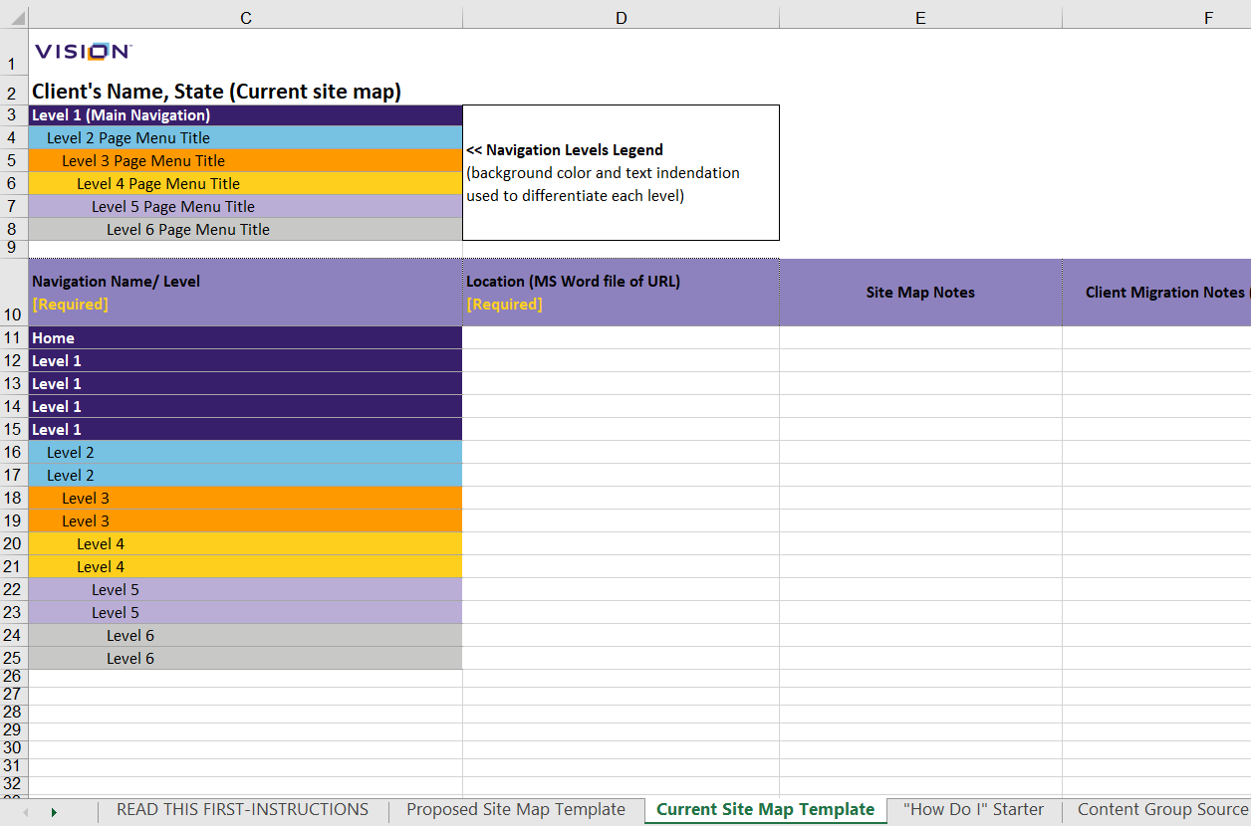
Current Sitemap
The Current Sitemap tab on the Migration Sitemap Excel spreadsheet gives a visual representation of all of the current pages on your website. Each row represents a unique page on your website.
In Column C, the titles are separated into Levels by color and indentation, with a lower page level having a greater page indentation. Level 1 is your website’s main navigation. Level 2 pages live as subpages of the most recent Level 1 page above it, and so on with each level under.
In Column D, the source URL is the unique page link on your website.
In Column E, any notes on special attributes to that page are listed (i.e. # of PDF pages, special iFrame inserts, special widgets or features).

Slide 5
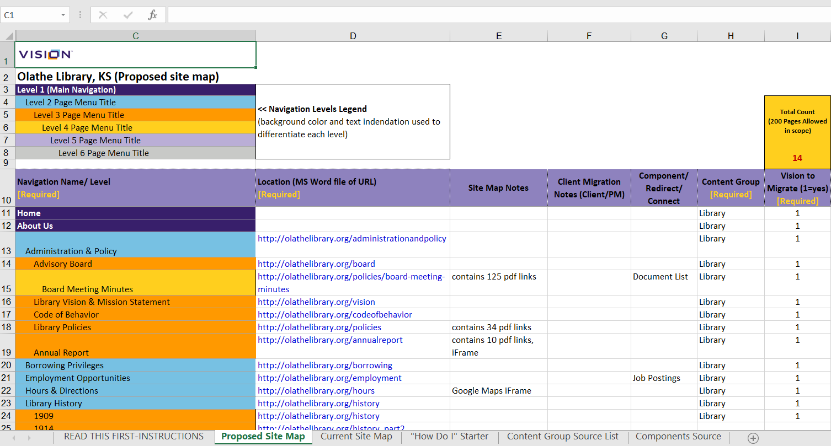
Proposed Sitemap
Determining the Proposed Sitemap
The Proposed Sitemap tab has a visual representation of all the proposed pages, rearranged from the Current Sitemap tab to match the new main navigation from your latest website design.
After Vision delivers the Content Migration Sitemap Document to your team, it’s your job to look through the “Proposed Sitemap” tab and to:
Finalize the page structure of the pages for your new website; column C
Specify which pages will be brought over to the new website by Vision; column I
Specify where content will be brought over to the new website from; column D
Below is an example of a properly filled out Proposed Sitemap:
Vision arranges the pages on your Proposed Sitemap based off of the new navigation menu on your approved homepage wireframe layout. We place each page under the main navigation category that fits best.
Review the Proposed Sitemap tab and move or edit each page to live under the page structure that you would like. To move a page, select the row of the page by clicking on the row # on the very left, then cut the row (Ctrl + X), click on the row under where you would like this cut row to live, and then paste the row (Ctrl + V). You can select and move multiple rows at once.

Slide 6
Proposed Sitemap
Filling out the Proposed Sitemap
For new pages to be added to the Proposed Sitemap, follow the instructions below:
Put the title of the page in Column C.
List the source of the page – either the URL of the live page or the name of the Microsoft Word file uploaded to Box, in column D. If you are rewriting your website content, please read the “Content Migration Template” for further instructions.
In Column G, list the Components Source, if applicable.
The “Components Source” tab contains a list of Components available. The applicable page template will be applied based off of the Components Source listed.
Assign a Content Group to each page (column H) that reflects the content ownership groups you defined in the permissions worksheet.
First, update the placeholder Content Group names with actual ones in the “Content Group Source List” tab.
Then, in column H, use the dropdown to select the Content Group.
Mark “1” in column I for pages that Vision will migrate. The “Total Count” box counts the number of pages you have marked for Vision to Migrate.
Pages without “1” in Column I are pages that you will migrate yourself.

Slide 7
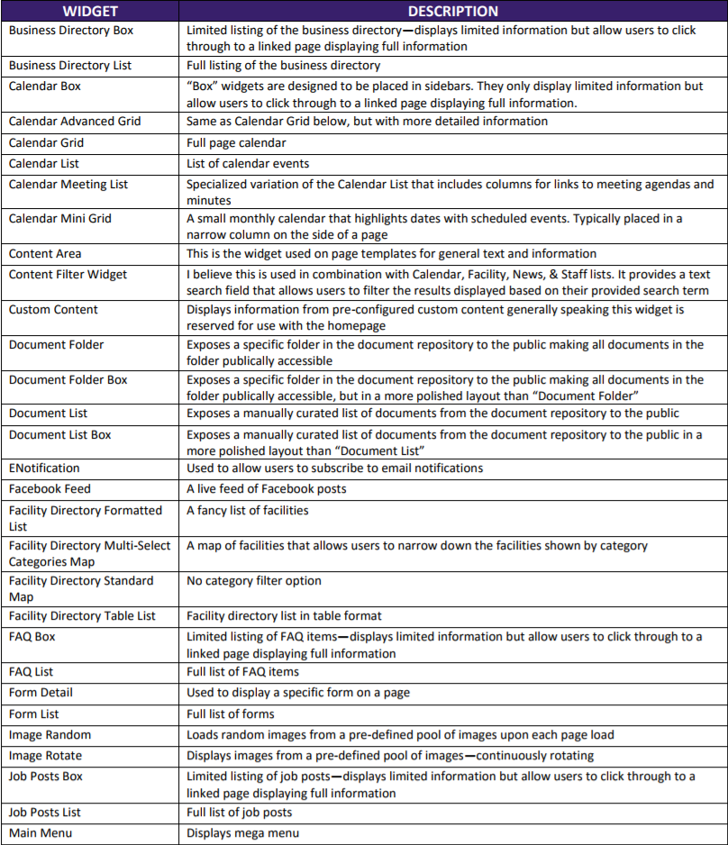
Proposed Sitemap
Description of the Components

Slide 8
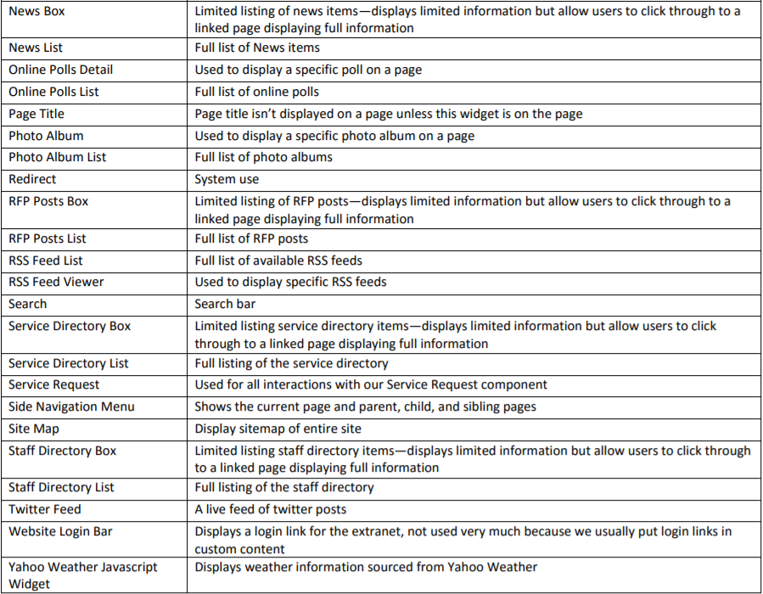
Proposed Sitemap
Description of the Components
Additional Information and Best Practices
Maintain all formatting, including the color and indentation—that way our team can distinguish each page/page level. This can be done with format painter in Excel.
Keep the content migration sitemap in the original template format. If needed, add more columns to the right for comments but do not alter the Excel sheet structure/formatting or delete any rows already created.
Please make all migration instruction notes in column F.

Slide 9
Content Migration Template
The Content Migration Template is a handy guide for rewriting your website content. Even if it will be your staff performing the actual migration, the Content Migration Template affords your team the ability to write the new content in advance of having the actual website ready. This section will walk through the Content Migration Template step-by-step for each of the respective sections.
Current URL Address
Include the source URL for the page being migrated so that the migrator or staff member can refer to it during migration.
Current URL Address
The page title/navigation on the current site
Map ID# from Proposed Sitemap
Row/Map # from the ID # column so that the migrator can confirm that the page being migrated matches what’s indicated on the sitemap.
Navigation Name (from Proposed Sitemap)
Fill this section out if the page will have a new title on the new site.
Department
Specify the Department/Content Group that this page will belong to.
Subject Matter Expert
Staff Member who currently manages the page and/or will be managing it on the new site.
Submitted by
Staff that rewrote the content
Page Content
The rewritten page content will be placed here. For documents and images used in the page body, use tags such as [documentname.pdf] to denote where the link should be placed. Likewise, use a tag like [imagename.png] to indicate where an image should be placed.
Attachment(s) & Image(s)
Any documents and images to be used. Include the filenames so that the migrator is able to verify that the correct ones are being used.
Update Frequency
The period which the Subject Matter Expert/Author will review the page and if it needs to be updated.

Slide 10
Setting Up the Box Folder
Once the Content Migration materials have been prepared (Proposed Sitemap, Department Access Matrix & User Permissions, and the Content Migration Templates), the final step is to add the Content Migration Templates, images, and documents to the Box folder provided by your Project Manager earlier in the project process.
Folder Structure
The Box folder should be organized so that each page is contained within its own folder, with the subpages being relegated to subfolders within their respective parent pages. Additionally, each folder should contain the following:
Content Migration template for the page
Folder for Images linked on the page
Folder for documents linked on the page
Here is a quick visual representation of how the folders should be set up:
Level 1 Page Folder
Level 2 Page 1 Folder
Level 3 Page 1 Folder
Images Folder
Documents/Attachments Folder
Content Migration Template.doc
Level 2 Page 2 Folder
Images folder
Documents/Attachments folder
Content Migration Template.doc
Images and documents will be sorted by Content Group for the Image Library and Document Central, but if your organization wants a specific folder structure, please provide it to your Project Manager.

Slide 11
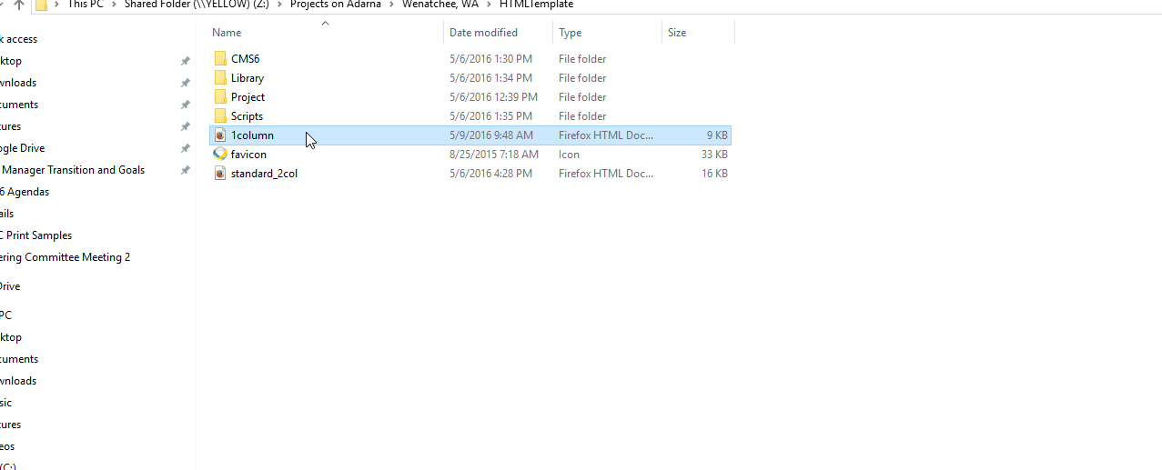
3rd Party Integrations
Most likely your team will have certain applications or tools that cannot be replicated using the visionCMS functionality without additional customization. In these instances, the 3rd party integrations will need to be reviewed on a case-by-case basis with your Project Manager. There are two primary methods of integrating these 3rd party applications on the new site: iFrame and HTML Templates.
iFrame
An iFrame allows you to place external content within a given space, allowing the framed content to appear seamlessly integrated within the page. iFrames are added using the HTML editor and inserting the iFrame tag into the desired position.
Keep in mind that the framed content needs to fit within dimensions of the content area, otherwise website viewers will have to use scroll bars to adjust the frame view to see all of the framed content.
Lastly, any content that is iFramed should come from an SSL-protected URL. If using https instead of http in the URL results in the content not appearing, then it will have issues displaying on your site if it utilizes https.
HTML Template
In cases where an iFrame is not sufficient for displaying the content either due to SSL issues or the content not framing correctly, an HTML template is a suitable replacement. Pages utilizing an HTML template exist within your internal network on a subdomain, but will feature the same appearance and layout as the main website.
Once development for your site has been completed, ask the Project Manager to provide the HTML templates. The HTML templates can be utilized like so:
Open the template for the site/page style you are trying to use:

Slide 12
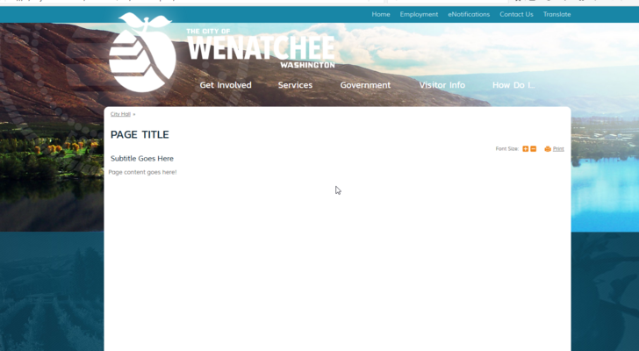
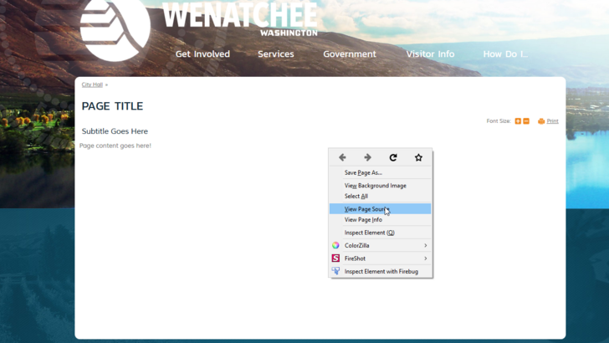
3rd Party Integrations
HTML Template - Continued
The file should open in a browser:
Right-click to view the page source:

Slide 13
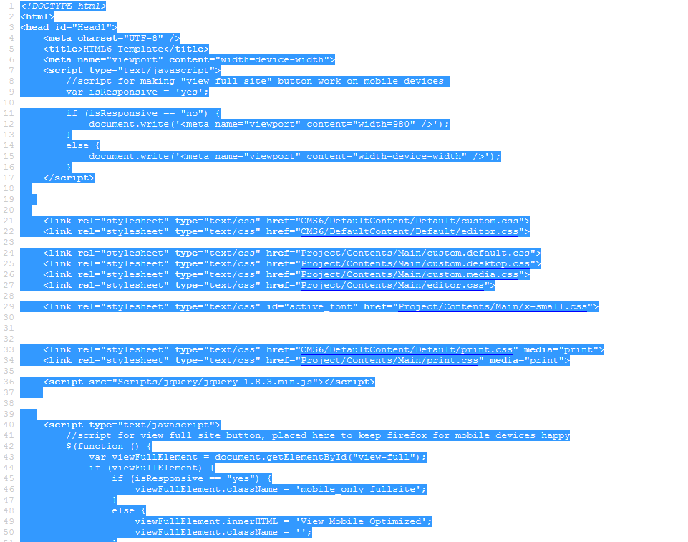
3rd Party Integrations
HTML Template - Continued
Copy the code and use it for creating any new pages or paste it into any 3rd party applications using the page template:

