Slide 1
Content Strategy Overview
May 16, 2016

Slide 2
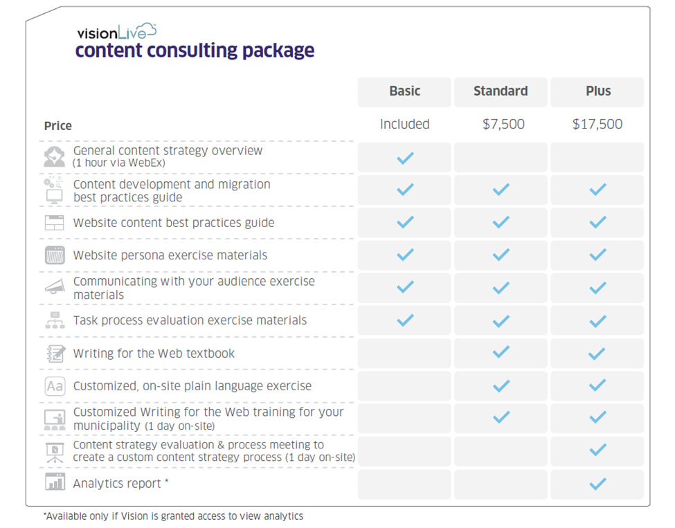
Content Consultation Offerings

Slide 3
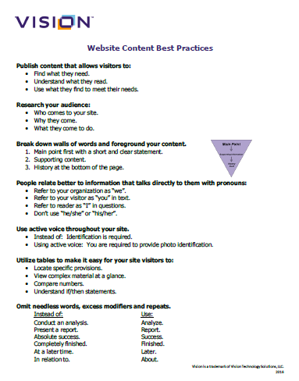
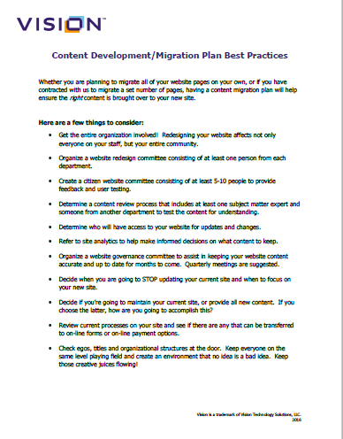
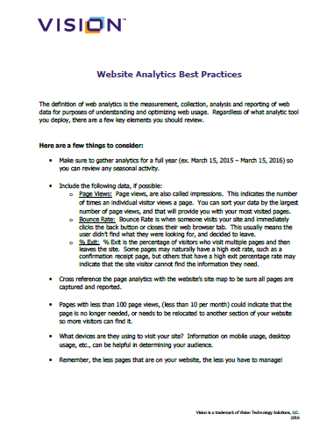
Basic Content Strategy
Included with every website implementation we offer.
One-hour WebEx to provide information and materials in a train-the-trainer setting on how to conduct three citizen-focused exercises for their staff.
Provides best-practice handouts.
Does NOT include any plain-language training.
Completed clients: Blowing Rock, NC, Bloomington, IL, Willamsburg, VA

Slide 4
Standard Content Strategy
Clients who already have an idea of how to approach their content and have a process in place for editing content for this website project.
One day of on-site content writing and customer-focused exercises. (Up to two, 4-hour sessions)
Website redesign goals, demographics and examples of content from their current website are gathered and inserted into custom presentation.
Ideal for redesign clients who are current Vision clients, and small to mid-size communities.
Completed clients: Vacaville, CA

Slide 5
Premium Content Strategy
Clients who have no idea how to approach their content and what needs to be addressed when creating a process to edit their current content before migration.
One-year of analytics review provided to client. (see examples)
Two days of on-site consultation. (Separate visits)
First day consists of:
Review of analytics.
Review/creation of client goals and expectations.
Overview of current content development process, providing feedback and recommendations.
Creation of editing process based on internal staff, political climate, etc. (see examples)
Discussion on website governance.
Identifying trainees for 2nd visit.
Timeframes established and 2nd visit scheduled.

Slide 6
Premium Content Strategy cont.
Second day consists of:
Training content authors and staff on plain-language training and the importance of writing customer-focused content. (Standard Content Strategy)

Slide 7
Analytics Examples
Added departments from their current departments navigation
Washington County, AR
Included a list of components so they can start thinking of new functionality.
Added a list of actions of what to do with the content.

Slide 8
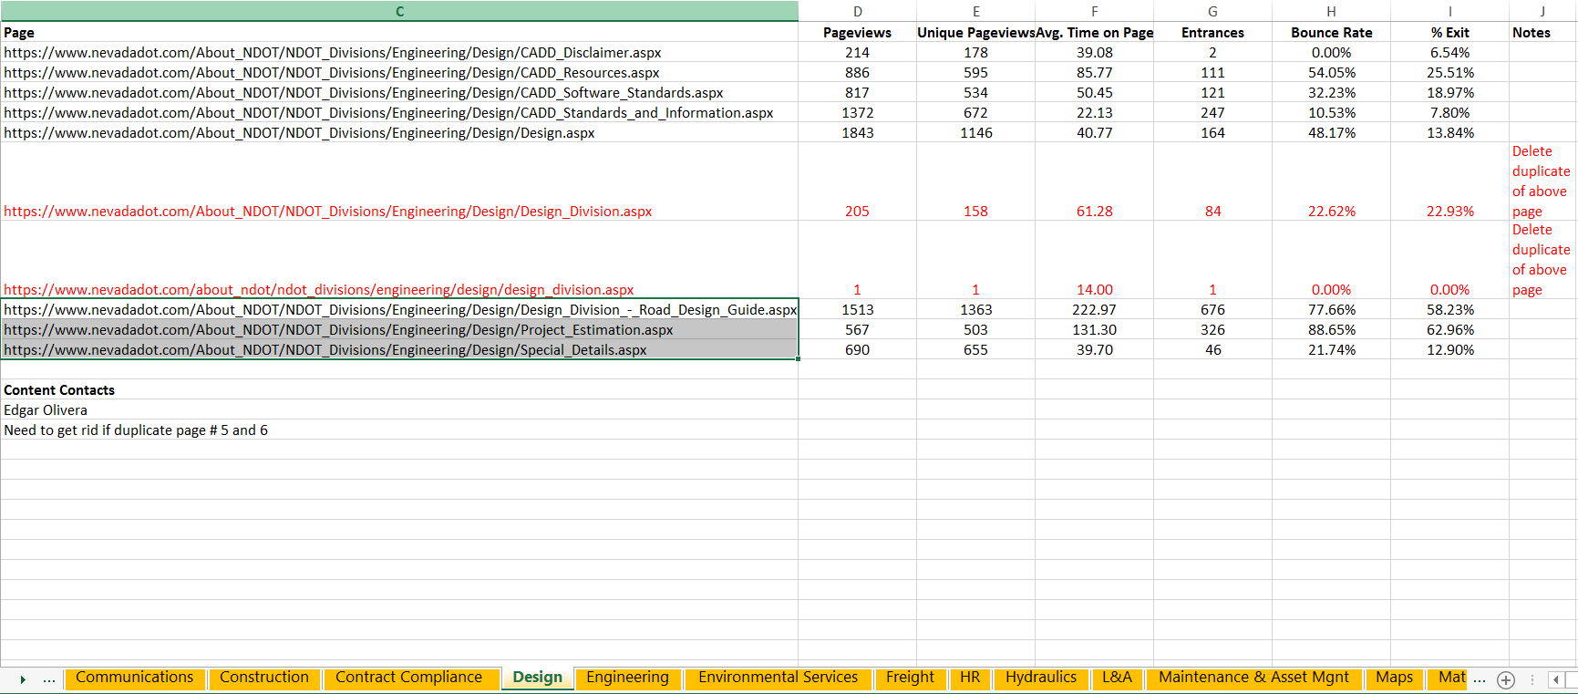
Analytics Examples
Nevada DOT
All departments were added as “tabs” at the bottom to better determine the # of pages they need to edit.

Slide 9
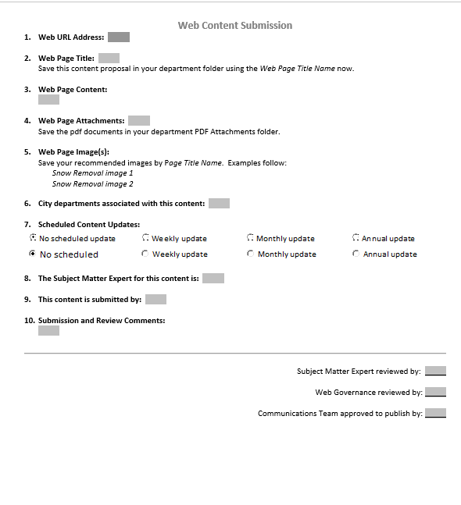
Content Editing Process Examples

Slide 10
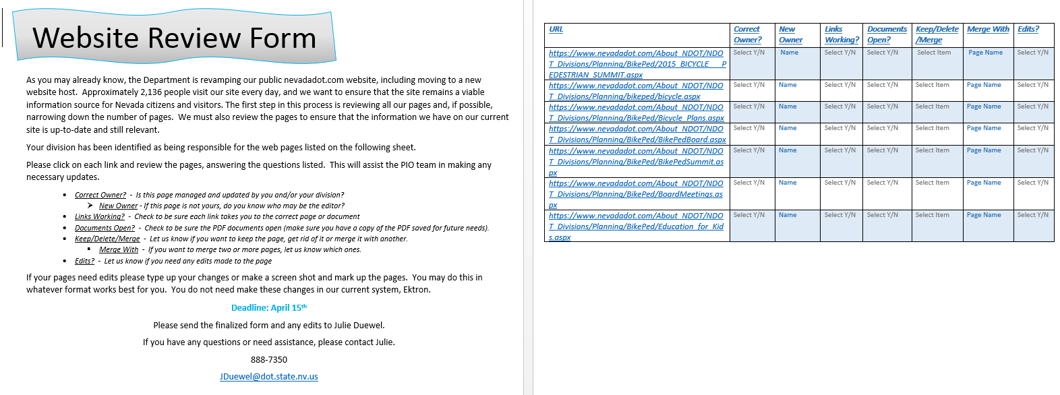
Content Editing Process Examples

Slide 11
Benefits to Cities
Help support the efforts of moving the website from IT to Communications. (All levels)
Trains content “writers” on how to write content for their customer. (Standard and Premium)
Provides the ability for all staff to become included in the project. (Standard and Premium)
Provides direction on how best to run a city-wide project and get buy-in from all levels. (Premium)
Uses data-driven decisions to help shape what should be on their website. (Premium)
Introduces the idea of Website Governance and provides examples of how others handle this. (Premium)

Slide 12
Benefits to Counties
Help support the efforts of moving the website from IT to Communications. (All levels)
Trains content “writers” on how to write content for their customer. (Standard and Premium)
Provides the ability for all staff to become included in the project. (Standard and Premium)
Help support the idea of unifying the branding and messaging for all elected officials. (Premium)
Provides direction on how best to run a county-wide project and get buy-in from all levels. (Premium)
Uses data-driven decision to help shape what should be on their website. (Premium)
Introduces the idea of Website Governance and provides examples of how others handle this. (Premium)

