Slide 1
Accessibility Lunch-n-Learn November 20, 2015

Slide 2
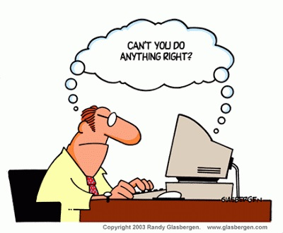
Who’s Responsible for Accessibility?

Slide 3
What is Accessibility?
Accessibility is:
good design
simplicity
empathy for others
usability
the law
a headache

Slide 4
“Removing barriers that prevent the interaction with or access to websites by people with disabilities”
What is Web Accessibility?

Slide 5
How Many Americans Have Disabilities?
6%
14%
22%
34%

Slide 6
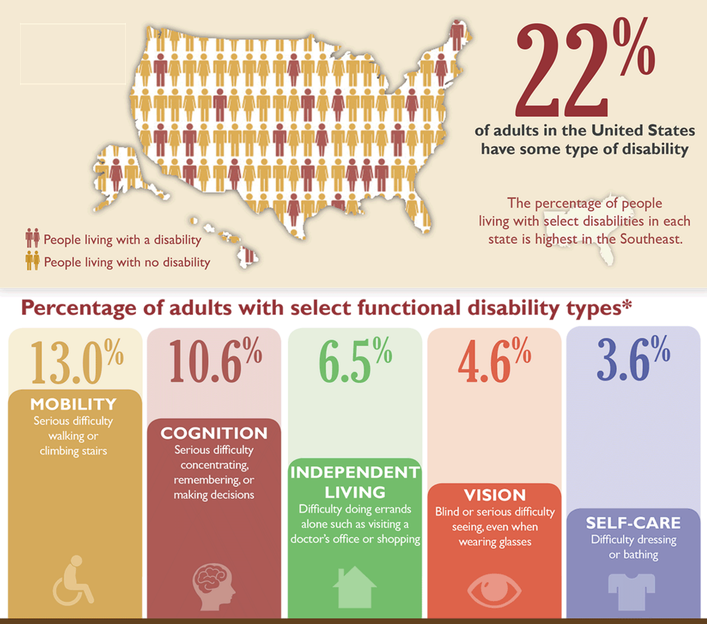
Americans with Disabilities

Slide 7
Recognized Disabilities Include:
Visual (blindness, low vision and color blindness)
Motor and Mobility (can’t use a mouse)
Auditory (hearing)
Seizures (1 in 26 have epilepsy)
Cognitive and Intellectual

Slide 8
Let’s Start with Some Basic Definitions
Term | Description
ADA | Americans with Disabilities Act requires that State and local governments provide qualified individuals with disabilities equal access to their programs, services, or activities (whether or not they receive Federal funds)
DoJ | Department of Justice
Section 504 | Is a part of the Rehabilitation Act of 1973 that prohibits discrimination based upon disability and applies to any organization that receives Federal assistance
Section 508 | An amendment to the Rehabilitation Act of 1973 that requires websites of Federal agencies to make electronic and information technology accessible to all users
WCAG | “W-CAG” – Web Content Accessibility Guidelines developed by W3C
WCAG 2.0 | Version 2.0 of WCAG guidelines adopted in 2008
W3C | World Wide Web Consortium

Slide 9
Web Accessibility Standards Timeline
Rehabilitation Act of 1973
Section 504
(1973)
Internet Takes Off
(1995-96)
Section 508
Amendment
(1999)
New 508
Refresh
(2015)
Americans with Disabilities Act
(1990)
WCAG 1.0
(2000)
WCAG 2.0
(2008)

Slide 10
Subpart E - Communications
ADA – Americans with Disabilities Act
A public entity shall take appropriate steps to ensure that communications with applicants, participants, and members of the public with disabilities are as effective as communications with others.
Who does the law affect?
Americans with disabilities and their friends, families, and caregivers
Private employers with 15 or more employees
Businesses operating for the benefit of the public
All state and local government agencies
The ADA encourages self-regulation of accessibility standards and the Department of Justice is currently developing regulations to provide specific guidance to the entities covered by the ADA. Organizations are encouraged to use the WCAG 2.0 level AA guidelines as a guide.

Slide 11
Section 508 of Rehabilitation Act of 1973
In 1998, U.S. Congress amended the Rehabilitation Act of 1973 to require Federal Agencies to make their electronic and information technology accessible to all users, including people with disabilities.
Section 508 has been adopted as the accessibility standard for many local governments.
Section 508 is Product-Based:
Software applications and operating systems
Web-based intranet and internet information and applications
Telecommunications products
Video and multimedia products
Self-contained, closed products
Desktop and portable computers

Slide 12
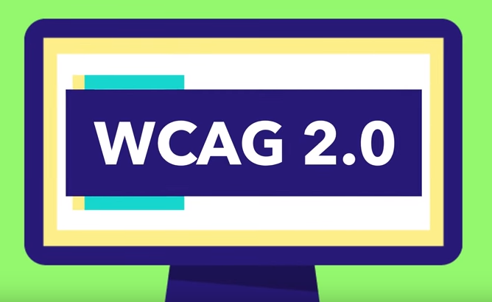
WCAG 2.0
First published in 2008 and became an ISO standard in 2012
Followed WCAG 1.0 which was issued in 2000
Functionally-based instead of product-based
Applies different types of web technologies as well as future technologies

Slide 13
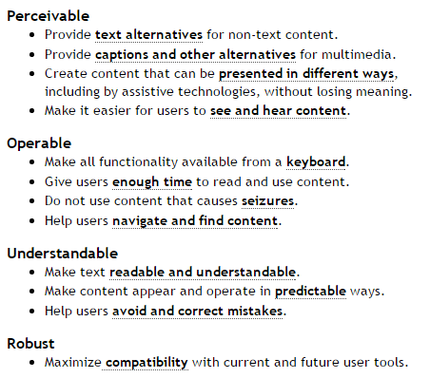
WCAG Acronym = P.O.U.R.
12 WCAG 2.0 guidelines
Measured on three levels – A, AA and AAA
Each level of compliance requires a stricter set of conformance guidelines.

Slide 14
An Introduction to Accessibility
From Citizens Online

Slide 15
15 Tips from Video Overview
Make accessibility part of the contract
Use themes and plugins deemed ‘accessible’
Allow users to customize their experience of pages, and use responsive layouts
Always let users know where they are and how they get to somewhere else
Make sure that every action can be completed using the keyboard alone
Give the user control over moving content
Provide captions and transcripts for audio and visual content
Add ‘Alternative Text’ to images
Make your text easy to understand
Organize your text and add ‘mark up’ to make structure and features perceivable
Make links stand out clearly from surrounding text
Test text and background color combinations
Let visitors extend their sessions if they wish
Provide an accessibility statement
Use alternatives to CAPTCHA

Slide 16
Proposed Section 508 Refresh
Section 508 Refresh
In February 2015, the United States Access Board issued their proposal to update the existing Electronic and Information Technology Accessibility Standards, combining Section 255 of the Telecommunications Act of 1934 and Section 508 of the Rehabilitation Act of 1973.
Bottom Line
Section 508 will incorporate WCAG 2.0 Guidelines
Applicable to web content and non-Web electronic documents and software
Reflects newer multifunction technologies (smart phones, cameras, etc.)
Not Final Yet
Public hearings and comments are still being held, and the final rules will take effect 6 months after they are published, likely sometime in late 2016.

Slide 17
Let’s Get This Straight
Current Section 508
Section 508 Refresh
WCAG 2.0

Slide 18
Testing Challenges for Accessibility
Lots of guidelines – in total, WCAG 2.0 consists of 4 basic principles, 12 guidelines and over 60 success criteria
Multiple systems – testing should occur across all operating systems, browser types and versions
Automated testing – While cheap and fast, however, it is effective only at validating a certain sub-set of accessible requirements and can not provide a comprehensive validation of accessibility
Live testing – automated testing is not enough and testing by “real” people with disabilities should be part of any testing program
Diverse elements – including HTML, CSS, client-side, server-side, scripting and flash, and not all testing can be carried out by a single tester or tool
Ambiguous guidelines – there is room for interpretation making it difficult whether a specific guideline is met or not
Content updates – whenever content is added or edited, the website could be out of compliance

Slide 19
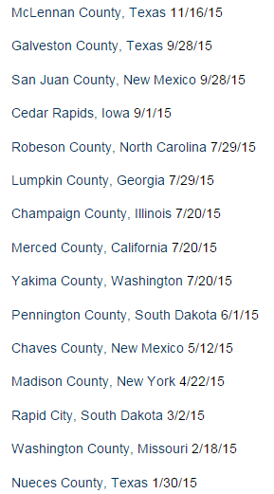
The ADA Project Civic Access has reached settlement agreements with 219 localities since 1999 – including 15 in 2015 (vs. 0 in 2014)
The DoJ is Serious About Accessibility
http://www.ada.gov/civicac.htm#chron-list

Slide 20
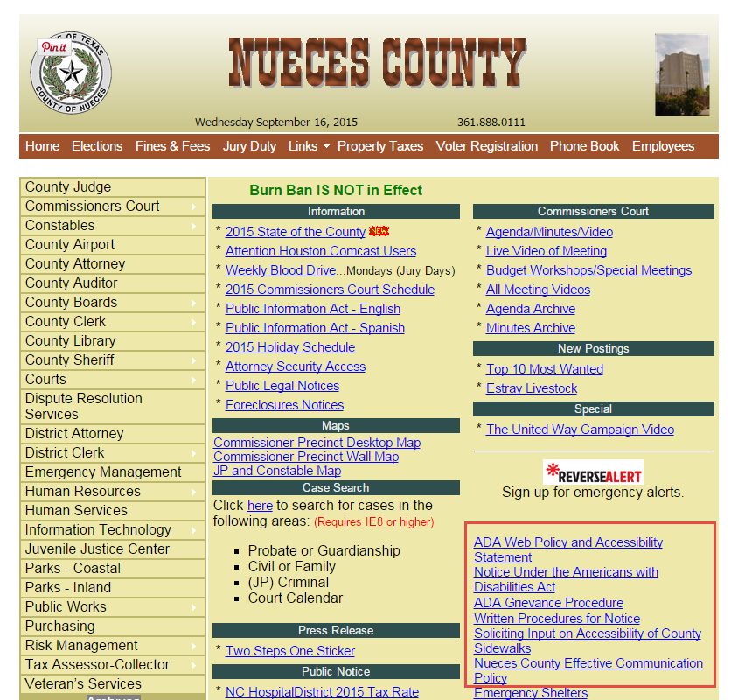
ADA Compliance for Nueces County, Texas
In 2012, Nueces County was selected for inspection through Project Civic Access.
Their final DoJ settlement was signed in January 2015 and cited hundreds of accessibility items that need to be corrected, including making their website compliant with WCAG 2.0.

Slide 21
Nueces County Settlement Agreement
Website accessibility coordinator – need to hire experienced coordinator
Accessibility policy – adopt, post and share an accessibility policy annually
Website accessibility notices – need notices to instruct visitors on how to request accessible information and how to provide feedback on improving website accessibility
Accessibility training – train web content personnel on how to author accessible information
Accessibility provisions in performance evaluations – add provisions that ensure accessibility of website and content into performance evaluations of anyone who creates content for the website
Accessibility testing – perform accessibility testing with automated tools and with individuals who have different disabilities (blind, deaf and inability to use mouse at a minimum)
WCAG 2.0 compliance – ensure that all websites, web content and online services are WCAG 2.0 AA compliant, or will be compliant within the next year or two

Slide 22
Our Project with Nueces County
Deal - Signed in May 2015 – kickoff is early December
$57,890 for website redesign
$27,868 for ADA compliance
Sherry Eshrati is the project manager
CMS Product Review - Nueces had a consultant look at our weknowgov.com demo site and we meet most of WCAG 2.0 already
Recommendations - Consultant made recommendations and identified some modifications we need to meet WCAG 2.0 compliance include:
HTML formatting
Calendar grid view
Forms and surveys
CMS Product Requirements - Product requirements have been developed, and updates will be made in the December and January sprints
Design Review - Adriane will review the Nueces design when it is complete to identify any potential accessible issues

Slide 23
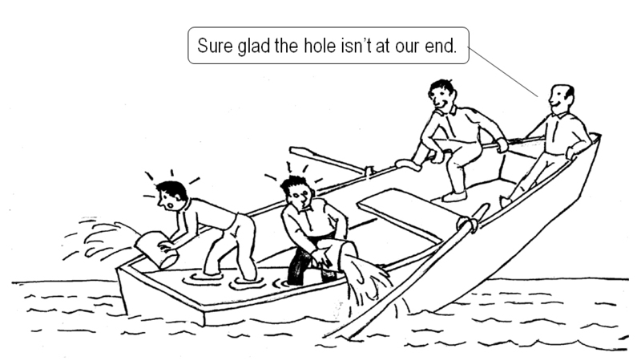
Who’s Responsible for Accessibility?

Slide 24
Who’s Responsible for Accessibility?
Our Customers | Vision
Administrators | All of us
Elected Officials
Webmaster
Content creators
Content reviewers
Trainers
Human Resources
Legal

Slide 25
How Do We Test for Accessibility Today
visionCMS
All of our sites are Section 508 compliant on the frontend
We are making updates to CMS to become WCAG 2.0 compliant
Automated software
Use SortSite testing tool software to scan website before launch; any issues are fixed
Training
Part of accessibility is creating accessible content
PMs and Joe touch briefly on tables and alt tags in training
Checklist
Liam has started a quality control Section 508 compliance checklist
Screen reader emulator
We have a screen reader emulator, but do not use it on a regular basis
Live accessibility testing
We did live accessibility testing on one project

Slide 26
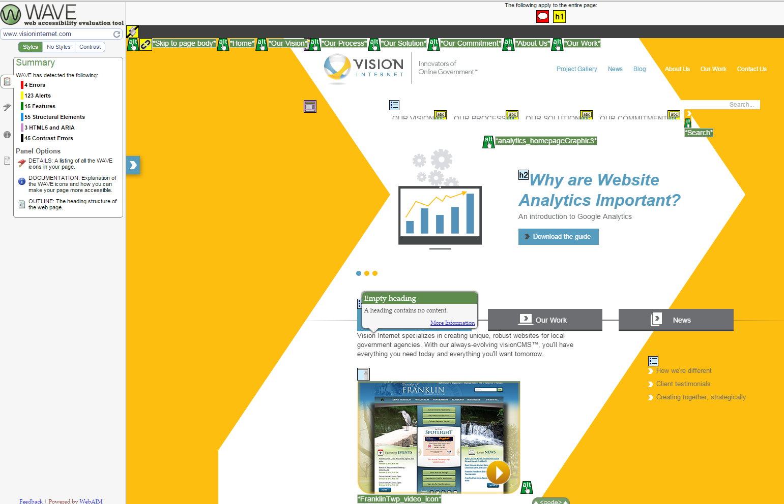
Run an Accessibility Evaluation Tool
http://wave.webaim.org/ - or download Chrome extension

Slide 27
Pretend You Can’t Use a Mouse
Let’s look at a couple of websites:
Monterey County
Santa Clara
North Port

Slide 28
JAWS is leading screen reader software Let’s see how it works…
How Does Screen Reader Work?

Slide 29
What Do We Say About Accessibility
From Vision Internet Proposal
Disability Accessibility
Although the language of the ADA does not explicitly mention website accessibility, the Department of Justice has issued guidance on the ADA as applied to the websites of public entities. We are capable of fully complying with Section 508 and WCAG 2.0.
Website
Currently, we don’t say anything about accessibility on our website

Slide 30
Resources
Vision Internet blog
Introduction to Accessibility
Why You Should Be Serious About Web Accessibility
ADA Guidelines
http://www.ada.gov/websites2.htm
Section 508
www.section508.gov
W3C Accessibility Resources
http://www.w3.org/standards/webdesign/accessibility
WCAG 2.0
www.w3.org/TR/WCAG20/
Citizens Online
www.citizensonline.org.uk
WebAIM
http://webaim.org/resources/
Cornell Accessibility Resources
http://www.it.cornell.edu/policies/accessibility/primer/wa1_intro.cfm
18F – U.S. Government Design Agency
https://pages.18f.gov/accessibility/checklist/

Slide 31
What Can I Do?
Open an accessibility dialogue
Check out accessibility resources
Try to navigate a website without a mouse
Analyze a website with accessibility tool
Share your knowledge with others

Slide 32
Final Quiz – Accessibility Takeaways
What does WCAG stand for?
Web Content Accessibility Guidelines
What accessibility guidelines are most important?
WCAG 2.0 (and Section 508)
What acronym can help you remember the WCAG 2.0 Guidelines?
P.O.U.R. (perceivable, operable, understandable and robust)
Who is responsible for accessibility?
Everyone

