Slide 1
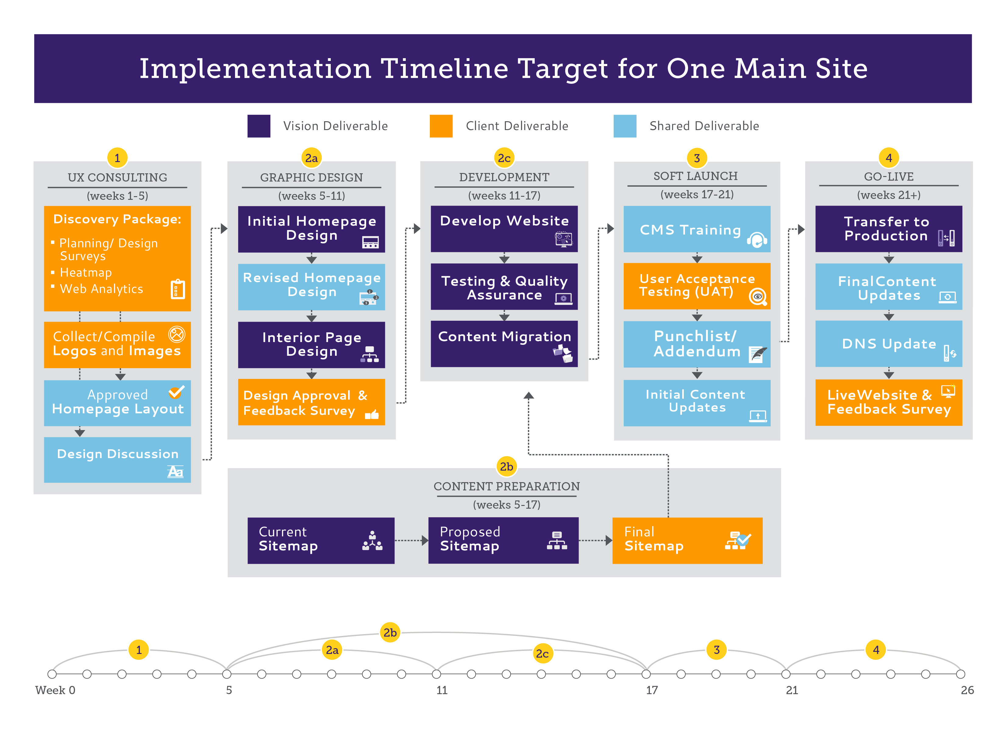
3. Implementation Timeline

