Slide 1
Website Usability

Slide 2
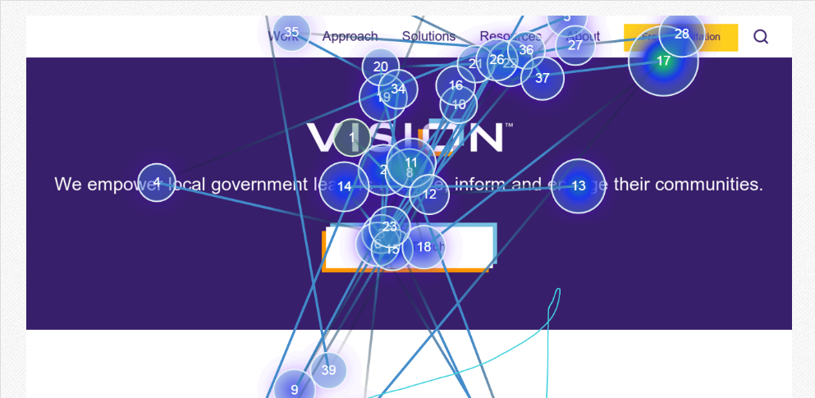
What is website usability?
It is the measure of the quality of a customer’s experience when they interact with a website.
Notes:
Refers to how well users can learn and use a product to achieve their goals
Refers to how satisfied users are with that process

Slide 3
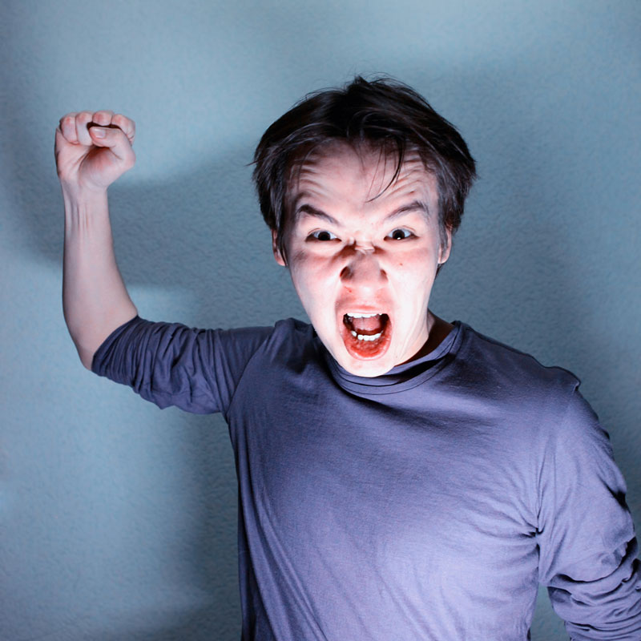
Why is it important?
Prevents wasted time and frustration that lead to loss of visitors and trust
Notes:
Users cannot find what they are looking for 60% of the time

Slide 4
Usability is a combination of factors:
Usability is a Combination of Factors
Intuitive Design
Ease of Learning
Efficiency of use
Memorability
Error Frequency & Severity
Subjective Satisfaction
Notes:
Combination of factors
Intuitive Design: A nearly effortless understanding of the architecture and navigation of the site
Ease of Learning: How fast a user who has never seen the user interface can accomplish basic tasks
Efficiency of Use: How fast an experienced user can accomplish tasks
Memorability: After visiting the site, if a user remember enough to use it effectively in future visits
Error Frequency and Severity: How often users make errors while using the system, how serious these errors are and how users recover from the errors
Subjective Satisfaction: If the user likes using the system

Slide 5
Hick’s Law
William Edmund Hick describes the time it takes for a person to make decisions as a result of the possible choices he or she has:
RT = a + b log2 (n)
Notes:
RT = Reaction time
a & b = Constants which depend on task and subject conditions
Log2(n) = linear function of the logarithm (base 2) of the number of options the person has to choose between (basically, it doubles)

Slide 6
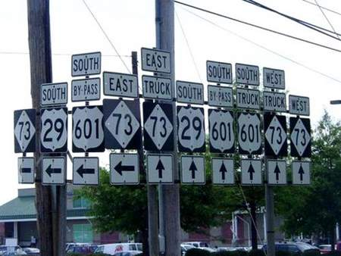
Hick’s Law
Reaction time increases as the number of choices increase
Notes:
RT = Reaction time
a & b = Constants which depend on task and subject conditions
Log2(n) = linear function of the logarithm (base 2) of the number of options the person has to choose between (basically, it doubles)

Slide 7
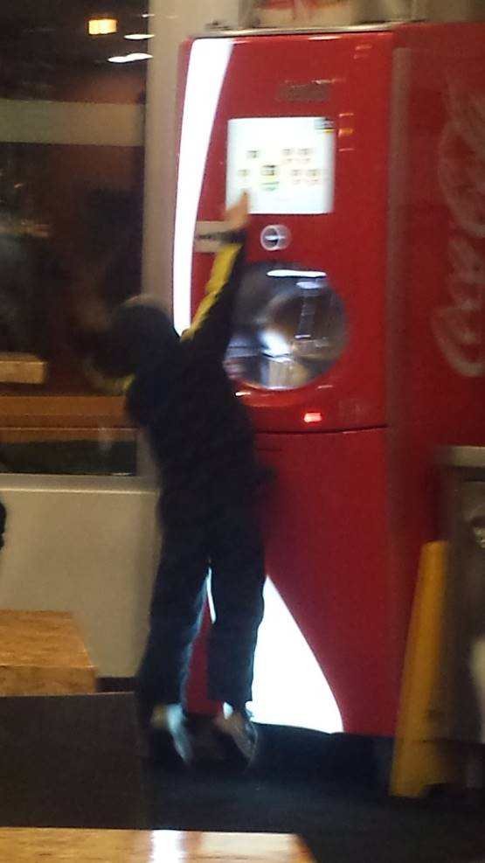
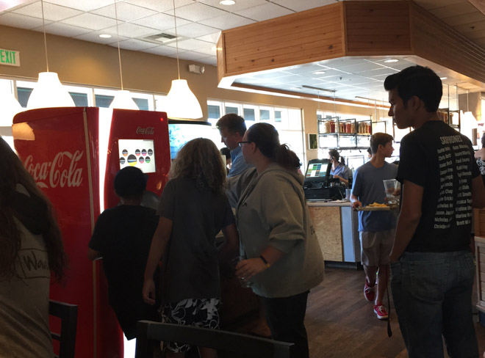
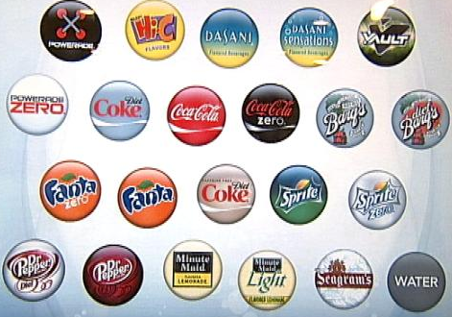
Hick’s Law
“Featuritis” can be an exhausting disease for users!
Hoa Loranger, NN/g – 11/2015
Notes:
A sophisticated soda machine that features over 100 drink flavors, the idea sounds really cool but in reality, filling up a cup of soda with a simple machine is a task that takes about 10 seconds, with these fancy soda dispensers this task has increased to over a minute.

Slide 8
Fitts’ Law
In 1954 Paul Fitts, psychologist, published an article that detailed his theory on human mechanics.
T = a + b log2 (2*D/W)
Notes:
- This theory stated that the size of the target object along with its distance from the starting location could be measured, allowing him to model the ease at which a person could perform the same action with a different target object.
This theory did not application for computers in 1954
T = time
a + b = constants
log2 = increments by two
2 * Distance (measurement from starting point to end point [target object]) / Width (width of the target object)
The easy explanation:

Slide 9
Fitts’ Law
The farther a user has to move the cursor, the more effort it will take
The smaller the object is, the harder it will be to click on it
Usability = ☹
Usability = ☺
Send
Send
Notes:
Bigger is not necessarily better all the time, fitts’ law is non-linear, fitt’s law runs along a curve, it is a binary logarithm

Slide 10
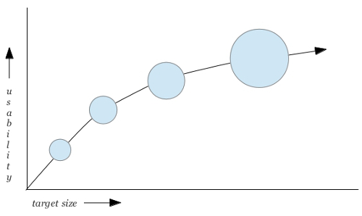
Fitts’ Law
Size and Usability are measured in a non-linear fashion
Notes:
if you make a small button 10% larger, it will become much more clickable, but if you make an already very large button 10% larger, you will not gain much more in terms of its usability.

Slide 11
Hick’s + Fitts’ applied to your Homepage
Include a reasonable number of features
Associate related elements as much as you can
Keep the elements among reasonable distance but don’t be afraid of using white space
Go BIG on your homepage!
Notes:
Bigger is not necessarily better all the time, fitts’ law is non-linear, fitt’s law runs along a curve, it is a binary logarithm

Slide 12
Usability Facts
Users don’t read, they scan in a non-linear fashion (F Pattern)
Users like content
Users have limited patience
Users don’t make great decisions

Slide 13
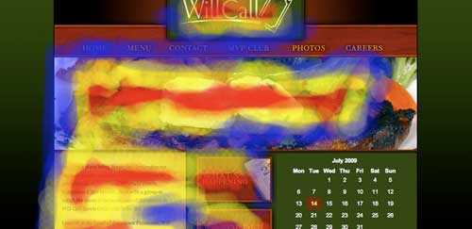
“F” Pattern
Notes:
Usability Facts
Users don’t read, they scan in a non-linear fashion (F Pattern)
Users like content: Develop rich content, link to pages, create related images but keep it concise
Users have limited patience: They will only be from a fraction of a seconds to a few seconds looking at your pages (create easy and clear paths to content)
Users don’t make great decisions: As a result of having limited patience, users will click on the first thing that remotely makes sense to them, they will satisfy but this does not mean that their actions are precise (create clear naming conventions with good size and limit elements on pages)

Slide 14
Conclusions
Don’t make me think!
Strive for simplicity
Organize, Economize and Communicate
Notes:
Plan your navigation and main features in a way that is intuitive
Organize: Clear structure
Economize: Do more with less (visual cues, less elements)
Communicate: Combination of readability, colors, contrast, texture, etc (luckily for you most of this stuff will be taken care by Vision ☺)

Slide 15
How is your website being used?
Qualitative Study
Stakeholder Planning Survey
Quantitative Study
Analytics
Heat-maps

Slide 16
Stakeholder Survey
Priorities:
Creating an Information Portal
Quality of Execution
Being better than other websites

Slide 17
Stakeholder Survey
Goals:
Highlight Excellence of municipal services
Promote Village as Premier Municipality
Portal of “All things Pinecrest”

Slide 18
Stakeholder Survey
Purpose of website visitors:
Access to Municipal Services and Information
Notes:
Stakeholder missed airport, which appears to be a top 10 task on this website

Slide 19
Stakeholder Survey
Likes:
Appearance…but needs updating

Slide 20
Stakeholder Survey
Dislikes:
Outdated, too many clicks to reach information

Slide 21
Stakeholder Survey
What do people ask on the phone or via email?

Slide 22
Most requested pages
Home
Apply for a Job
Pinecrest Gardens
Building & Planning
Calendar
Contact Us
Search
Download Documents
Pinecrest Community Center
Events & Festivals
Fun for Kids & Adults
Facility Rental
Admissions
Building Division
Forms
Notes:
To measure usability on your current site Vision & the IT department analyzed two main factors:
Google Analytics – What are the most visited pages
Usability Software – How is the current homepage being used? (what is working great, what can be improved?)

Slide 23
Heat-maps
Technique to measure areas of interest
Events on the client are sent to an “In the Cloud” solution
Experiment runs for about 3-4 weeks
Data is aggregated and areas of attention are extracted as “hotspots”
A screenshot of the homepage is taken and the hotspots are overlaid on top of it

Slide 24
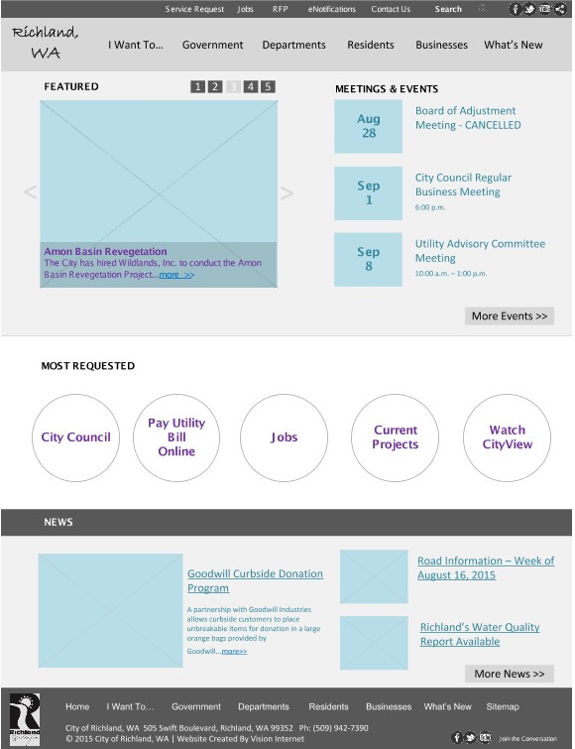
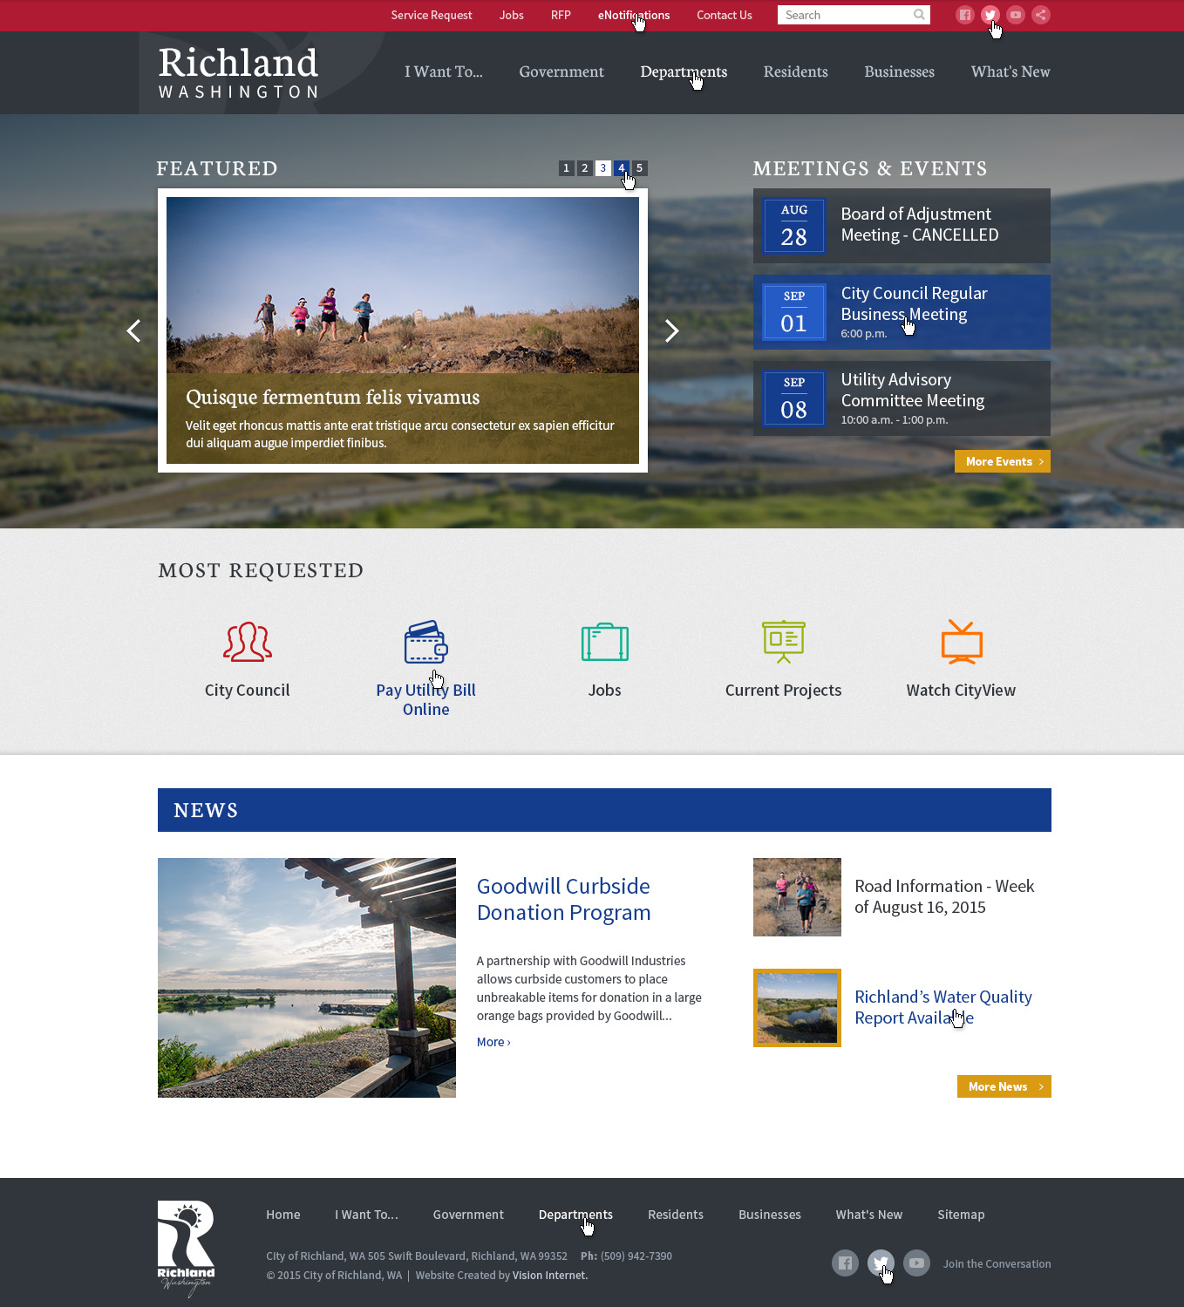
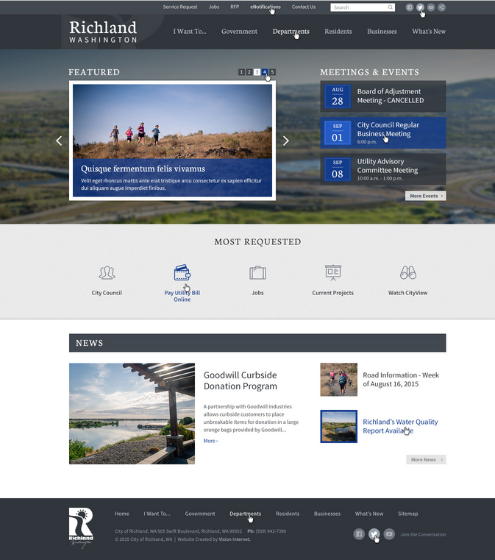
What is a wireframe?
A simple Visual Guide
Suggest Structure of a Page
It’s a Blueprint!
Design will be incorporated later
Notes:
A Web wireframe is a simple visual guide to show you what a Web page would look like
Suggest Structure of a Page without using any design
A wireframe in web design is equivalent to the a house blueprint, you want to take into consideration:
Information to be Displayed
Hierarchy (size and placement)
Basic layout
Design will be incorporated at a later stage, for now, we just need to take into consideration the overall layout and functionality

Slide 25
Activity – Create wireframes
What are your visitors looking for?
What are your goals for the new website?

