Slide 1
City of Grande Prairie Website Proposal
Adam Isern
Regional Sales Manager
913.660.0617 / 310.656.3103 fax
aisern@visioninternet.com
Vision 222 N Sepulveda Blvd, Suite 1500 El Segundo, CA 90245
www.visioninternet.com
Date: DUE DATE OF PROPOSAL

Slide 2
Dear Selection Committee Members,
Thank you for the opportunity to submit a proposal for the upgrade of the City of Grande Prairie’s website. Ashley enjoyed having the opportunity to meet with Trenton Parrott at the MISA Prairies Conference last spring. Based on their conversations and the thoroughness of your RFP, we can see creating a comprehensive website designed to enhance the communication efforts of the City is a top priority.
Why is Vision uniquely positioned to help transform Grande Prairie’s website?
Your customers will be our customers. We work hard to serve our customers, but define customers as more than the government agencies that use our software. We look to the end users, citizens who expect the best experience possible with their local government.
You will never be alone. Creating a great customer experience isn’t a set-it-and-forget-it proposition. We view our customers as long-term partners that inspire each other to grow, innovate and succeed.
Your success will be guided by our expertise. Anyone can build a website, but Vision has 20+ years of experience empowering local governments to build better digital interactions. Throughout the development and after launch, our customers have access to training, resources and educational opportunities that help them thrive.
You will make better, data-driven decisions. Experience and knowledge of best practices are important when building a digital strategy, but adding advanced UX techniques into the mix elevates your overall approach. Vision helps you make fully informed, data-driven choices when crafting a superior digital experience for your municipality.
Your toolset will constantly grow and evolve. To stay still is to fall behind. Vision always looks and pushes forward, making sure that users’ high expectations for the latest features are being met and exceeded.
We see tremendous potential for your website and would welcome the opportunity to help you achieve it. I look forward to talking with you soon about what’s next for the City of ____.
Respectfully submitted,

Slide 3
Contents
Executive Summary 5
The Vision Difference 1
A Research-Driven Approach 2
Content Strategy 2
Flexible Technology 2
Strategic Partnership 2
Community-Focused Results 1
Case Studies and Design Showcase 2
Project Plan For Grande Prairie 1
Vision’s Project Team 2
Grande Prairie’s Project Team 2
Project Process Timeline 2
Detailed Scope of Work 2
Project Estimate 2

Slide 4
Executive
Summary
Who is your audience?
Who is the audience for your website? They could be men, women, husbands, wives, fathers, mothers, or children – but they are all digital customers – bringing experience gained through their daily interactions elsewhere on the web to your site. They have little tolerance for delays, inefficiencies, or frustration and they do not want reduce what they expect from a website when they visit your city’s site. For these residents, digital residents, the website has become the primary way they access services, engage in the community and transact business with their government. The website has replaced brick-and-mortar offices and shapes the perception of governmental efficiency and effectiveness.
As these digital customers visit your site, does your website deliver the same experience – a customer experience – that will engage and delight them? How do you understand, interpret and keep pace with the ever-evolving, and heightening, expectation from this new “digital customer”?
Customer expectations have changed
In the past five years customer’s expectations in the digital world have grown dramatically. They want to find clear, understandable answers to their questions, quickly, at any time and on the device of their choice. Increasingly, that device is a mobile one, which can prove challenging when sites have thousands of pages of information, all of which someone, at some time, determined were “necessary” and relevant to the resident, but may not have edited since. Digital residents, who have come to expect an intuitive and tailored experience, now are bringing these same elevated expectations to municipal websites.
Vision can partner with you to profile who your customers are, determine what they need, and deliver it to them in a way that will leave them satisfied in their government’s efficiency, and more likely willing to further engage in the community because of the positive feeling they developed in their last interaction.

Slide 5
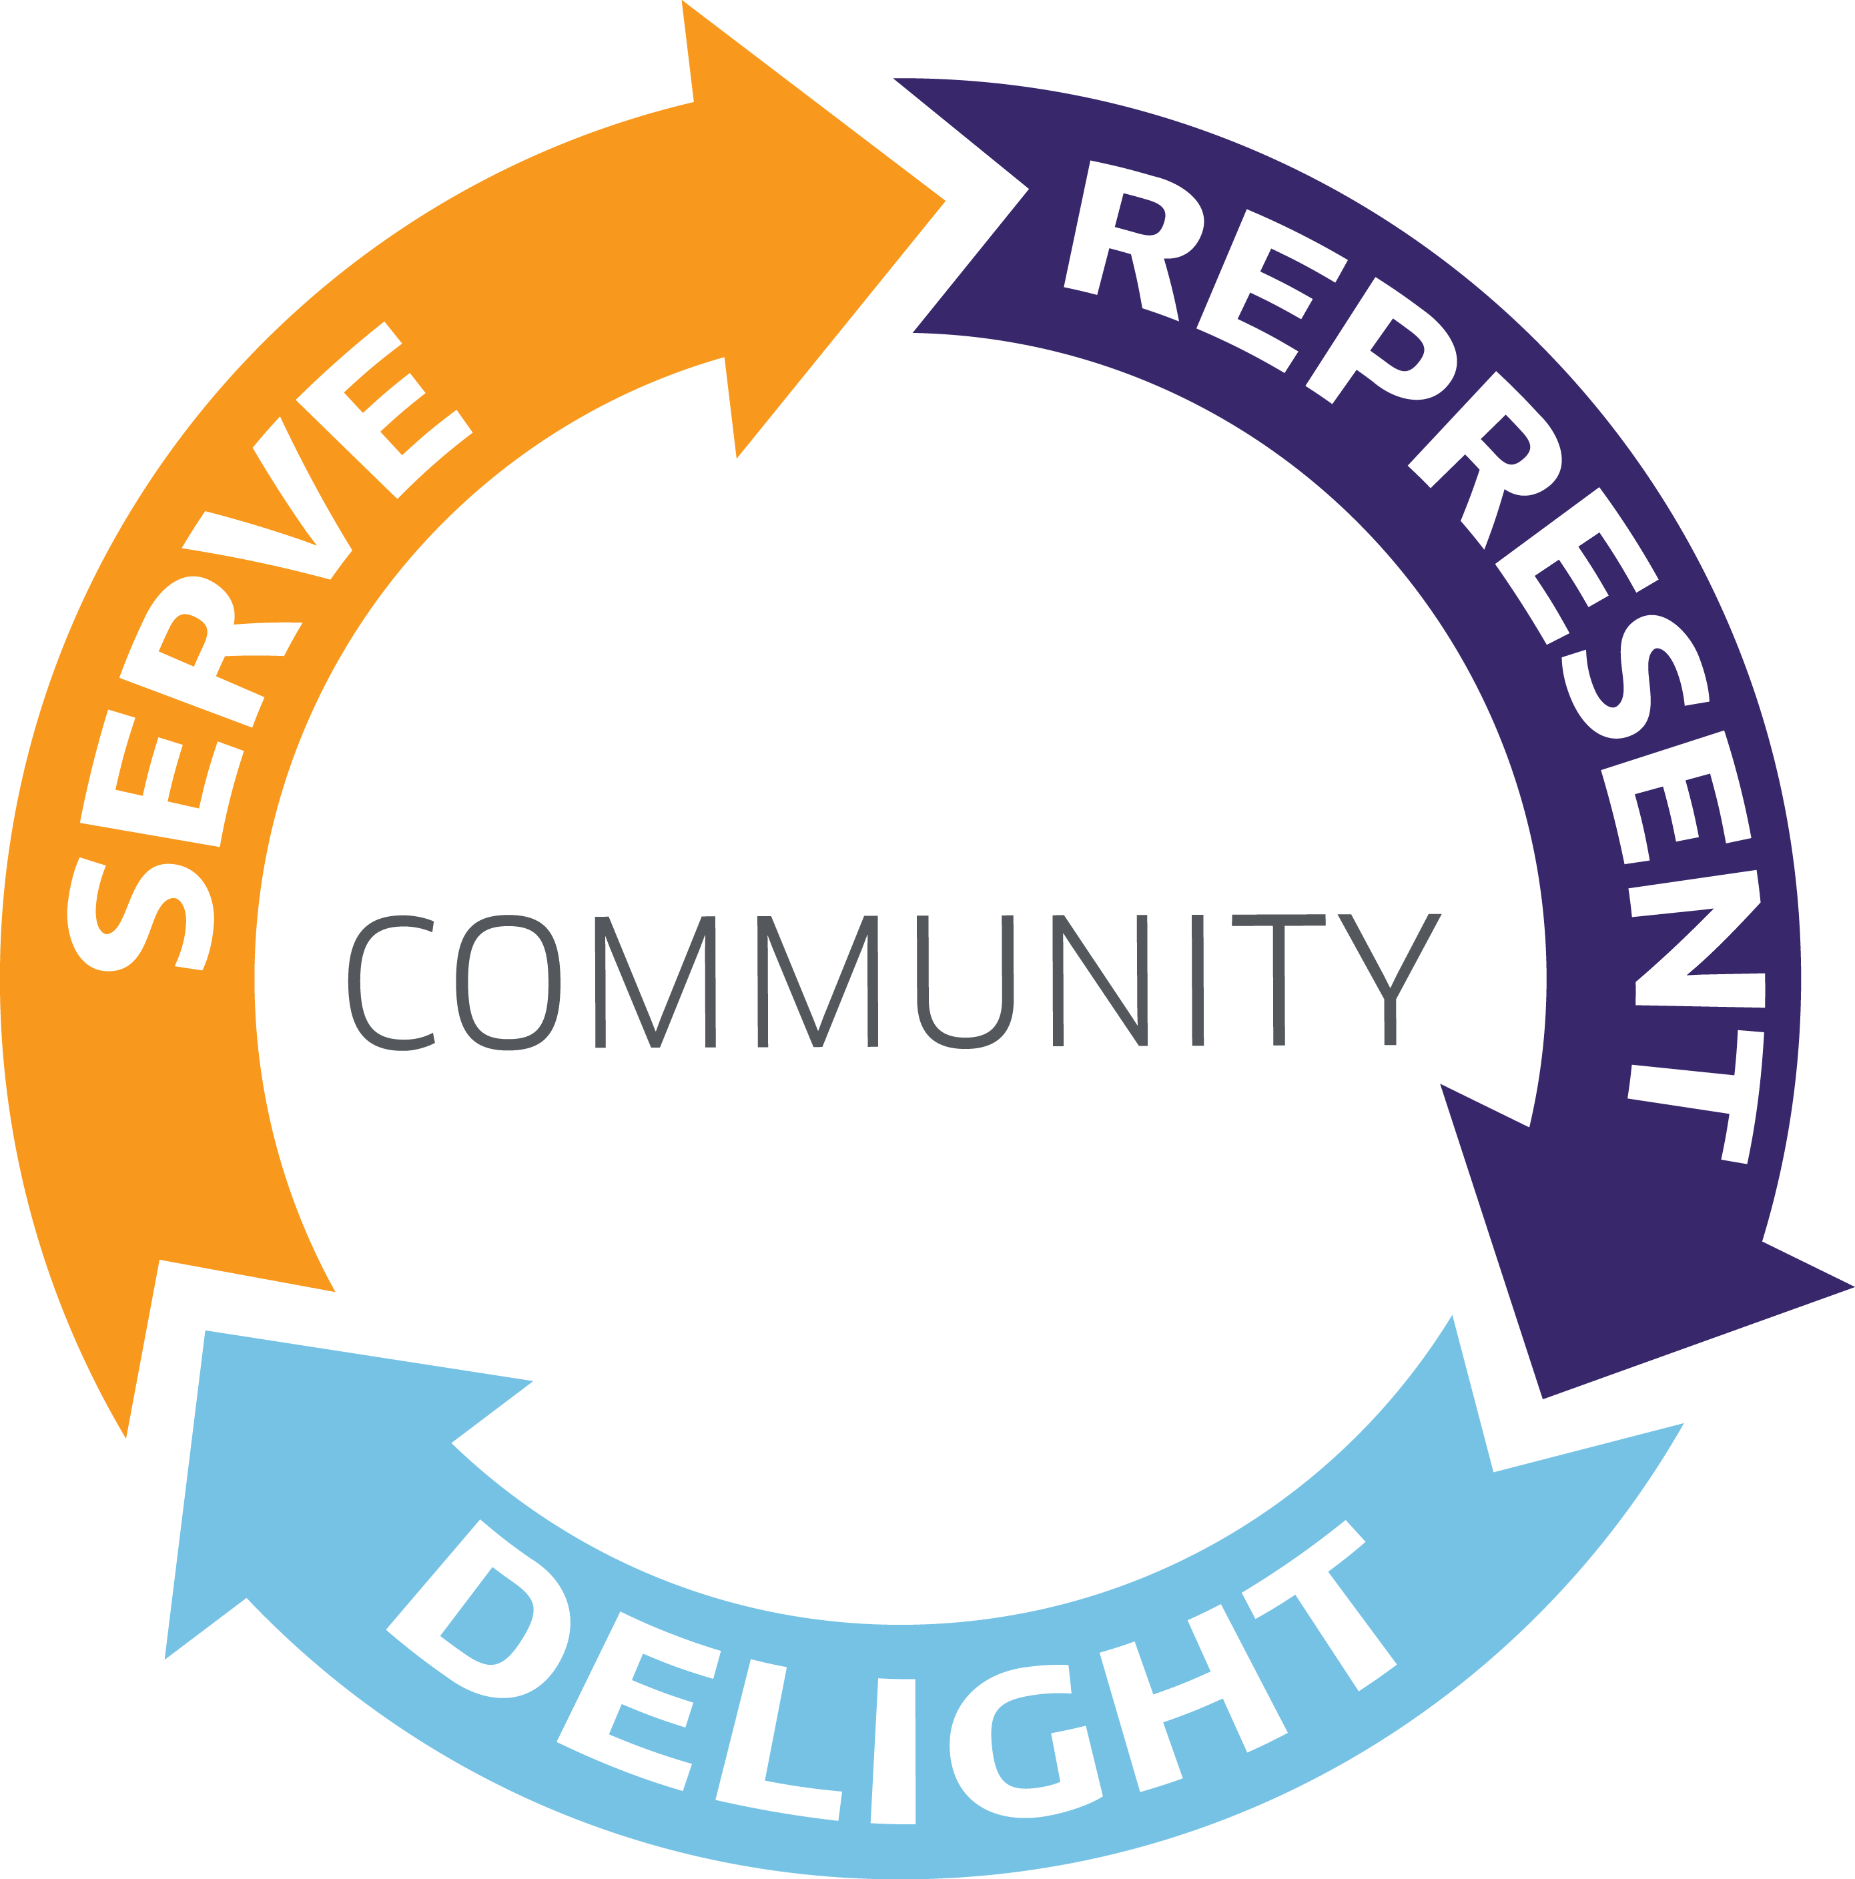
Why is customer experience important?
This view of the resident’s evolution into a “customer” is coming into sharper focus. A recent Accenture digital government study found that “improved digital services would positively change citizen attitudes toward government.” In fact, 72% of the respondents say that better digital services would also increase their willingness to engage.
For the majority of digital residents, the website profoundly shapes their perception of government; the website has become the government. More than 65% of the respondents also mentioned that the following beliefs would also be positively impacted with improved digital services:
My government is forward looking
My government is efficient and effective
I have confidence and trust in government
I am satisfied with my government
Developing a customer-focused website for your community
Vision’s approach will bring you more than just new technology. Through our service of nearly 700 of some of the most progressive municipalities across the United States, we developed and refined a comprehensive, research-based development process that focuses on understanding your community’s goals first. From the insights gained during our User Experience (UX) process, only then do we apply both our technology and expertise to tailor a solution that exceeds your community’s expectations while reflecting its personality.
We will create a website for
Sheboygan County
that will Serve, Represent & Delight
your unique community.

Slide 6
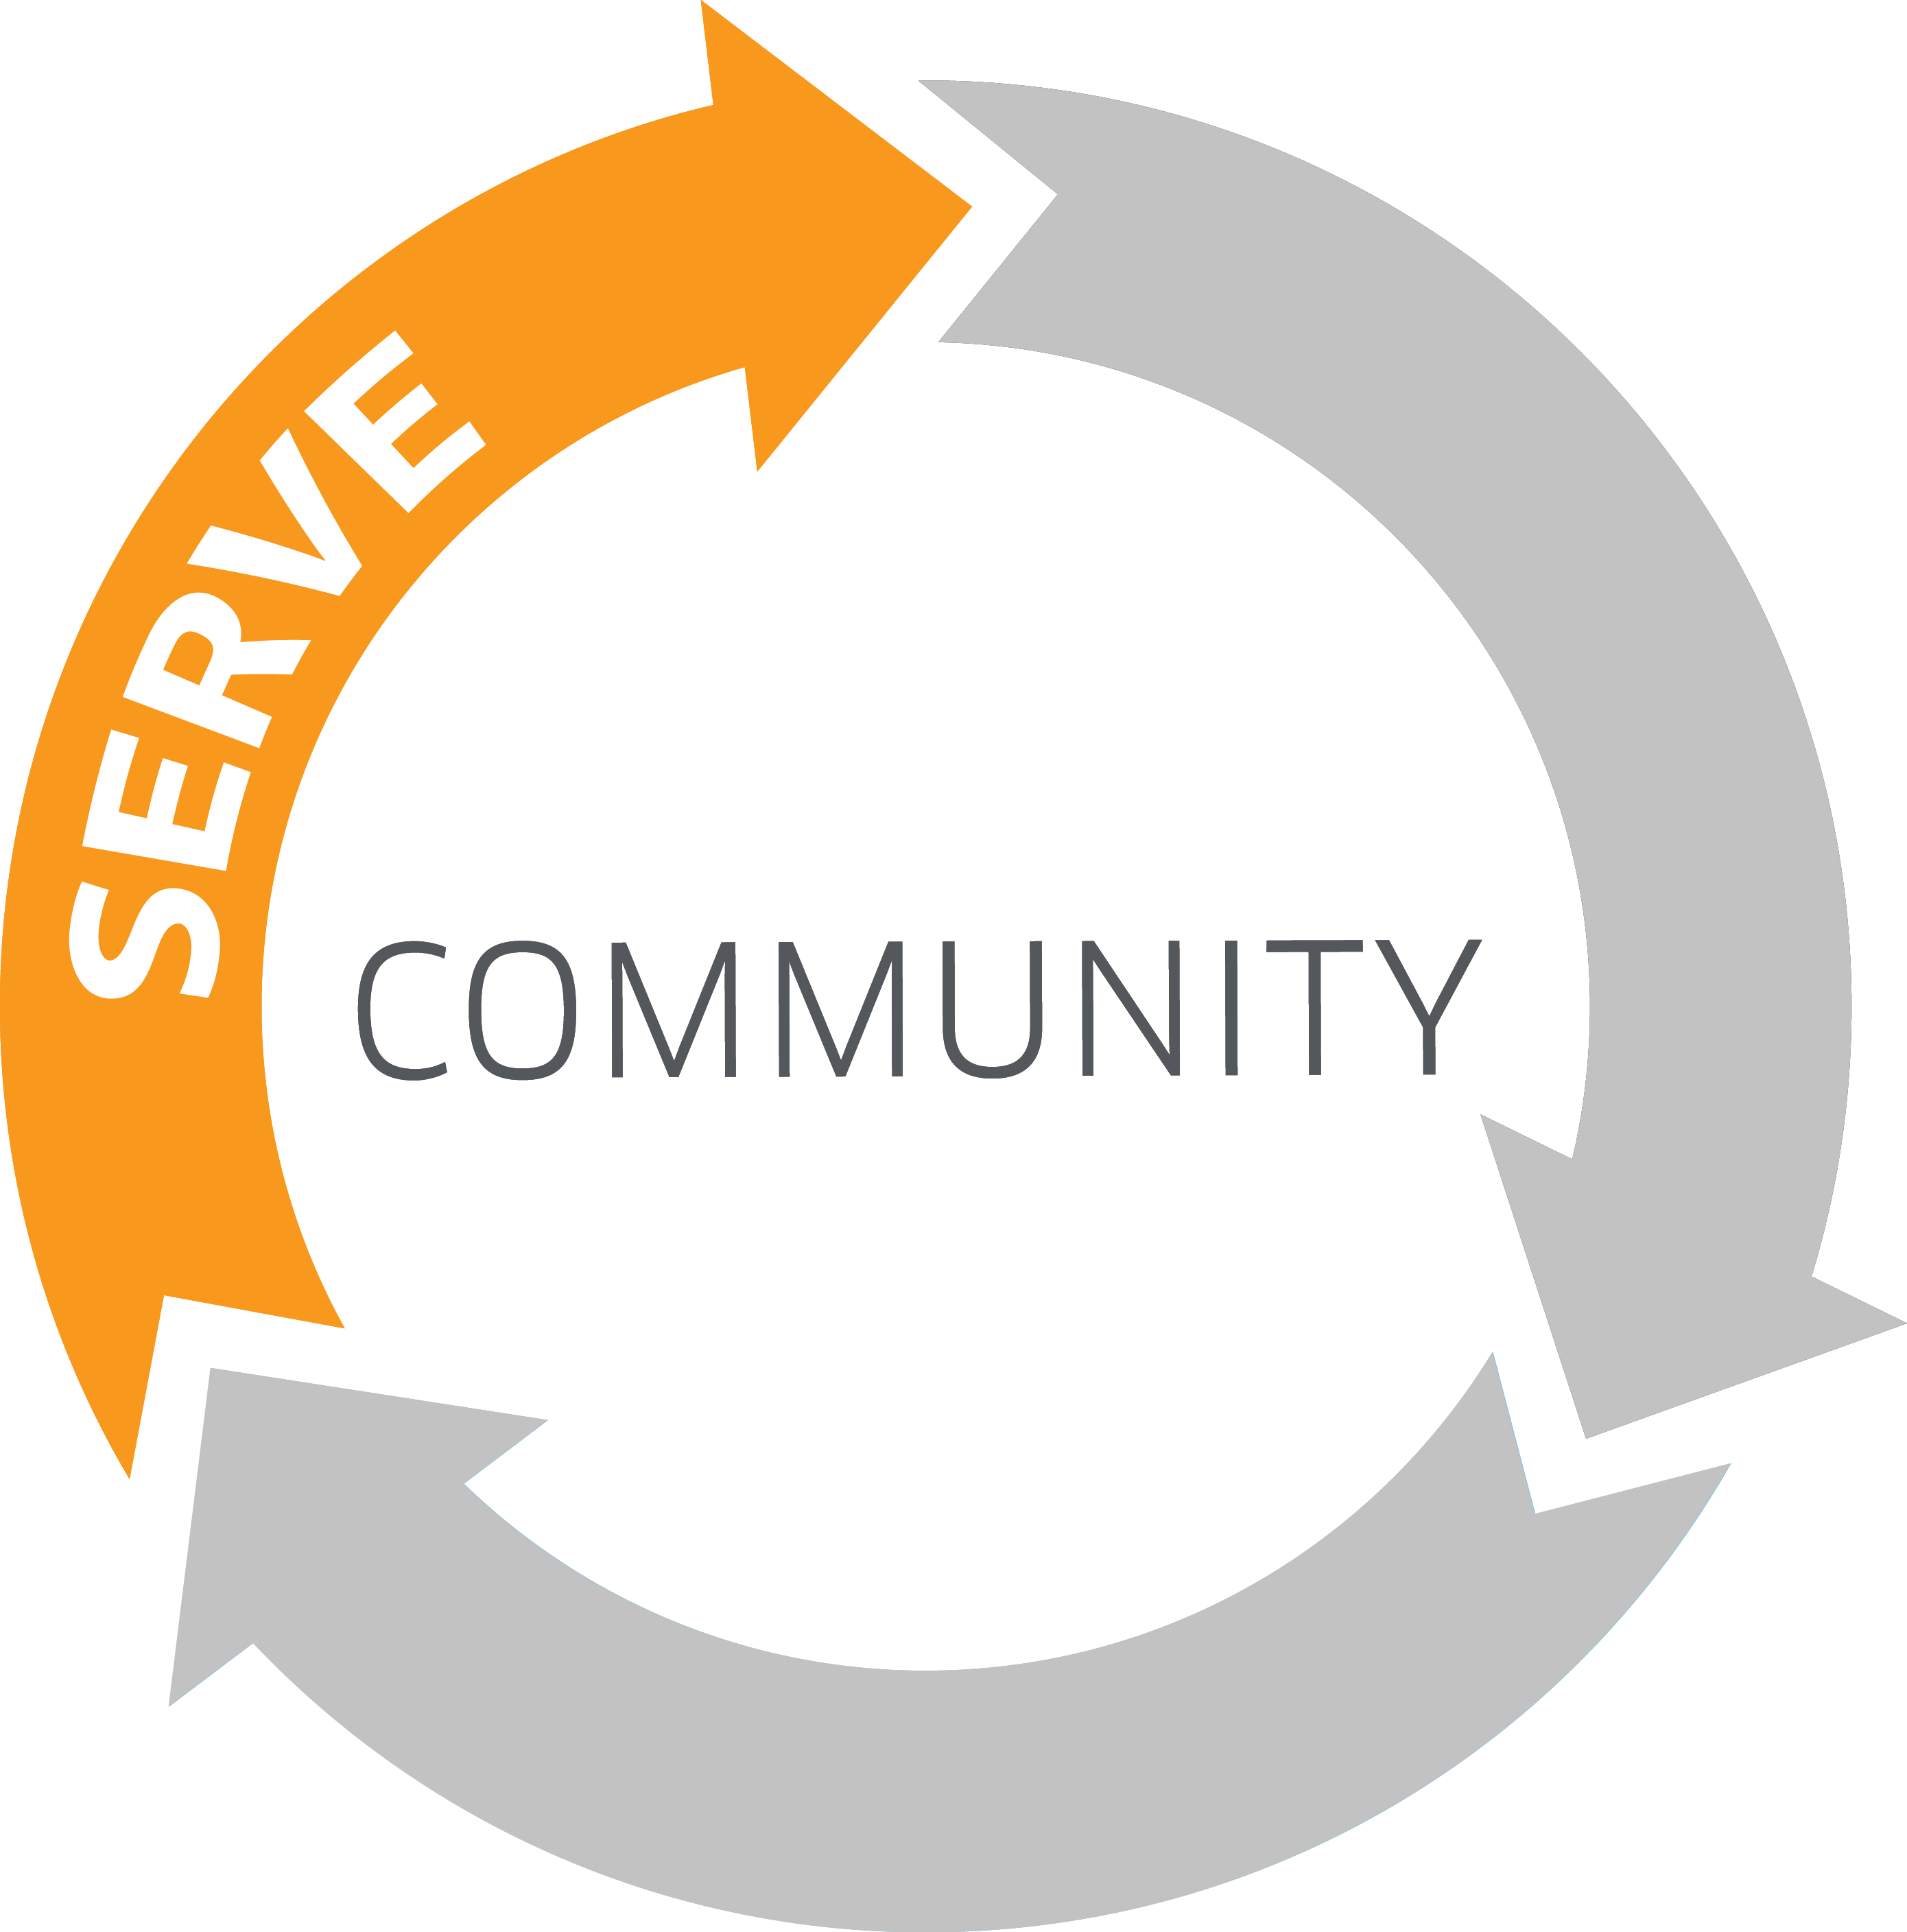
Serve your community
Your residents will be able to conduct business with you 24/7 - eliminating the need for cumbersome visits to your offices. Within our process we take the time to determine the needs of various stakeholders, both from within your staff and throughout the community. From this outreach effort and the data collected, we will ensure that your residents’ needs are quickly addressed by:
Analysis
Analyzing the top tasks residents look to complete on the website and optimizing how they are able to access key information
Responsiveness
Determining the smart-phone and tablet traffic to your site so we can build a mobile experience equal to the main site. Vision was the first to bring responsive design to municipal websites and we are extending our lead with tools like our visionMobile Designer, which lets you quickly preview your site on popular mobile devices and allows for independent editing of the mobile view. Vision is committed to helping you reach more of your community on the device they predominately prefer to use.
Functional
Providing numerous interactive components, such as Online Job Applications, Facility Reservations, Online Payments, eNotifications and more to create a robust, functional website.
Education
Educating your staff to write succinct, purpose-guided content that is customer-focused. Vision is the first to include Content Strategy enablement for staff on every site we build. While many vendors will offer to move all of your existing content, only Vision can provide your team the tools to keep your content ever-mindful of your customer.
Accessible
Ensuring the site is accessible to all members of the community. We have native functionality in our visionLiveTM CMS to ensure compliance with the latest standards, including WCAG 2.0, as well as best practices to ensure you can stay in compliance.

Slide 7
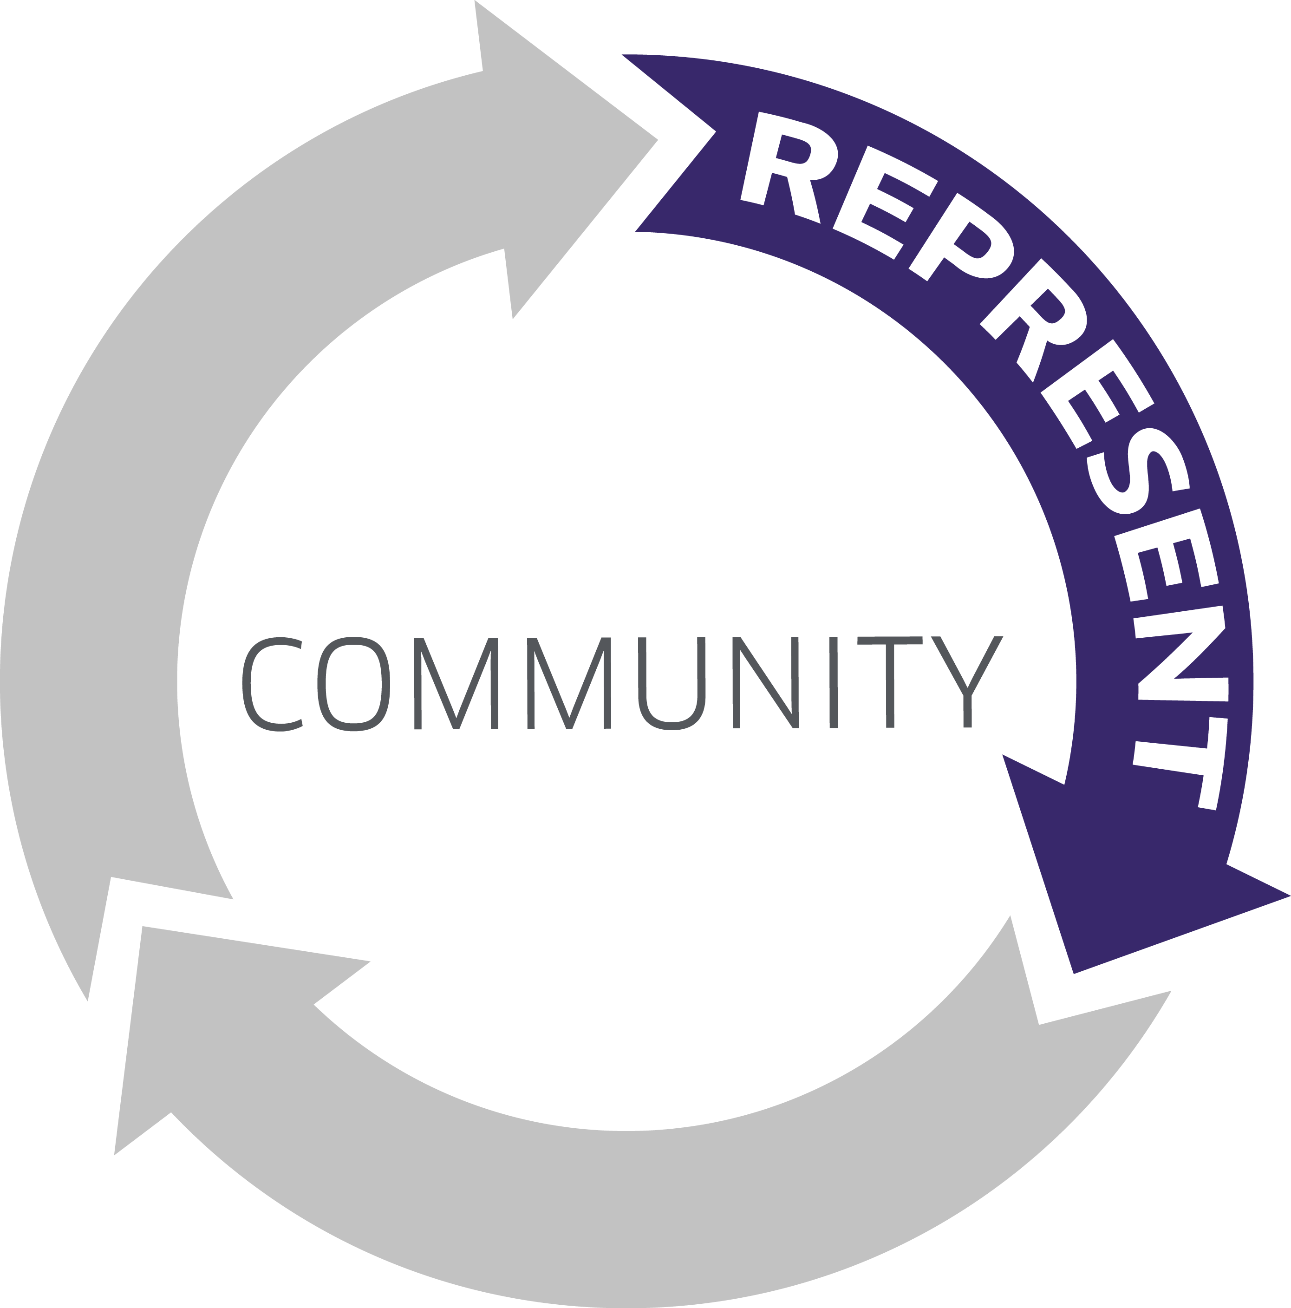
Represent your community
As residents expect more from their city’s online presence, many Vision clients are seizing the opportunity to use their website to brand their community and convey a sense of professionalism and character through the site’s look and feel. Through Vision’s collaborative design and development process, you will receive a customized website design will reflect the branding of your community, leadership and individual agencies and departments, in order to:
Drive commerce
Use of bold graphics and full resolution imagery will convey the unique economic and cultural identity of your community to prospective residents, visitors and businesses.
Convey credibility
Just as a clean, well-maintained building demonstrates to your physical visitors the professionalism and values of your organization, your website design will provide the same experience for your digital visitors.
Showcase your organization
Allow individual departments to leverage the ability through visionLiveTM to individualize the design of your depart-ment’s subsite while adhering to the overall style and approval structure of the larger site.
Our collaborative approach will result in a more compelling design faster.

Slide 8
Delight Your Community
Paying fines, taxes, applying for permits and registering for events are not typically considered “delightful” tasks. However, when a resident finds a website that is streamlined and can be accessed on their terms, the seeds of delight are planted. This delight is the sum total of all of the elements offered through the partnership with Vision. Whether it is the intuitive design driven by our UX process, a coherent Content Strategy delivered through our workshops, a site that is fully responsive and adaptive to any mobile device, or the technology and expert guidance to effectively meet existing challenges, Vision will provide the total experience throughout our relationship with you, delivering:
A delightful mobile experience
Vision was the first to bring mobile responsive design to government websites. Many of your residents want information right now, at the point of need, which means it should be equally easy to find and understand information on phones and tablets as it is on a computer.
A delightful CMS experience
To empower staff, reduce administration time, and give you complete control we will implement our advanced content management system - visionLiveTM. With one click access to regularly used features and individualized workspaces, your staff will have complete control over their online experience.
A delightful customer experience
Your website will have a stunning design that reflects your community and your visitors will easily find what they are looking for. We will organize your information by audience, topic, service, and/or department, create multiple paths to information, and implement a site search tool.
A delightful partnership experience
With a steady stream of training (onsite and on demand), workshops and user groups, Vision is committed to keeping your staff capable and confident on the system. We also offer a dedicated Client Success Agent to assist in meeting any emerging challenge or need from your community, along with Site Improvement Credits built in to make incremental changes over time, ensuring your ongoing success.

Slide 9
The Vision
Difference

Slide 10
The Vision
Difference
If you make the shift to recognize your residents as customers, what does this mean for your project? How do you need to think differently about your approach in order to create a successful website? You may have initiated this project thinking you simply need new technology in order to have a more effective website, but it’s more likely addressing your customers’ needs requires a more comprehensive solution.
Vision has developed more than 700 websites for municipalities of all sizes. This experience has shaped our understanding of what it takes to get it right.
Research-Driven
Approach
Your community is unique. You must take the time to understand them and their expectations for your website. If you guess and develop your content and navigation on based on general best practice, you may get it right – but how will you know? We will help you uncover exactly what your customers are looking for so you can be confident you are getting it right.
Flexible
Technology
While our process will uncover the needs of your community today, you must be equipped with the tools to evolve with those needs over time. We provide comprehensive functionality that is intended to put that control in your hands. Easily swap out homepage buttons, create an election-night specific homepage or configure a special mobile view. You will have the tools with Vision to respond to your community’s needs.
Strategic
Partnership
Just as your community’s needs will evolve, the standards for local government websites will change as well. You need a partner that will educate you over time, both on how to best utilize the technology available to you, but also on changing standards for accessibility, transparency, mobile and more. We have been a part of the evolution of digital government for more than 20 years and will be there to provide that insight and guidance.

Slide 11
A Research-Driven Approach
Vision understands government websites. The insights and expertise gained from 700 implementations guides each and every project we undertake. However, collective best practice can only go so far. You cannot create a website that effectively Serves, Represents and Delights a community without first taking steps to understand the unique needs of that community.
Sheboygan County does have a unique community.
Here’s what we know already:
Population of 320,000
Includes cities of XXXX
Primary industries are XXX
Tapestry data shows XXX
More data XXX
Population of 320,000
Includes cities of XXXX
Primary industries are XXX
Tapestry data shows XXX
More data XXX
But these insights barely scratch the surface of the information that can help drive better decisions for your website redesign. Through our approach, we will uncover critical insights into your customers, their needs, and what they expect to see from you online.
Advanced User Experience (UX) Analysis
Vision will conduct a comprehensive User Experience (UX) Analysis to uncover:
Who your customers are
What information they seek
How they prefer to access it
We use both qualitative and quantitative evaluation methods that vary in terms of formality and the degree of end-user participation. By combining the results of these tests, we are able to create a snapshot of the specific needs of your community.
Community Surveys Do you know the top five things visitors are seeking to find on your website? Do you know if they are able to easily find the information they need and complete tasks? How do you go about understanding what your community would like to see on your website? You ask them. The Community Survey is an online questionnaire that will be created with input from your website committee. This process has consistently uncovered valuable insights that shaped our recommendations for the homepage wireframe and navigation.
“Use clear, simple terms for major headings, with more specific information included in each general heading. I.e. use GARBAGE instead of Solid Waste.”
“Info tends to be either too general or too specific; sometimes there is info about what specific ordinances exist but other times you have to dig through the Municipal Code itself. Would appreciate an additional layer that made it easier to peruse/navigate as a lot of what we deal with tends to be code violent/enforcement issues.”
“There is no section labeled "Parks" you have to do a search.”

Slide 12
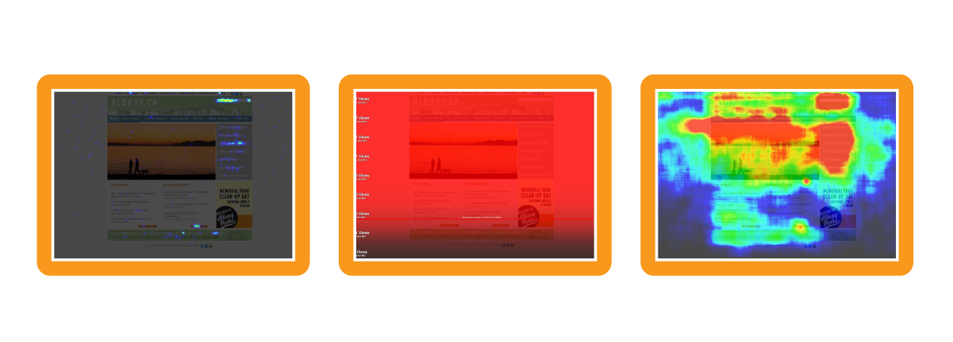
Heat Map Analysis Heat map analysis is used to provide insight into what content and elements of your website are drawing your website visitors and how they are interacting with your content. Over the course of several weeks, we will collect information about your users’ actions that can be analyzed and studied in depth.
Recorded User Testing Have you ever observed someone unfamiliar with your website attempting to use it? When you’re involved in the day-to-day maintenance of the site, it can be hard to be objective about whether content is easy to find and understand. Using special screen-sharing software, we will record 5 to 10 test users as they narrate their way through common tasks on your website, such as finding a job or paying a bill. Many clients have major “Ah ha!” moments as they see, often for the first time, what it’s like for people outside their organization to use their website.
Content Strategy
The most often overlooked and undervalued part of your website’s usability is arguably the most important: Content. The most visually stunning website will not be effective if the information within it is difficult to find and understand. As you redevelop your website, total page migration shouldn’t be your goal; rather, keeping the information that is important to your customer and delivering it in a way that is easily understood should be.
While the majority of the UX Analysis focuses on how users interact with your website, Vision’s Advanced Content Strategy Consultation focuses on your team, providing a highly-customized analysis of your website’s content and online processes. Vision’s Content Strategy Expert will help you develop and implement a content strategy that fits your organization, and will present the strategy to stakeholders in your organization. This unique, one of a kind service offering will help (city/county/school, etc.) discover the best way to approach your content.
In addition, it includes a unique, hands-on learning experience led by an experienced Government Content Strategy Expert, training your staff to write better content for the web.
Click Map
Scroll Map
Hover Map

Slide 13
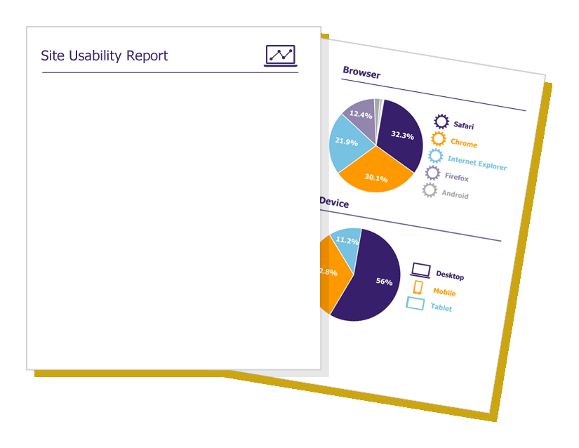
Consider these two content examples, which are two pages that have information about alarm permits:
Which one is easier to understand?
The content in the example on the right is not only easier to scan, but allows the customer to complete a process on the website. The end result of this phase is fewer pages to manage, a higher satisfaction rate from your customers, and the knowledge and training to write and publish better web content.
The Result: A Comprehensive Understanding of Your Community
At the conclusion of the UX Analysis process, you will receive a comprehensive report outlining key insights and recommendations for the layout, navigation, content and design new website. This critical document will serve as a guide for the rest of the project, enabling your team to confidently make data-driven decisions through the rest of the development process.
Project Goals
Methods Used
Community Survey Results
Stakeholder Survey Results
User Testing Results
Analytics Results
Heatmap Results
Mobile Usability Analysis Results
Top Content

Slide 14
Flexible Technology
Maintaining an effective website requires the flexibility to adapt and respond to your community’s evolving needs. The functionality offered through our CMS will not only equip your users with intuitive tools to maintain content, but places control in your hands to control your homepage, mobile experience and search.
Additionally, numerous interactive components are available with visionLiveTM to allow you to offer interactive services to your residents 24/7. Available features include:
Calendar
Citizen Request Manager
eNotification
Event Registration
Form and Survey Builder
Facility Directory and Reservation Tool
Job Application Manager
Online Payments
RFP Postings
Service Directory
Social Media Manager
Staff Directory
visionMobile DesignerTM
WCAG 2.0 Compliance
So What Makes Us Different
Flexibility
Your community’s needs will evolve over time. visionLiveTM puts more control in your hands to make changes to your site’s design and content.
Accessibility
Local government agencies must ensure content is available to all residents. That’s why visionLiveTM gives you the tools to maintain a site compliant with WCAG 2.0 standards.
Mobility
Vision was the first local government website developer to implement responsive design and continues to lead the way in mobile-first design and CMS functionality.
“This is my eighth career website, and visionLiveTM is the best content management system I have had the privilege of working with. It is beauty as well as function.”
Mandy Cawby,
WaterOne

Slide 15
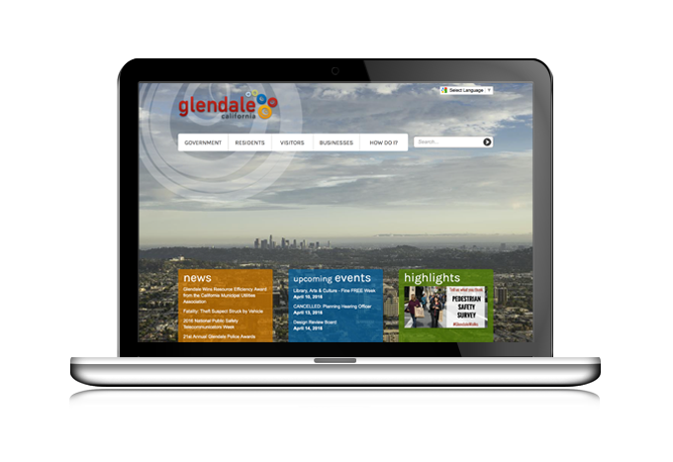
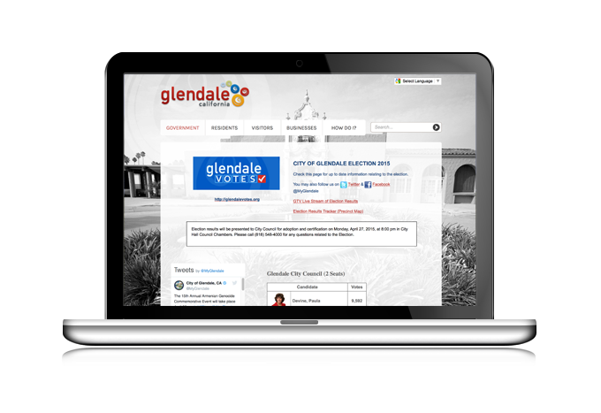
Flexibility
Leveraging your website to effectively communicate with your community requires adjusting your message from time to time. With the tools built into visionLiveTM, you will be able to change your website’s background image, swap out buttons and even create a new homepage if needed. Consider this example from the City of Glendale. On an average day, the site’s homepage showcases the landscape and beauty of the community. However, on election night, the website is flooded with traffic seeking the results. With just a few clicks in the CMS, the communications team at Glendale can overwrite the homepage to display all relevant election information.
Easily Change Your Homepage for Special Events:
Glendale’s standard homepage
Election night homepage
Accessibility
Local government agencies must ensure content is available to all residents. That’s why Vision has built several key features into the visionLive CMS to promote the creation of content compliant with WCAG 2.0 standards, including:
Mouse-free navigation
Required alt-tags
Form field labels
Providing accessible technology is a critical first step, but Vision also provides professional services and guidance to ensure your website is designed and developed with compliance in mind, including:
Training resources to teach your staff how to create accessible content
Development of a website design compliant with WCAG 2.0 standards
Automated testing and report confirming pages manually migrated by Vision are compliant
"Website accessibility is a top priority for Rancho Cordova….Vision went above and beyond by walking us through the process and allocating resources to make sure Rancho Cordova was on the cutting edge of accessibility. It’s an ongoing learning process, but we couldn’t have asked for a better partner!“
Ashley Downton,
City of Rancho Cordova

Slide 16
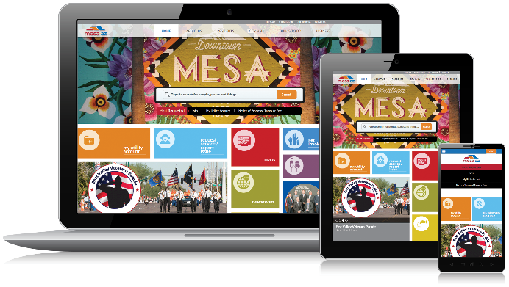
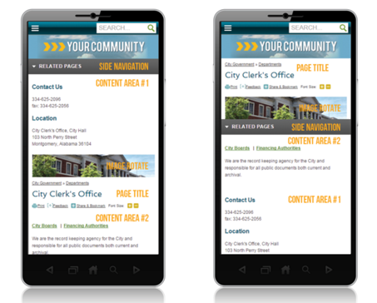
Mobility
All Vision websites are implemented with Responsive Web Design (RWD) ensuring content automatically resizes to fit mobile, tablet and monitor screens.
While RWD will make your site viewable across all devices, there may be times where you will want to adjust your content to make it easier to read and use on smaller screens.
visionMobile DesignerTM enables you to move, hide and reorder content for your mobile site, giving you full control to design your website’s mobile experience. The result is superior usability for your mobile visitors, who will be able to more easily access the content you want them to see. According to Vision’s analytics, 33% of local government website traffic was mobile in 2015, meaning this tool will allow you to serve a significant portion of your customers like never before.
Drag and Drop to Prioritize Key Mobile Content:
Standard Mobile Design
Reordered Mobile Design

Slide 17
Strategic Partnership
In the past five years, customers’ expectations in the digital world have grown dramatically. The next five years will be no different. In this environment, waiting 3-5 years between redesigns makes it difficult, if not impossible, to maintain a website that Serves, Represents and Delights the community. To help you evolve to meet the challenges of tomorrow Vision provides comprehensive services as part of visionLiveTM.
On-going Website Quality and Analytics Reports
The Advanced UX Analysis conducted at the beginning of your project will provide valuable insight into what users seek on your website today. But, in an environment of constant change, their behavior will evolve over time. Though you will have access to a Google Analytics account at any time, Vision will deliver periodic reports to you to help keep track of key metrics over time, including most frequently accessed pages, top entry and exit pages, mobile traffic and more. These reports will give you the insight needed to gauge the effectiveness of your website and an attractive document to share with internal stakeholders interested in how your website is performing.
On-going Training
Though training is included as part of the development process, we understand having on-going training opportunities is important to help bring new staff members up to speed and reinforce best practices. In addition to on-demand training videos available in the CMS, Every month, Vision provides free live training webinars. These sessions focus on CMS functionality, client best-practices and general trends from the industry, such as transparency, accessibility and content strategy. Anyone from your organization that is interested may attend at no cost, providing an easy to access training resource.
Innovation in Online Government Academies
Vision’s Innovation in Online Government Academies bring our clients together to participate in a free educational conference showcasing best practices and trends in website management. Each one-day event features a keynote from an industry-leading speaker, educational sessions about trends in the industry, an update about what’s new at Vision and advanced training on the visionLiveTMCMS. We are at our best when we’re listening to our clients and these events provide a unique opportunity to learn and develop together.
“The Innovation in Online Government Academy proved to be an excellent platform for receiving best-practice tips and training, a better understanding of the direction and plans of Vision, and a sense that the company cares about their partnerships with their customers.”
Jason Eggers, City of Belmont

Slide 18
Unlimited Technical Support
At Vision we stand behind our clients and can provide you with the support you need. Typical support questions include how to perform advanced tasks, configure the system, or accomplish some organizational need in the best way possible.
In all cases, Vision is able to address your technical and/or operational needs. Continual monitoring of your site is provided to assist your staff in finding solutions to any unexpected problems. For issues that occur after business hours, emergency staff support is provided 24 hours a day, 7 days a week.
Dedicated Client Success Manager
In addition to technical support, you will also be assigned a dedicated Client Success Manager who will help you get the most out of your website long-term. Their relationship with you will include on-going website health check calls, where they will review your site reports with you and discuss possible areas for improvement.
CMS Upgrades and Enhancements
Technology is continually evolving. visionLiveTM ensures your website will keep pace. As CMS upgrades are released, they will automatically be added to all visionLiveTM client websites at no additional charge. Has a new browser been released? Has a new mobile device become popular? No worries! We have you covered.
Site Improvement Credits
The days of developing your website, then not revisiting it until you redesign it 3-5 years later, are over. Your website should constantly evolve to meet the changing needs of your community. In order to facilitate this, Vision has built Site Improvement Credits into our subscription plan. These credits can be used to purchase any service Vision offers, from design time, to training to programming, enabling you to make incremental changes to your website without allocating an additional budget. Conversely, Credits can be accrued over the course of your contract if you would prefer to save up for a complete redesign.

Slide 19
Robust Hosting & Security
Grande Prairie will receive comprehensive hosting through our visionLiveTM subscription service, ensuring optimal website performance, protection and security.
Robust Hosting
Physical
Certified data center SSAE 16 Type II compliant
Security access via ID, biometrics, CCTV and keycard
Redundant ISP providers
Firewall protection
Power
Power failure equipment including battery backup
Redundant generator backup
Monitoring and Backup
24 hour monitoring
Daily onsite/offsite data backups
99.9% guaranteed uptime
DDoS Mitigation
Distributed Denial of Service (DDoS) attack protection is standard for all subscribers and detects malicious traffic within seconds:
State-of-the-art technology capable of mitigating the world’s largest and most complex attacks
Global terabit-scale network has over 1 Tbps of active capacity
Continuous coverage and monitoring
Smart detection technology uses dual methods to accurately diagnose and mitigate attacks:
- Signature-based identifies the source
- Heuristics-based analyzes the behavior
Disaster Recovery
In the event of any outage impacting our primary data center, your website visitors will be able to access your website as usual via our backup data center, which is: Geographically separate from our primary data center SSAE 16 Type II compliant
Standard for all subscribers
Guaranteed Recovery Time Objective
– RTO: ≤ 90 minutes
Guaranteed Recovery Point Objective
– RPO: 15 minutes Recurring monthly failover testing
Premium Option
“Hot” standby site running at backup data center at all times
Guaranteed Recovery Time Objective
– RTO: ≤5 minutes Automatic failover and failback

Slide 20
Community-Focused Results

Slide 21
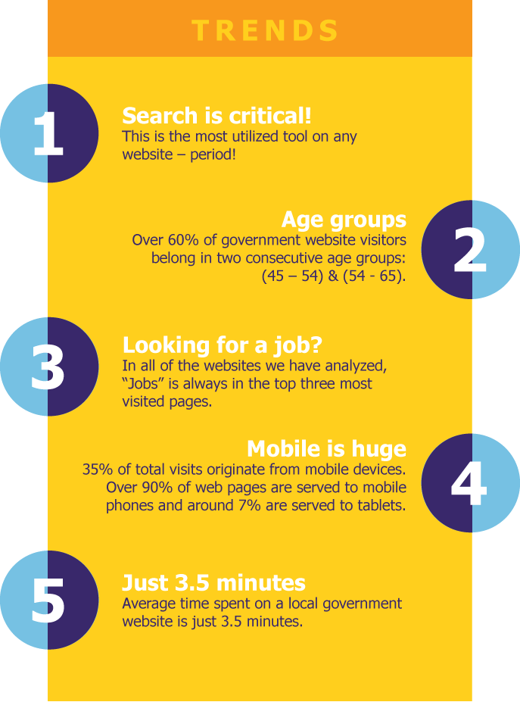
Community-Focused
Results
Insights gained through our Research-Driven Approach not only inform our recommendations for each project, but allow us to continually keep a hand on the pulse of resident expectations.
Additionally, these insights, coupled with our Flexible Technology and Strategic Partnership with our customers, have resulted in the creation of a large portfolio of Community-Focused Results.
Case Studies We selected two case studies to demonstrate how our approach, and specifically the UX Analysis, helped shape the wireframe, navigation and design for the communities served.
Representing Communities: Design Showcase Using design to accurately represent your community is a critical components of building an effective website. We profiled a number of key projects to showcase their dramatic transformations.

Slide 22
Case Study
Culver City, CA
Overview
Population:
40,000
Launch:
December 2015
Key Features:
• Mobile-friendly design
• Homepage slideshow
• Simplified top level menu with mega menus
• Graphic homepage icons for key information
• Tabbed Highlights, Events and Announcements
Stats
What devices used?
Only 10% of web visitors were mobile in December 2014 – but the city knew that the mobile was going to be important in the future (by December 2015, the mobile % grew to 26%).
Where are visitors from?
Interestingly, only 14% of web visitors were from within the city, demonstrating the importance of workers and visitors to community. This led the city to use Work and Enjoy as top level menu options in the final design.
What are top pages?
The top pages from the review of Google Analytics led to placing buttons for Bus and Jobs in prominent positions on the homepage.

Slide 23
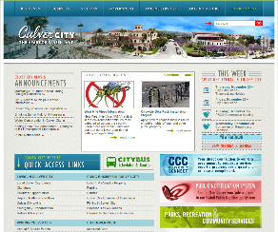
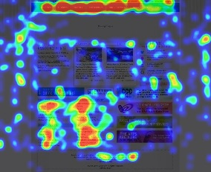
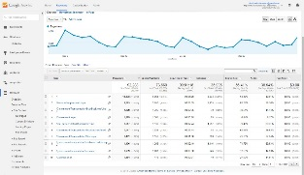
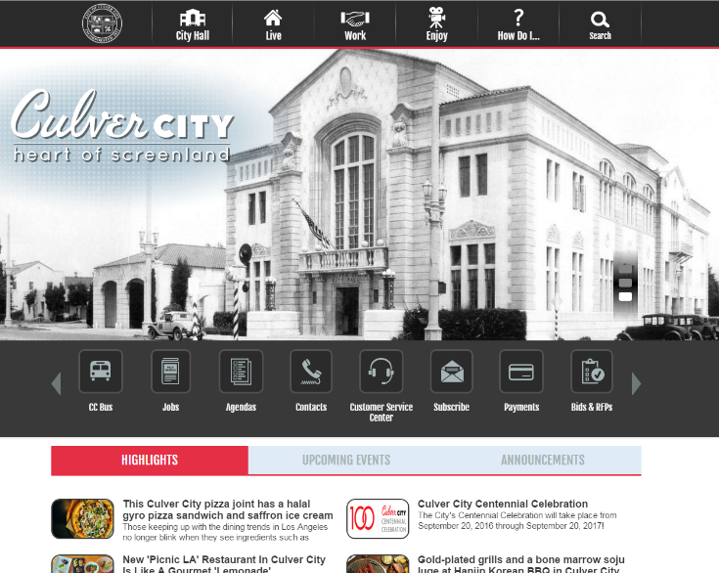
Culver City, CA (cont.)
User Experience Analysis Identified Insights
Previous Website
The previous website was loaded with informational links. The buttons in the lower right corner resembled banner ads and the announcements and highlights in the center of the page took up valuable real estate. Both were rarely clicked.
Heat Mapping
The most important quick access links in the lower left region where users were drawn to included Contact Us, Employment, Parking, Permits, City Maps, Meetings and Agendas, Bids/RFPs and Things to Do. You can see the ‘dead’ areas of announcements, highlights and banner ads.
Website Analytics
Website analytics showed that the most popular pages were Jobs, City Bus System, the main Government page and Calendar.
Community Surveys
When asked what information do you access the most in the survey, respondents most frequently mentioned agendas, meetings, events and government. Only one person mentioned employment and no one mentioned the city bus system. Just 16% of respondents said that information is easy to find and only 23% thought the design was attractive.
User research uncovered a need for a prominent search function.
The city showcases the importance of the film industry on their brand and history in a series of rotating homepage pictures.
The web analytics uncovered Bus and Jobs were frequently accessed pages so buttons were created to make this information easy to find.
The majority of users surveyed wanted easy access to Highlights, Events and What’s Happening in the community and a tabbed widget was chosen to showcase this information in an economical way.

Slide 24
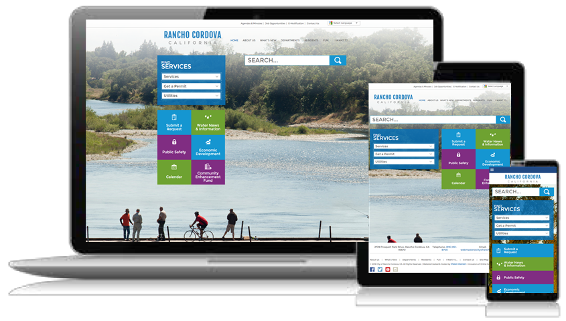
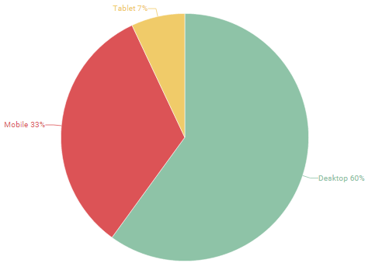
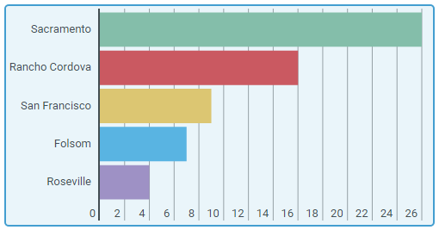
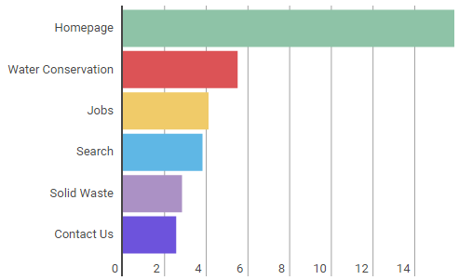
Case Study
Rancho Cordova, CA
Overview
Population:
65,000
Launch:
February 2016
Key Features:
• Mobile-friendly design
• Clean and visually appealing design with minimal homepage text
• Large homepage images, which change on every visit to showcase local natural resources
• Prominent search bar
• Find Services section to easily access key services
Stats
What devices used?
Nearly 40% of web visitors were using mobile or tablet devices to access the city’s website, demonstrating the importance of having a mobile-responsive website.
Where are visitors from?
Only 16% of web visitors are from Rancho Cordova, while the majority of visitors were from nearby communities. Nearly 9% of visitors came from San Francisco, which is 100 miles away. To serve these visitors, emphasizing tourism and recreational activities is key.
What are top pages?
The top pages from the review of Google Analytics led to adding Jobs, Contact Us and Search in the top menu. Services and Water Conservation were added as prominent homepage buttons.

Slide 25
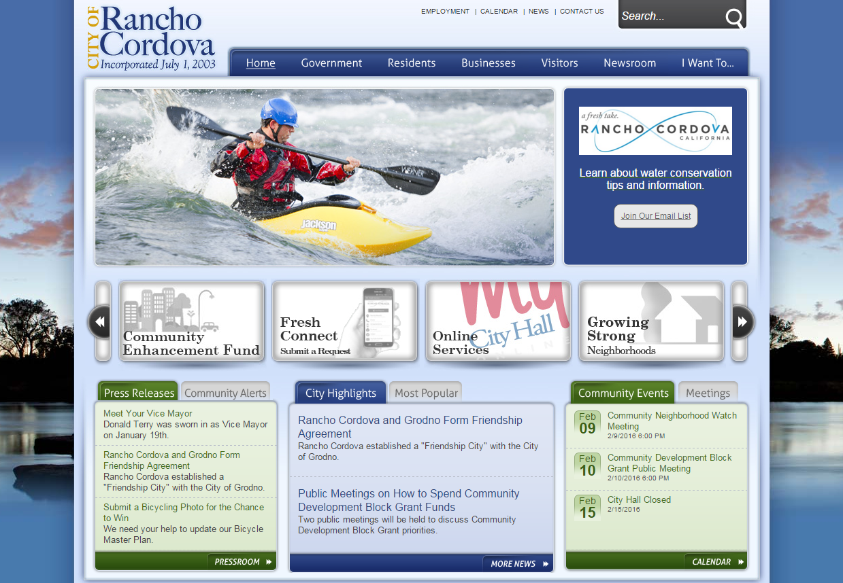
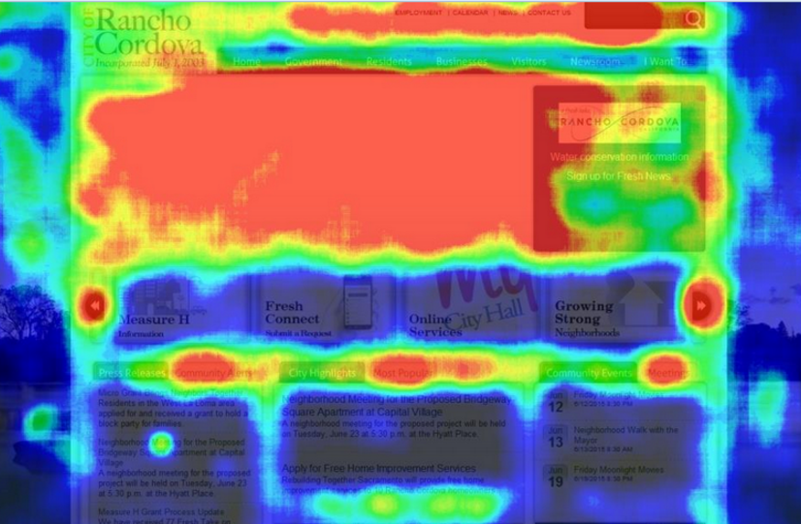
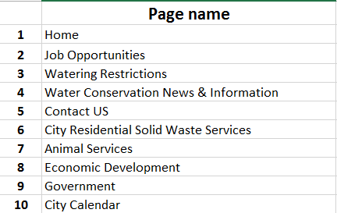
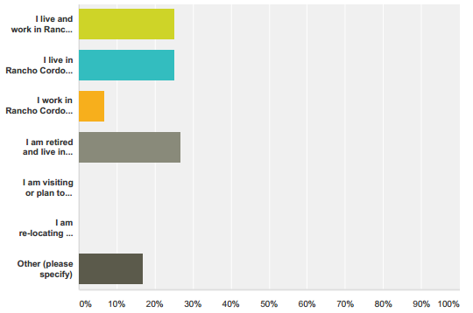
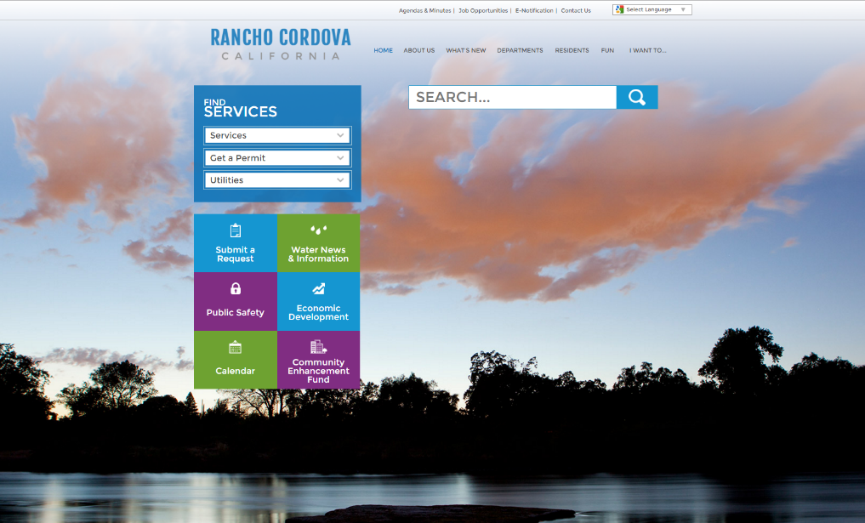
Rancho Cordova, CA (cont.)
User Experience Analysis Identified Insights
Previous Website
The previous website had a dated look and a lot of content on the homepage. There were quick link buttons in the middle of the page, but they did not match the users’ top requests.
Heat Mapping
The heat mapping identified visitors most frequently clicked on the top menus of Employment, Calendar, News, Contact Us and Search. The buttons in the middle of the page were not clicked often, but the arrows were – indicating the users saw the buttons, but didn’t find what they wanted. Community Alerts, Most Popular Highlights and Meetings were also popular sections of the site.
Website Analytics
Website Analytics showed the most popular pages were Jobs, Water Conservation, Contact Us, Solid Waste Services, Animal Services, Economic Development, Government and City Calendar.
Community Surveys
The Community Survey received input from a wide cross-section of people who live, work or are retired in Rancho Cordova. Survey respondents wanted a streamlined design, better navigation and search, a mobile-friendly site and more pictures to showcase the community.
Surveys led to the inclusion of Jobs, Agendas, eNotifications and Contact Us in the top-level menu.
Analysis of the site’s analytics uncovered that most of the top pages featured services, so they were incorporated into the Find Services box with an easy-to-use dropdown list.
Large buttons were created for other top content, including Submit a Request, Public Safety, Water News, Calendar and Economic Development.
The community’s preference for a photogenic site, uncovered in the Design Survey, was met with a series of local scenery along the American River that change every time you visit the page.

Slide 26
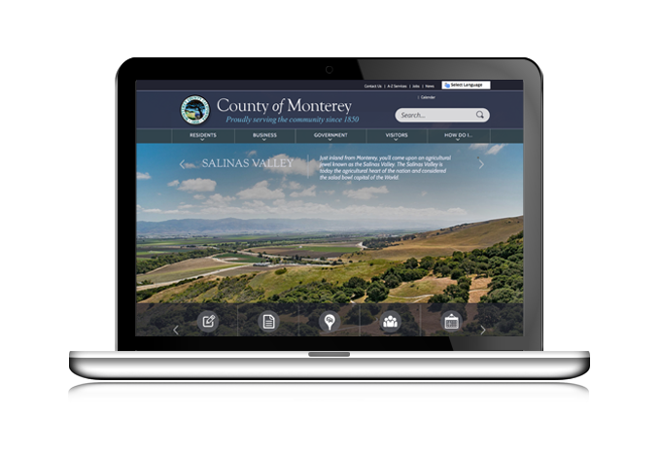
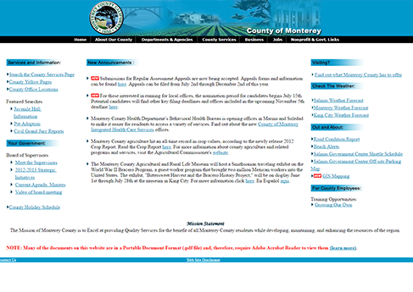
Representing Communities
Monterey County, CA
Before
Population:
429,000
Launch:
2015
After
More About Monterey County
Monterey County is situated on the Pacific coast of California and is home to the 17 Mile Drive on the Monterey Peninsula that has made the county world famous. To showcase the beauty of the area, homepage images were included to feature each of the cities that comprise the county. Taking advantage of the flexibility of the CMS, the tech-savvy team at Monterey County routinely updates the homepage to reflect the changing seasons and holidays. Additionally, the team has taken care to create user-centric content designed to serve residents, visitors and businesses looking to conduct business with the county online.
“Working with Vision provided the County with a modern website which focuses on finding information with ease while showcasing the beautyfof California’s central coast. Their vast knowledge of government made our transition a timely, comfortable experience.”
Eddie Urena,
Systems Programmer Analyst

Slide 27
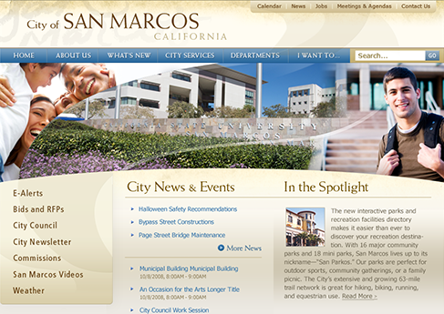
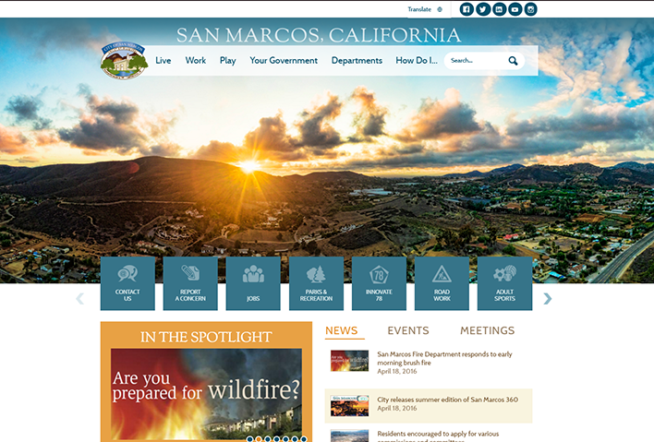
Representing Communities
City of San Marcos, CA
Before
Population:
90,000
Launch:
2016
After
More About San Marcos
Also known as the “Valley of Discovery,” the City of San Marcos maintains a small town atmosphere despite its rapid growth. Partnering with Vision, the city focused on ensuring that key information and services were easily accessible to residents on their new website. After working with Vision’s UX Experts, San Marcos leaders knew their residents had high expectations for their community website, and could benefit from a streamlined view of the city’s plentiful recreation options. To that end, they leveraged Vision’s Facility Directory to highlight the community’s 60 miles of trails, 29 parks and 11 recreation centers.
“Today, residents expect the same level of innovation and transparency from government as they do from consumer products and services around the world. To meet this expectation, the City of San Marcos’ new website showcases an improved design with the most popular items right up front, making it easier to navigate the site.”
Sarah Macdonald,
Communications Officer

Slide 28
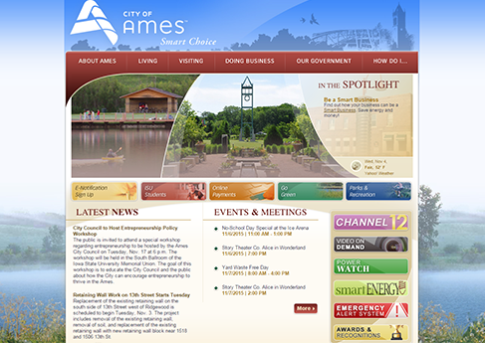
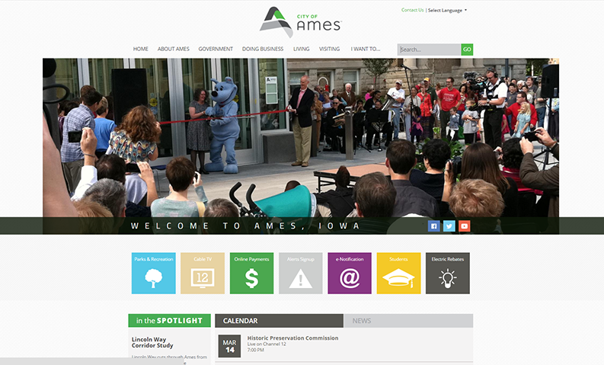
Representing Communities
City of Ames, IA
Before
Population:
62,000
Launch:
2015
After
More About Ames
A progressive Midwestern community, Ames is home to Iowa State University. Its initial website with Vision launched in early 2011, ushering in new functionality that enabled the city’s communication staff to manage the site’s information. In 2015, Ames undertook a redesign, seeking to unify the digital brands of the city, Chamber of Commerce and Convention and Visitors Bureau. With the launch of its new, simplified design, this goal was achieved.
“As a university community, we have a large, tech-savvy population and all our information must be easily accessible on the web. Our new site perfectly blends our desire for an attractive, user-friendly design with the functionality needs of our citizens.”
Susan Gwiasda,
Public Relations Officer

Slide 29
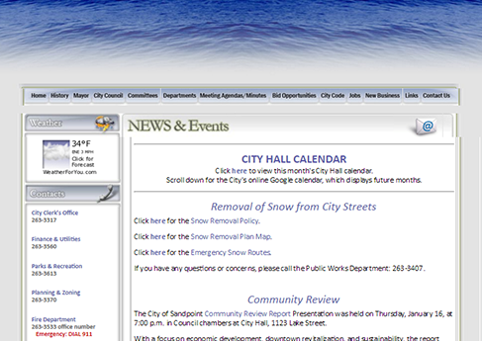
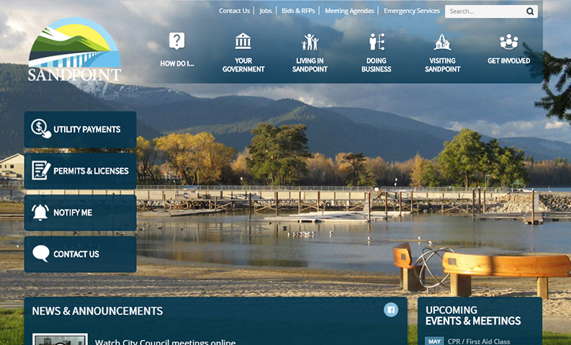
Representing Communities
City of Sandpoint, ID
Before
Population:
7,400
Launch:
2016
After
More About Sandpoint
Surrounded by three mountain ranges, the scenic City of Sandpoint, Idaho lies on the shores of Lake Pend Orielle. Frustrated with the limitations of their homegrown website, the city initiated a redesign in order to create a more visually appealing and easy to manage website that would better represent the community as a tourist destination. After partnering with Vision, Sandpoint’s website now reflects the beauty of the area, and showcases the community for businesses and residents looking for a new home.
“The City of Sandpoint’s new website is not only visually stunning – supporting our economic development efforts – but is also much more usable by citizens and city staff. The positive feedback from users is consistent with what our analytics data shows: a dramatic decrease in drop-offs from our homepage since the redesign. There is no overstating what a massive improvement our new site is from the old. Thank you, Vision!”
Aaron Qualls,
Director of Planning & Economic Development

Slide 30
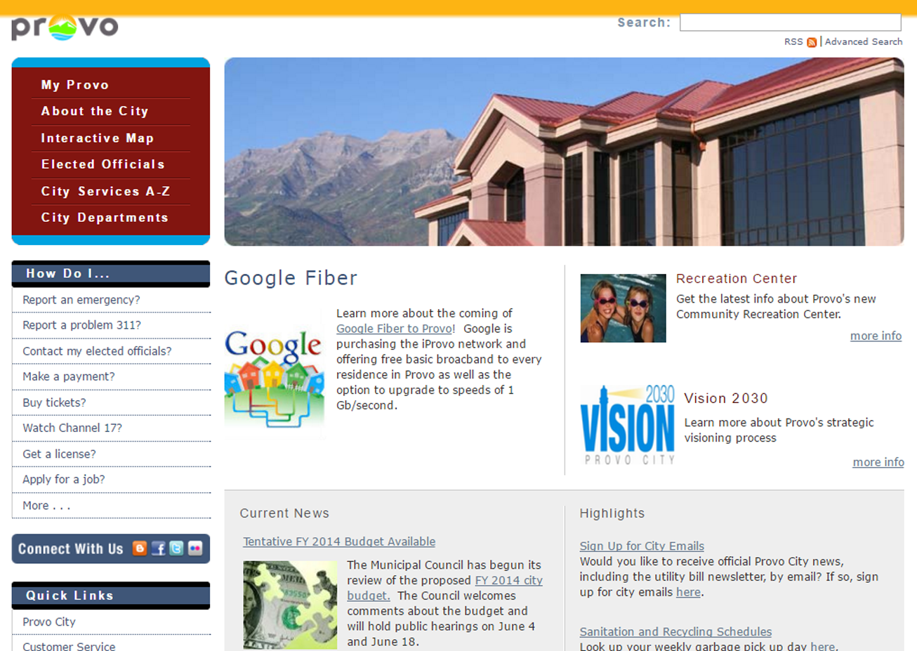
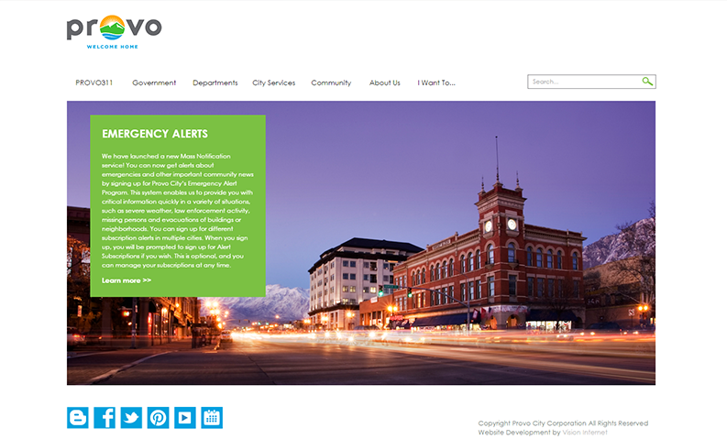
Representing Communities
City of Provo, UT
Before
Population:
116,000
Launch:
2013
After
More About Provo
The third largest city in Utah and home to Brigham Young University, the City of Provo sought demonstrate their innovative culture with a website that leverages best-in-class design inspiration from the private sector. Mayor John Curtis has always placed a high value on customer service and innovation, which reflects the city’s tech-forward/resident-first culture. For Provo, local government representatives – especially the mayor – reach out to residents with a website presence that’s open, active and visible.
“The thing we hear most often about our site is that it doesn’t feel like a government site, to me there is no higher praise…We have found such amazing success working with Vision. Their ability to deliver results when handed complex problems has been inspiring. We have enjoyed our site these last two years, but stay tuned for continued big changes to Provo.org!”
Brian Nye,
Creative Director

Slide 31
Project Plan
Grand Prairie

Slide 32
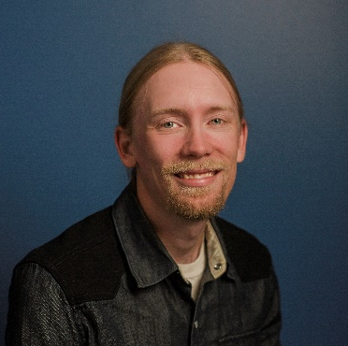
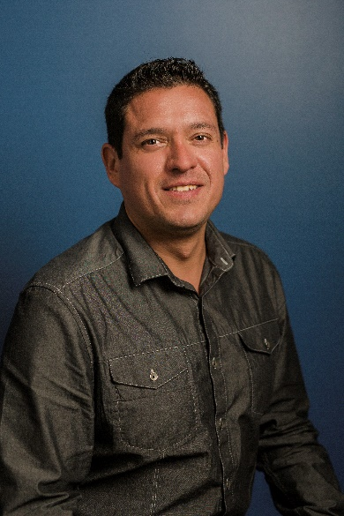
Project Plan
Grande Prairie
Introduction
A successful project is the result of a dedicated team working toward a shared goal. Our tried and true project methodology is the result of developing more than 700 local government projects and is designed to deliver superior results on time and on budget.
After reviewing your specifications, Vision recommends the following customized project plan for Grande Prairie.
Vision’s Project Team
An essential component of the project process is establishing clear expectations about who will be involved in the project and what they will deliver. Vision enjoys the contributions of long-term, dedicated staff who guide the development of each and every project. Their expertise will ensure the success of your development.
Kristoffer von Bonsdorff, Lead Project Manager
Kristoffer vast technical expertise coupled with deep knowledge of local government enables him to coach and guide the development of each website. A part of Vision’s team since 2008, he oversees our staff of 10 project managers. Once your project is approved, Kristoffer will assign your primary project manager, who will serve as your main point of contact throughout the development.
Uriz Goldman, Certified User Experience (UX) Consultant
Uriz is passionate about creating more intuitive customer experiences for each of our clients. As a Certified User Experience Consultant, he will oversee the comprehensive User Experience Analysis for your website, bringing a wide depth of experience gathered from working with hundreds of local government agencies since joining Vision in 2005.

Slide 33
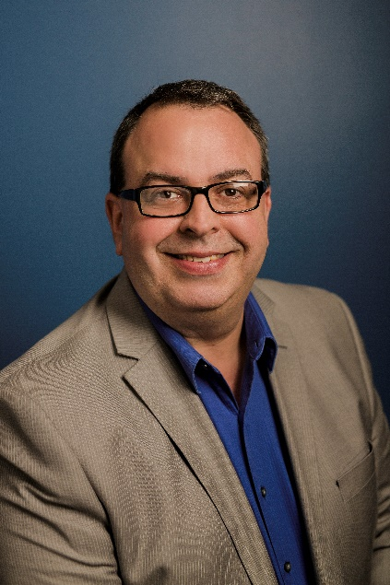
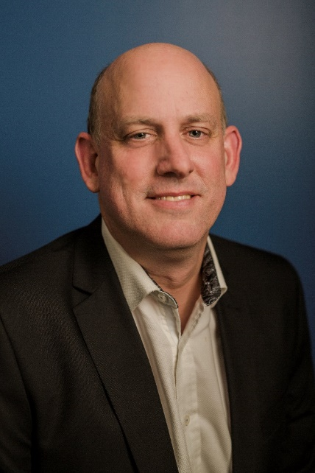
Project Plan
Grande Prairie
Vision’s Project Team (cont.)
Natalia Cudlip, Art Director
Natalia’s eye for detail and creativity have resulted in some of Vision’s most stunning website designs since she joined Vision in 2007. As our Art Director, she will meet with you to uncover what makes your community unique and collaborate with our team of designers to bring it to life with a beautiful, custom design.
Joe Capucini, Training Manager
Joe is an experienced software trainer and consultant who specializes in adult learning. Certified as a Technical Trainer (CTT+), he has designed and delivered multiple training programs. He will equip you to get the most out of visionLiveTM , both through the initial training included in your project and through on-going live training webinars available to all clients.
Lyman Benton, Technical Support Manager
An expert at visionLive, Lyman oversees Vision’s technical support team. These specialists will be your first line of defense if you have questions about how to use the system or need to solve technical or user-experience issues. You can reach out to Lyman or his team for live technical support via telephone or email.
Robert Schnelle, Client Success Manager
Robert knows visionLive inside and out and has a passion for serving customers. He will work with you once your website launches to ensure you’re getting the most out of your relationship with Vision, by monitoring the site’s performance, consulting with you about new features and services and providing feedback during your Site Health Check calls.

Slide 34
Project Plan
Grande Prairie
Grande Prairie’s Project Team
While Vision’s team will guide the process, we will depend on the dedication of staff and resources by Grande Prairie to achieve the best result.
Based on our experience, we recommend assigning staff into the following roles:
Project Manager
You should assign a dedicated project manager, who will serve as the main point of contact to interface with Vision throughout the development of your website. This person will work closely with your Vision project manager at each stage should be empowered to make final decisions on behalf of the city.
Core Project Team (3-5 people) To help guide decisions, you should form a core project team. This group will work closely with your designated Project Manager in helping to gather input from your staff and guiding key decisions through the course of the project. Commonly this team includes staff from the following departments:
• Communications
• Administration
• IT
Steering Committee (varies)
To help build buy-in across your organization, we recommend forming a steering committee. This larger team should include representatives from across all of your departments. They will be included in larger surveys and potentially provide input at key decision points. Gathering this group early helps engage the organization in the development, gaining buy-in for the project and providing alignment for decisions.
“We could not have had a better experience with Vision. Everyone was super responsive, patient, very helpful and positive throughout the entire project. Any time we needed guidance, our project manager was there for us. The Vision Team went above and beyond. They were as invested in the website as we were, and we truly appreciated that!”
Anthony Wilson, City of San Angelo

Slide 35
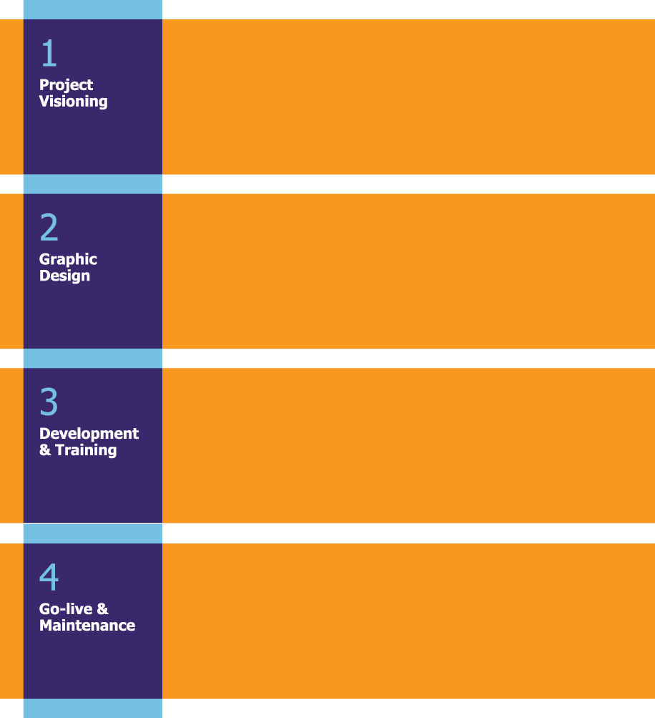
Project Plan
Grande Prairie
Implementation Flow
Deliverables:
UX Analysis & Consultation
Content Strategy
Collect/Compile Logos & Images
Approved Homepage Layout
Duration:
5 Weeks
Staff:
Project Manager
Certified UX Consultant
Art Director/Designer
Deliverables:
Design Visioning & Consultation with
Graphic Designer
Initial Design Concepts & Revisions
Approved Homepage & Interior Page Design
Duration:
6 Weeks
Staff:
Project Manager
Art Director/Designer
Deliverables:
Programming of Website
User Acceptance Testing
Content Preparation & Migration
Identification of Additional Work (if needed)
End User Training on visionLive™
Duration:
11 Weeks
Staff:
Project Manager
Training Manager
Technical Support Manager
Deliverables:
Final Content Check
DNS Update
Public Launch of Website
Transition of Client Success Manager
through visionLive™
Duration:
5 Weeks
Staff:
Project Manager
Technical Support Manager
Client Success Manager

Slide 36
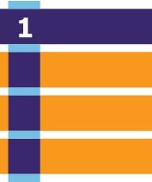
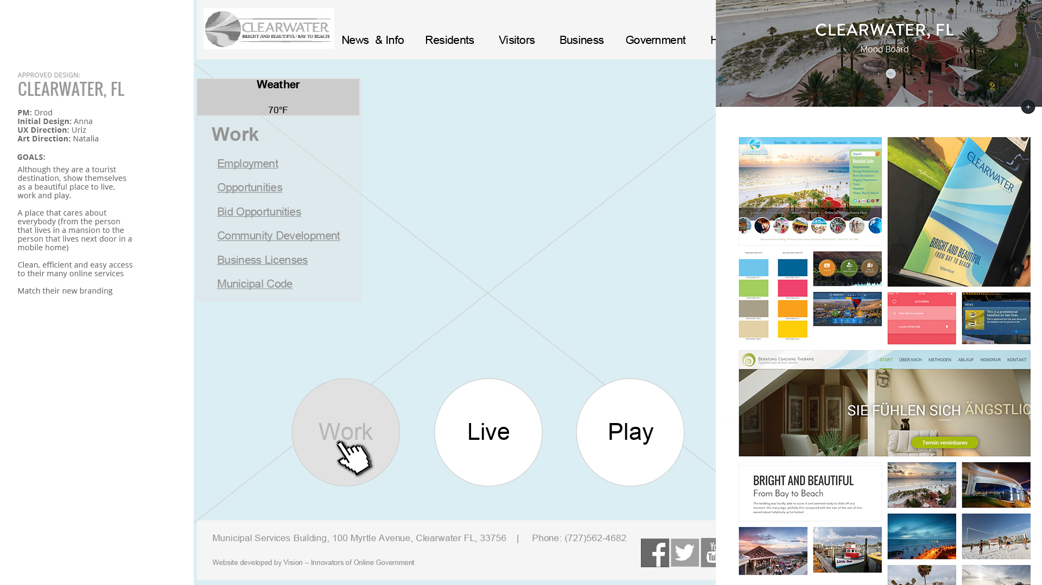
Project Plan
Grande Prairie
1. Project Visioning
Your project will begin with the Visioning stage, where we will work with your team to conduct an extensive information gathering process to uncover your community’s needs and lay the groundwork for your website’s new layout and structure.
User Experience (UX) Analysis Effectively Serving, Representing, and Delighting your unique community requires research to understand your users, what they expect to see on your website and how they engage with your website. As outlined in depth starting on page XX, Vision will apply a number of different evaluation methods to gather information about the use of your website to provide useful direction for development of a new website
Wireframe & Information Architecture Development Driven by the information discovered in the UX Analysis, Vision’s consultants will develop the initial layouts and Information Architecture recommendations for your project, ensuring key content is emphasized and easy to access by users.
Research uncovered Clearwater’s key audiences were resident and businesses, leading to the recommendation to showcase living and working on the homepage
Vision’s Deliverables
Grande Prairie’s Deliverables
Delivery of Discovery Package
Kick-off call agenda
File sharing repository for uploading site assets
Installation of analytics tools on website
Consulting workshop agenda
Site Usability Report
Draft homepage wireframes
Final homepage wireframe
Access to or help installing analytics and heatmapping software
Completed Discovery Package
Identification of staff to participate in content strategy training
Final Sign-off on homepage wireframe

Slide 37
Project Plan
Grande Prairie
2. Graphic Design
Once the Project Visioning is complete, it’s time to move into the Graphic Design Stage to bring the site to life with a compelling, but usable design. In order to create a design that effectively represents your community, our designers will review the data collected about your website in the Visioning stage, conduct surveys with your staff about design preferences and meet with your website committee to discuss their findings.
Following this analysis stage, you will receive a digital mood board, showcasing the graphics, photos, fonts, colors and other design elements that best represents your community/unique identity.
This mood board will help ensure the entire team is on the same page regarding the site’s look and feel before the initial concepts are / concept is presented.
As part of the process, we will present an initial concept, then provide unlimited revisions to ensure your satisfaction with the site’s design.
A mood board, created in collaboration with our designers, will lay the foundation for your site’s graphic design
Vision’s Deliverables
Grande Prairie’s Deliverables
Initial homepage design concept
Revisions of homepage design concept
Final homepage design concept and sign-off document
Interior page design concepts
Final interior page design concepts and sign-off document
Department Branding:
5 Design Themes
3 Advanced Subsites
Feedback on homepage design concept
Official sign-off on homepage design
Feedback on interior design concepts
Official sign-off on interior page design

Slide 38
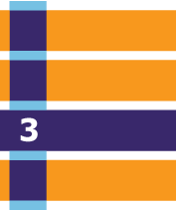
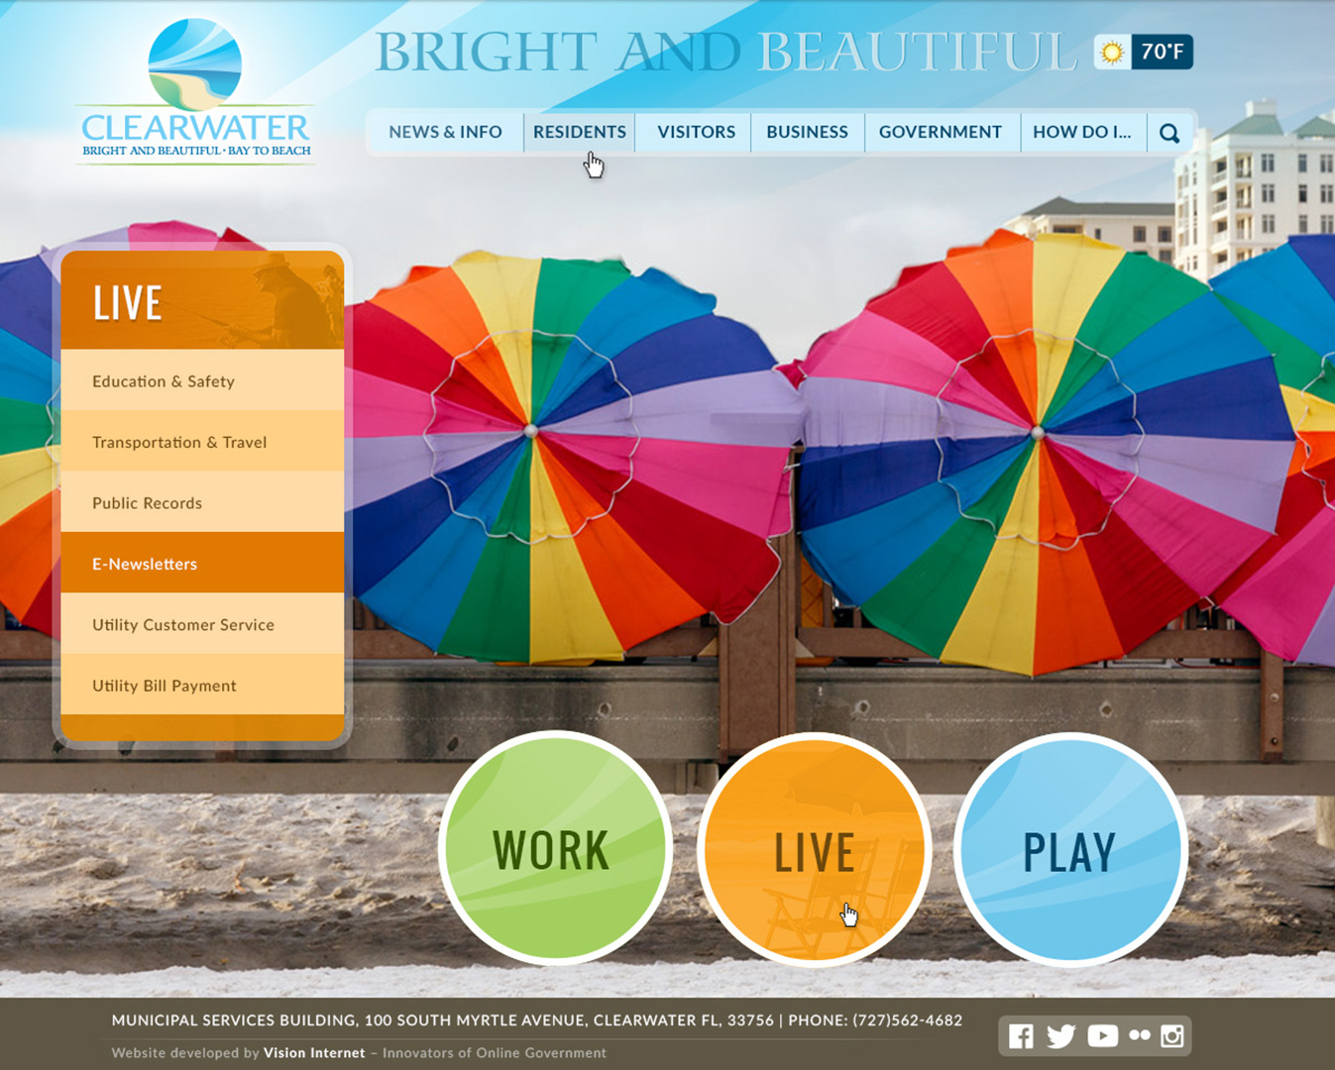
Project Plan
Grande Prairie
3. Development & Training
During the Development & Training Stage, the process continues as we program the website, implement the visionLive CMS, migrate content and train your team.
Content Preparation and Migration As part of your project scope, Vision will migrate a specified number of pages from your old website into the new website. The UX Analysis will uncover your top content, which typically informs which pages are included in the migration. Keep in mind your team will be able to migrate additional content as needed once we deliver the website.
Development Vision’s talented team of developers will program the website, both by implementing the visionLive CMS and ensuring your new website is Mobile Responsive.
Training & Soft Launch For your project, we will provide our web-based training. This train-the-trainer approach teaches your project manager how to use the site for content editing in addition to detailed instruction on advanced administrative functions including system configuration, system maintenance, reporting and strategies for future expansion.
Keep in mind we also include a full curriculum of on-going training courses that can be accessed on-demand after your site launches.
Your website will come to life with the implementation of visionLive and comprehensive training for your staff
Vision’s Deliverables
Grande Prairie’s Deliverables
CMS User and Permissions worksheet
Proposed content migration sitemap
Migration of 500 pages of content
Prototype website on development server
Training: 3 days on-site
Transfer and set-up website on product server
Introduction to Technical Support team
Completion of additional addendum work
Completed User and Permissions worksheet
Approved content migration sitemap with administrative rights for users identified
List of users for training and logistics support for training
User Acceptance Testing (UAT) and reporting of any issues
Review scope and sign addendum for any additional work needed

Slide 39
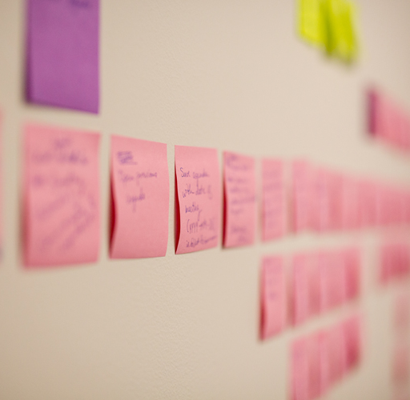
Project Plan
Grande Prairie
4. Go-live & Maintenance
Site planning and UX strategy
starts the site building
Vision’s Deliverables
Grand Prairie’s Deliverables
Introduction to Client Success Team
Monthly software updates
Unlimited technical support
State-of-the-art hosting
Training and best practice webinars
On-going new user training
On-demand training library
Site Improvement Credits
Account reviews
Schedule go-live date
Update domain DNS records and notify Vision of the change

Slide 40
Project Plan
Grande Prairie
Optional Professional Services
Onsite Consulting
Advanced UX Analysis & Consultation
Content Strategy
Collect/Compile Logos & Images
Approved Homepage Layout
$40,000
Onsite Traiing Program
Advanced UX Analysis & Consultation
Content Strategy
Collect/Compile Logos & Images
Approved Homepage Layout
$40,000
Onsite Consulting
Advanced UX Analysis & Consultation
Content Strategy
Collect/Compile Logos & Images
Approved Homepage Layout
$40,000
Onsite Consulting
Advanced UX Analysis & Consultation
Content Strategy
Collect/Compile Logos & Images
Approved Homepage Layout
$40,000

Slide 41
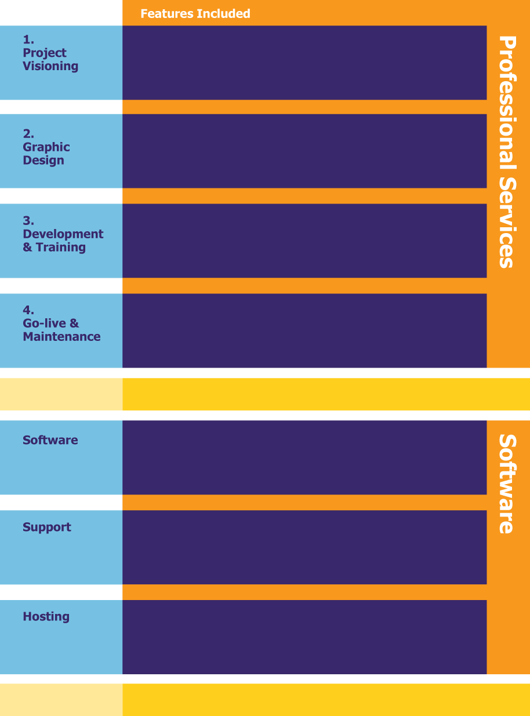
Project Plan
Grande Prairie
Project Estimate
Advanced UX Analysis & Consultation
Content Strategy
Collect/Compile Logos & Images
Approved Homepage Layout
Advanced UX Analysis & Consultation
Content Strategy
Collect/Compile Logos & Images
Approved Homepage Layout
Advanced UX Analysis & Consultation
Content Strategy
Collect/Compile Logos & Images
Approved Homepage Layout
Advanced UX Analysis & Consultation
Content Strategy
Collect/Compile Logos & Images
Approved Homepage Layout
Project Fee
$40,000
Advanced UX Analysis & Consultation
Content Strategy
Collect/Compile Logos & Images
Approved Homepage Layout
Advanced UX Analysis & Consultation
Content Strategy
Collect/Compile Logos & Images
Approved Homepage Layout
Advanced UX Analysis & Consultation
Content Strategy
Collect/Compile Logos & Images
Approved Homepage Layout
Annual Fee
$7,800

Slide 42
Project Plan
Grande Prairie
Appendix

Slide 43
Thank you

