Slide 1


Project Kick-off
Kit

Slide 2
Contents
    Project Planning 3
    Your Vision Team 3
    Your Project Team 5
    Implementation Flow 6
    Roles and Responsibilities Guide 7
    Risk Management Plan 8
    Communication Plan 9
    Effective Feedback Guide 10
    Design Asset Collection 11
    Survey Preparation 12
    Tutorials 13
    Google Analytics Tracking Set-up 13
    Appendix 14
    Glossary of Terms 14
    Kickoff Checklist 15

Slide 3


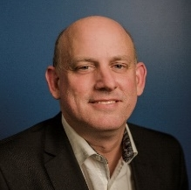
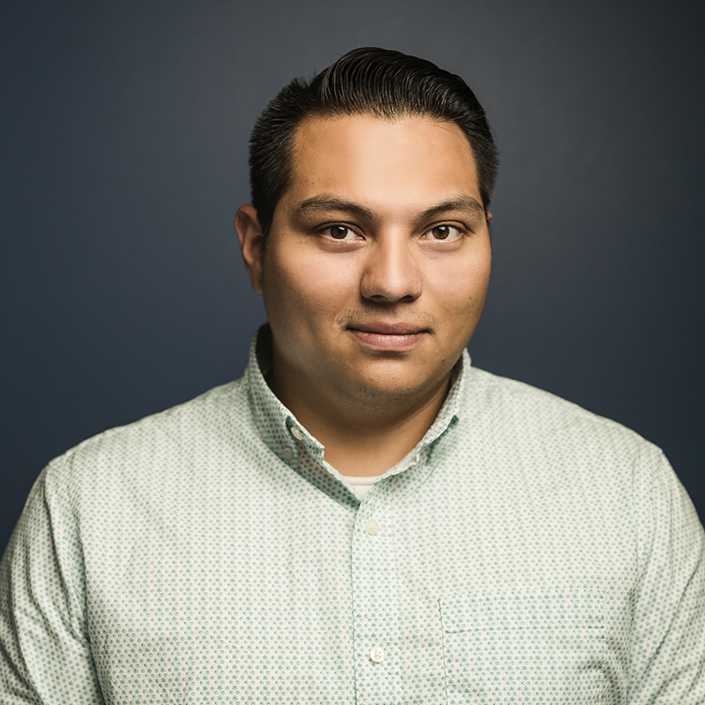
Introduction
Thank you for choosing Vision for your website redesign! We’re looking forward to learning more about your goals for the project and bringing them to life online. One of the most important elements of the development process is to make sure the right people are involved in each stage.
The following guide is intended to help you identify who should be involved and in what capacity. (Keep in mind it might make sense for multiple people to fulfill a specific role, or for one person to fill multiple roles.)
Vision’s Team for Your Project
Throughout the development process, you will engage with several members of Vision’s team. Here’s an introduction to the personnel who will be guiding your development. Keep in mind depending on scheduling and availability additional staff may contribute to key project phases as well.
Robert Schnelle,
Client Success Manager
rschnelle@visioninternet.com
310-656-3100 x283
Robert knows visionLiveTM inside and out and has a passion for serving customers. Though your Project Manager will serve as your primary point of contact for the website development, Robert is always available to answer questions or to help as needed. Once your site launches, he will work with you to ensure you’re getting the most out of your relationship with Vision, by monitoring the site’s performance, consulting with you about new features and services and providing feedback during your Site Health Check calls.
David Rodriguez,
Manager, Project Implementation
drodriguez@visioninternet.com
310-656-3100 x388
David’s technical expertise coupled with deep knowledge of visionLiveTM enables him to coach and guide the development of each website. In his role, he manages our project management team and will assign one to your project. If you have feedback regarding our process or your assigned project manager, contact David and he will be able to help.

Slide 4
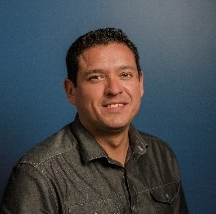


Vision’s Project Team (cont.)
Uriz Goldman,
Certified User Experience (UX) Consultant
Uriz is passionate about creating more intuitive customer experiences for each of our clients. As a Certified User Experience Consultant, he will oversee the comprehensive User Experience Analysis for your website, bringing a wide depth of experience gathered from working with hundreds of local government agencies since joining Vision in 2005.
Natalia Cudlip,
Art Director
Natalia’s eye for detail and creativity have resulted in some of Vision’s most stunning website designs since she joined Vision in 2007. As our Art Director, she will meet with you to uncover what makes your community unique and collaborate with our team of designers to bring it to life with a beautiful, custom design.
Brian Pope,
Technical Trainer
Brian’s teaching background has led him to provide training and instruction in various states and countries. He will provide technical training to all Vision CMS users.

Slide 5



Your Project Team
While Vision’s team will guide the process, we will depend on your dedication of staff and resources to achieve the best result.
Based on our experience, we recommend assigning staff into the following roles:
Project Manager
You should assign a dedicated project manager, who will serve as the main point of contact to interface with Vision throughout the development of your website. This person will work closely with your Vision project manager at each stage should be empowered to make final decisions on behalf of your organization.
Core Project Team (3-5 people)
To help guide decisions, you should form a core project team. This group will work closely with your designated project manager in helping to gather input from your staff and guiding key decisions through the course of the project. Commonly this team includes staff from the following departments:
• Communications
• Administration
• IT
Steering Committee (varies)
To help build buy-in across your organization, we recommend forming a steering committee. This larger team should include representatives from across all of your departments. They will be included in larger surveys and potentially provide input at key decision points. Gathering this group early helps engage the organization in the development, gaining buy-in for the project and providing alignment for decisions.

Slide 6
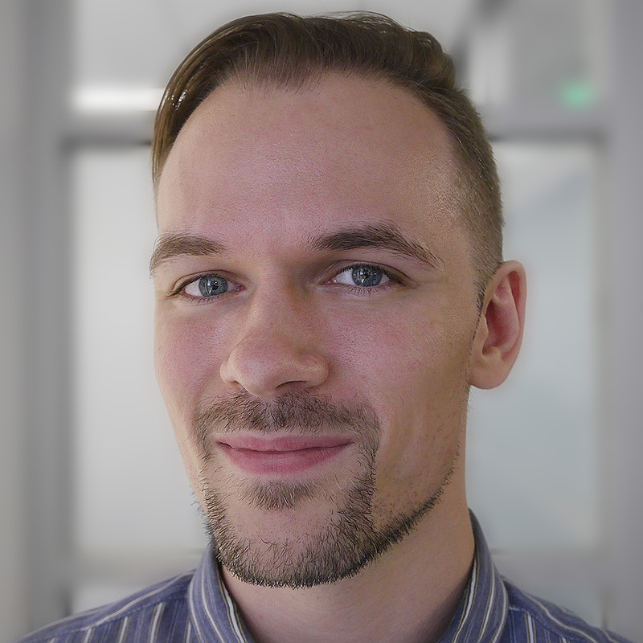

Communication
Plan
Establishing clear lines of communication will help keep the project on track and on schedule. Below, we’ve outlined the chain of command and escalation contacts at Vision you can use if you are ever not able to reach your project manager. Likewise, it’s helpful for us to know who is designated on your end to make decisions in case of emergency, vacations or unavailability of primary team members. This completed form will serve as the official communication plan for the project.
(full name)
(title)
(email or phone)
Lyman Benton
Project Manager
lbenton@visioninternet.com
310-656-3100 x261
(full name)
(title)
(email or phone)
David Rodriguez
Manager, Project Implementation
drodriguez@visioninternet.com
310-656-3100 x388
(full name)
(title)
(email or phone)
Jung Yoon
Senior Director, Operations
jyoon@visioninternet.com
310-656-3100 x389

Slide 7
Roles and
Responsibilities Guide
The following guide is intended to help you identify who should be involved and in what capacity. Keep in mind it might make sense for multiple people to fulfill a specific role, or for one person to fill multiple roles.
Project role … | Takes care of … | Typically filled by …
Decision Maker (Approximately 3-7 hours/week) | Final sign off on Vision deliverables Engaging key stakeholders such as Council or Administration Approving changes in scope or extra work | Administrator Communications Director IT Director/Chief Information Officer IT Project Manager / Consultant
Project Manager (Approximately 8-10 hours/week) | Primary contact with Vision Coordinating staff and resources to ensure timely deliverables and productive meetings | Communications Director Public Information Officer IT Director Webmaster Assistant Manager IT Project Manager / Consultant
IT Contact (Approximately 2-4 hours/week) | Coordinates with Vision primarily during the Go Live phase of the project DNS updates Email questions / setup | IT Director Webmaster
Content & Assets Coordinator (Approximately 5-8 hours/week) | Gathers all images, documents, branding, videos, logos etc. that will be added to the website | Marketing Coordinator Public Information Officer Webmaster
Billing Contact (Approximately 2 hours/week) | Interface with Vision to ensure prompt billing Resolve any questions about the billing of the project | Assistant Manager Clerk Finance Director

Slide 8

Implementation Flow
1
Project Visioning
Deliverables:
UX Analysis & Consultation Content Strategy Collect/Compile Logos & Images Approved Homepage Layout
Duration:
5 Weeks
2
Graphic Design
Deliverables:
Design Visioning & Consultation with Graphic Designer
Initial Design Concepts & Revisions Approved Homepage & Interior Page Design
Duration:
6 Weeks
3
Development & Training
Deliverables: Programming of Website User Acceptance Testing
Content Preparation & Migration Identification of Additional Work (if needed) End User Training on visionLive™
Duration:
11 Weeks
4
Go-live & Maintenance
Deliverables: Final Content Check DNS Update
Public Launch of Website
Transition of Client Success Manager through visionLive™
Duration:
5 Weeks
9
Avg. # of Hours per Week
3
1
Project Visioning
Graphic Design
Development Training & Go-live
Project Manager
Content & Assets Coordinator
Decision Maker IT Contact Billing Contact
7

Slide 9
Risk Management
Plan
A risk is an uncertain event or condition that can have a positive or negative effect on a project’s objectives such as scope, schedule, cost and quality. Vision can help you mitigate the most common risks by utilizing the Risk Management table below:
What is the risk? | How severe is it? | What does it entail? | How to mitigate it…
Unrealistic timeline | High | Not allowing sufficient time for major task completion | Provide and commit to realistic timelines that align with workload and resources available
Sign off / Approval process | High | Key project milestones may require approval from additional stakeholders | Adjust timelines to factor in additional time for approvals
Insufficient team resources | Medium | Not having the bandwidth to complete project deliverables due to lack of time or resources | Be realistic about availability and plan timelines accordingly to balance workload with project deliverables
Team availability | Medium | Key project members are unavailable for various reasons (i.e. competing projects, turnover, etc.) | Provide multiple points of contact in the event designated stakeholders are not available
Scope changes | Medium | Adding new feature requests mid-project increases the likelihood of an extended timeline | Work with your Project Manager to refine scope early as changes made after the design phase will have a larger impact on timeline

Slide 10
Effective Feedback
Guide
To help guide our discussions, here are some suggestions for ways to provide the most effective design feedback.
Tell Us Why
The more we know about the reasons behind why you like or don’t like a particular element, the better. If you like or don’t like something in a design, try to frame your comments into a “because” statement:
Okay: This looks cool.
Better: This is cool because it showcases a key landmark that we’re known for.
Okay: This color is too dark.
Better: This color is too dark because it’s not consistent with our brand.
Be Specific
Many design elements are subjective, so helping us understand your vision for a particular concept or “feel” will enable us to more effectively showcase it in the design. For example, if you want your design to feel like the ocean, share as many details as you can about what that means to you. Do you like the literal look of the water/waves? Or a beach-like color scheme? Or a nautical feel? Be as specific as possible!
Okay: “We like a beach-look.”
Better: “The beach is a major part of our community, so we want to reflect a surfer-vibe into our design. We’re thinking bright colors, waves, and other imagery that conveys what it’s like to be on our beach on an active day.”
Open a Dialogue
There may be elements of the design you don’t like. A blunt phrase like “I hate this” can deter discussion about why a particular element was included and ultimately determine what can be done better. Your designer will typically have a specific objective in mind with design elements, so digging into the reasoning behind an element will help foster a discussion to help everyone stay on the same page.
Okay: “I hate this!”
Better: “I don’t like this. Can you help me understand why it’s here?”
Other Tips:
Be honest: If you are not happy with something or think we are going the wrong direction let us know. We’d rather stop and collaborate with you about a solution than proceeding with a design that doesn’t meet your needs.
Keep the goal in mind: There will probably be elements of the design you don’t personally like, but it’s important to keep in mind the end goal of your website. Before deciding to remove an element, ask yourself: would the design be appealing to residents, visitors, and other key audiences?
Don’t be afraid to ask us questions: We’re always happy to go more in depth to explain how we come up with designs, we want you to be 100% on board with the process and the result.

Slide 11
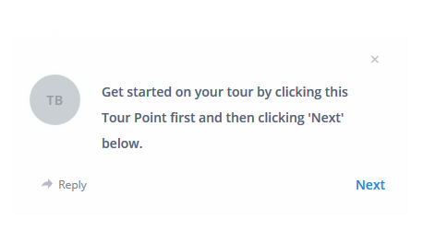
Design Asset
Collection
One of the first steps we will take together is a design discussion, working with you to develop a plan for the look and feel of your new website. As part of that process we need you to put together a collection of various images that are related to your organization and will allow our designers to create a website that is unique to you.
To help we have put together a guide in InVision that will spark some ideas of what you might want to send us. Click here to get started in InVision.
As you look through the guide you will see tour points:
Tour points will be shown as blue dots that your can click for more information. Click “Next” on the tour points to view the next slide or “Prev” to go back.
These tour points will provide insight into the kinds of images that will be the most helpful in guiding us forward.
Please provide a selection of images (up to about 100). If you are not sure if an image should be included, add it in. Your project manager will set up a space for you to share these images.

Slide 12
Survey
Preparation
In order to gather valuable insight from your internal stakeholders and community regarding your website, we have created a series of surveys (outlined below). These should be released as early as possible to allow for a maximum response rate. The information gathered here will be combined with our other analysis into the Site Usability Report that will be delivered to at the UX Consulting meeting at the end of this phase.
Our goal with the surveys is to gather as much information as possible in order to inform our recommendations for the layout of your new site.
The appropriate surveys for your project will be given to you by your Project Manager at the kickoff call.
Discovery Survey
Audience: Your core team, the main decision makers for the new website, please respond to this survey with only one response that reflects your organizations vision of the new website.
Goal Date: Three to four weeks after kickoff call
Community Survey (If Applicable)
Audience: Website visitors - please create a link on your site to this survey. Also, if you have an email campaign software I encourage you to broadcast this as a bigger sample is always preferred for
Location:
Goal Date (automatic cut-off date): Three weeks
Statistical Significance: In order to ensure that the data is a good representation of your users, there is a minimum number of responses needed, which is based on the population that you serve.
Population | Responses Needed
1000 | 278
5000 | 357
10000 | 370
20000 | 377
100000 | 383

Slide 13
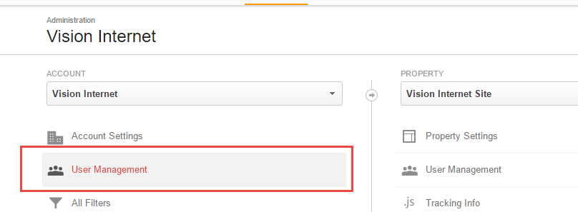
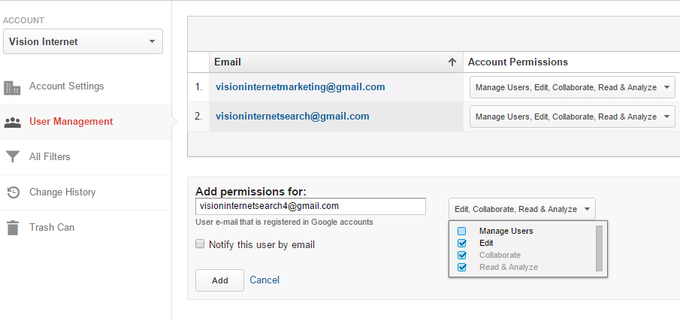
Google Analytics
Tracking
A critical part of analyzing your existing website is to dig into your Google Analytics data to understand how people are accessing your website and what content they’re seeking. In order for Vision to conduct this analysis, we need to be granted permission to view your account’s data.
Setting up Analytics
Our account of visioninternetsearch4@gmail.com requires “Edit” rights at the “Account” level or for each site so we can add the needed filters and dashboards for you to get the most out of your analytics.
Once in the appropriate area of user management, just add our account with the needed “Edit” rights and you are done!

Slide 14
Glossary of
Terms
Term | Definition
“Above the fold” | The section of a webpage you can see without scrolling
Analytics (Google) | A means of tracking the number of visitors that come to your site, where they go, and what they click on
Comp | Short for “comprehensive;” contains the annotations necessary for developers to create the frontend of the website (based off of the wireframe)
Consultation Workshop | A meeting with decision makers to discuss the process and provide direction regarding what the new website will look like; goal is to create a wireframe by the end of the meeting based on collected analytics and heat map results
Design Assets | Materials for the Vision Graphics Team such as logos, photographs, branding/style guides etc.; collected in the UX Phase prior to Graphic Design.
Heat Map | A collection of data points relating to where people click and hover on a site presented in a graphical representation
Homepage | The first page you see when you go to a website from the domain (www.city.com or city.com)
InVision | An app to share design drafts and allow direct comments; providing contextual feedback to the design of your website
Responsive Design | Specific design which allows a site to re-style and re-arrange successfully so it looks great regardless of device type (e.g., mobile, tablet, or desktop)
Style Guide | A manual to ensure design consistency; documentation of specific font and colors as well as how and when to use these items
User Experience | The overall experience of a person using a product such as a website or computer application, especially in terms of how easy or pleasing it is to use
WCAG | Web Content Accessibility Guidelines is a collection of recommendations that have been put together to provide guidance on how to make content on a website accessible no matter how you get to it, or perceive it. What you get if you visit the site with a screen-reader, color-blindness, or a regular web-browser should be the same.
Wireframe | A skeletal framework, much like a blueprint, which displays the functional elements of a website or page, typically used for planning a site’s structure and functionality

Slide 15
Kickoff
Checklist
You’re now ready to get started! Use this checklist to track the completion of tasks in preparation for your project kick-off call. Though finishing every task in advance of the call isn’t required, the more you are able to do, the better. We look forward to collaborating with your team.
Tasks |  | Completion Date
Assemble Project Team
Assign primary project Decision Maker |  | ___________________________
Assign Project Manager |  | ___________________________
Identify and assign IT Contact, Content & Assets Coordinator & Billing Contact |  | ___________________________
Identify Core Project Team (3-5 members) |  | ___________________________
Identify Steering Committee |  | ___________________________
Complete Communications Plan form and submit to Vision |  | ___________________________
Collect all assets such as images and documents |  | ___________________________
Walk through InVision image requirement tutorial Link to InVision tour |  | ___________________________
Complete Survey Preparation (After Kickoff Call)
Discover Survey |  | ___________________________
Community survey (if applicable) |  | ___________________________
Finish Technical Set-up
Google Analytics and account set-up |  | ___________________________

