Slide 1
visionSocial Customer Webinar
April 28, 2016

Slide 2
Agenda
Why is better social media management important?
What is visionSocial?
Demo - an introduction to visionSocial
Best practices
CMS configuration
Questions
We are recording the webinar and will send out a link along with other materials within the next day or two.

Slide 3
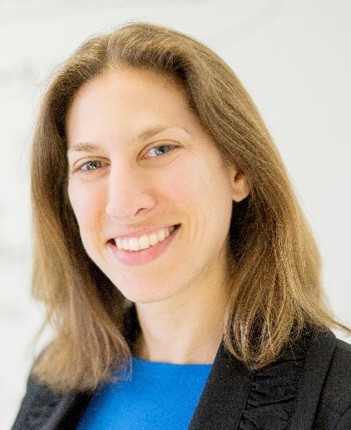
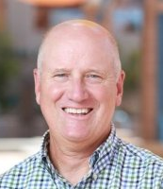
Vision Products Team
Denise Petrulis, Director of Product Management
dpetrulis@visioninternet.com
Jake Sager, Product Manager
jsager@visioninternet.com
Tom Humbarger, Product Marketing Manager
thumbarger@visioninternet.com

Slide 4
Social Media Challenges – What We’ve Heard
You’re overwhelmed with managing social media activity - and you want your posts to stand out:
Increase the efficiency of posting to social media accounts
Create better messages to engage your communities
Schedule their social media activity to maximize visibility

Slide 5
Social Media Pain Points – From Customer Survey
No time
Approval
Consistency
Scheduling
Keeping track
Customization
Security

Slide 6
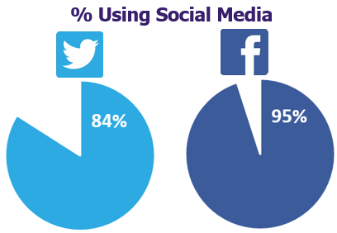
Majority of Our Customers Are Using Social Media

Slide 7
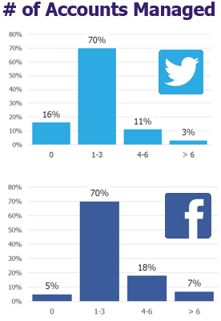
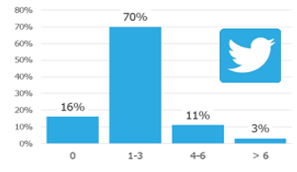
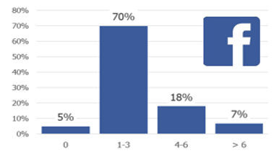
70% of Customers Manage Between 1 and 3 Accounts

Slide 8
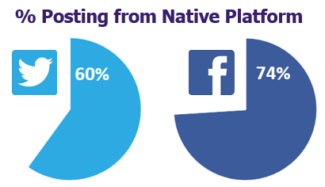
Vast Majority of Customers Post from Native Platforms

Slide 9
What is visionSocial?
Post what you want, when you want and where you want it.
Post to Facebook and Twitter directly from News and Events
Customize messages with text and images to increase engagement
Schedule posts to maximize visibility
Plan multiple posts across multiple channels to build campaigns

Slide 10
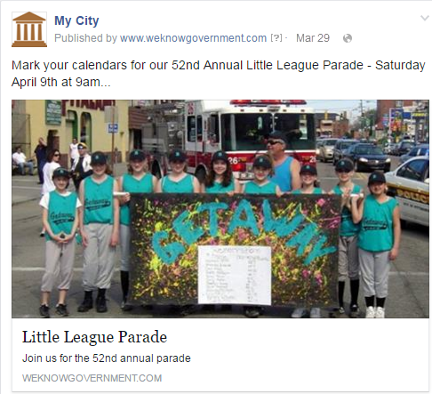
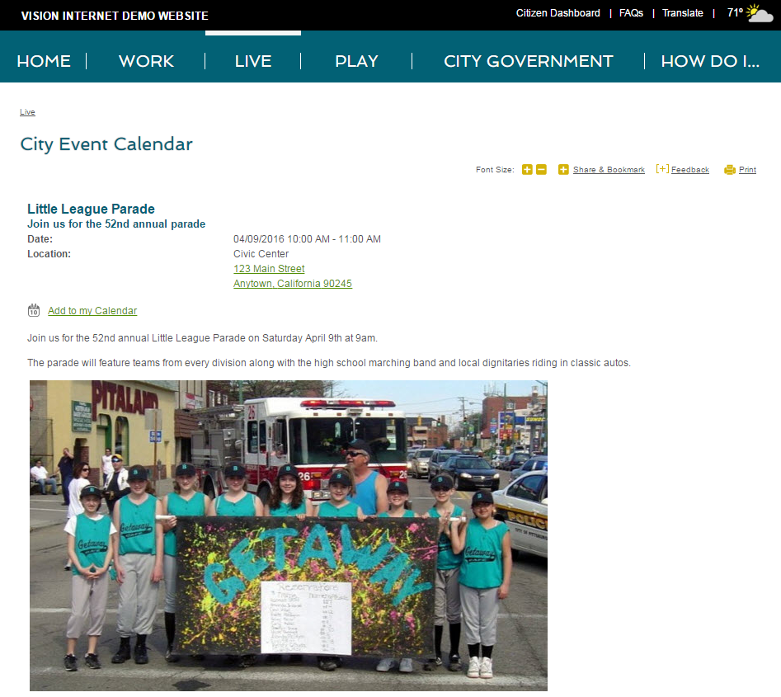
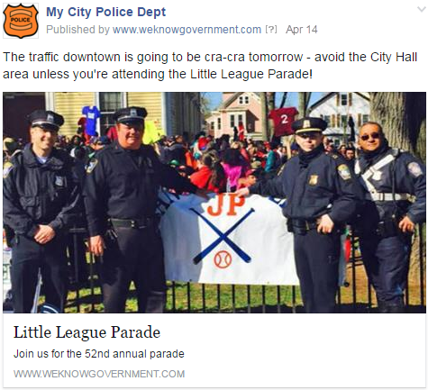
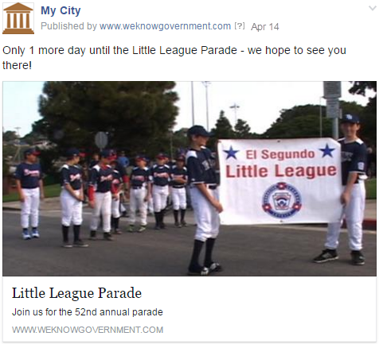
visionSocial = Social Media Management, Simplified

Slide 11
visionSocial Demonstration

Slide 12
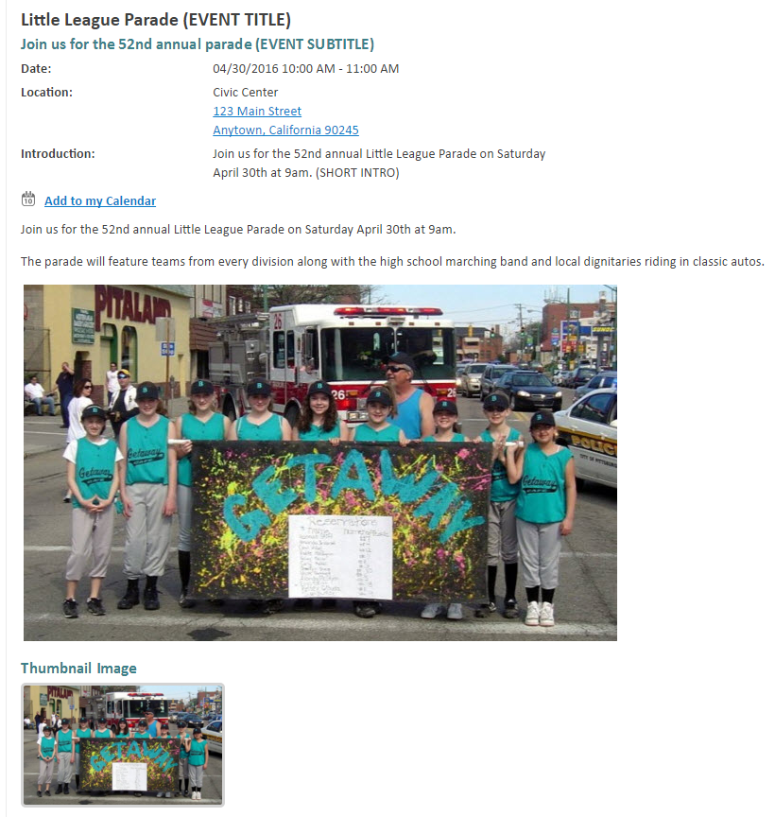
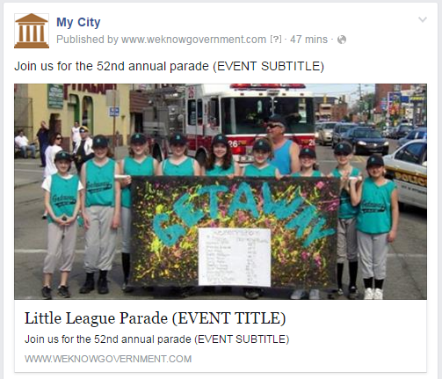
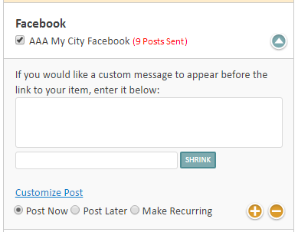
Facebook Post Example – Default Message

Slide 13
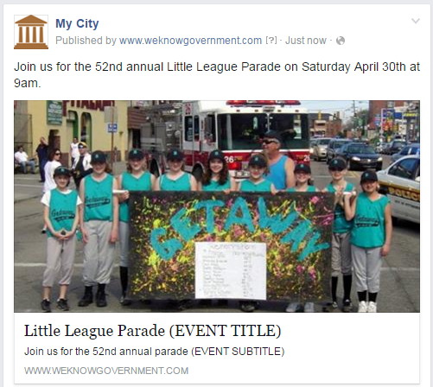
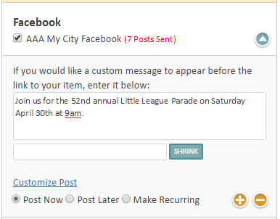
Facebook Post Example – Custom Message

Slide 14
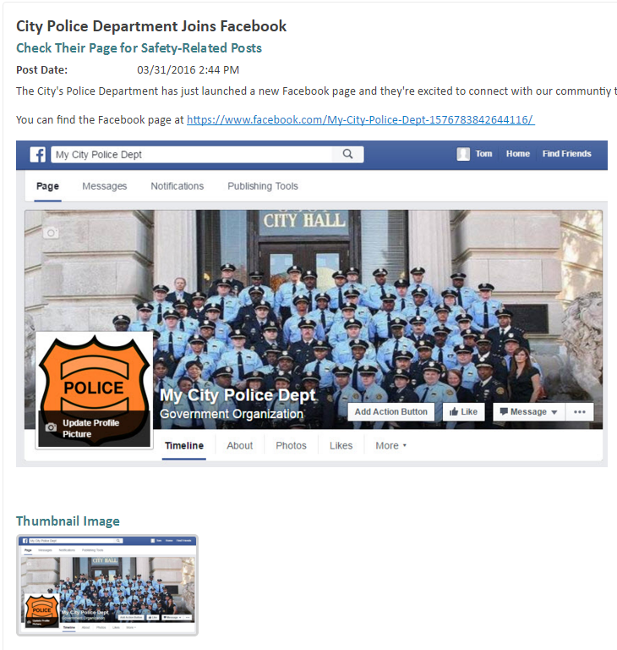
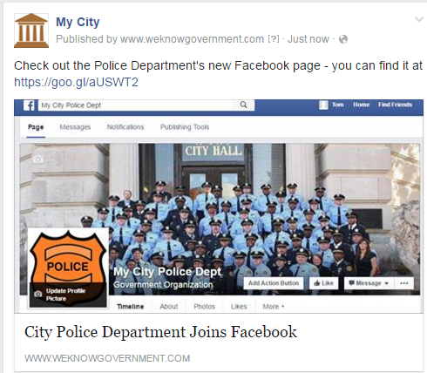
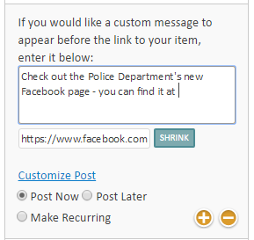
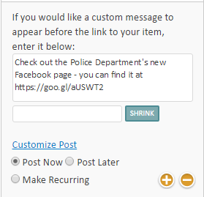
Facebook Post Example – Custom Message and Shrink URL

Slide 15
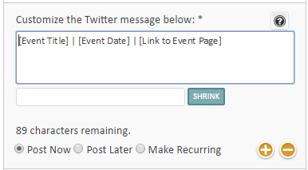
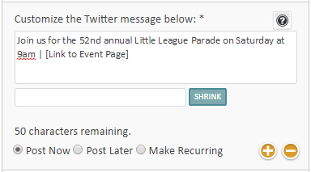
Twitter Example Posts

Slide 16
Social Media Best Practices
Customize your Facebook and Twitter messages to grab attention
Use images in Facebook posts to increase engagement
Schedule messages to match when your community is online
Post on a consistent basis

Slide 17
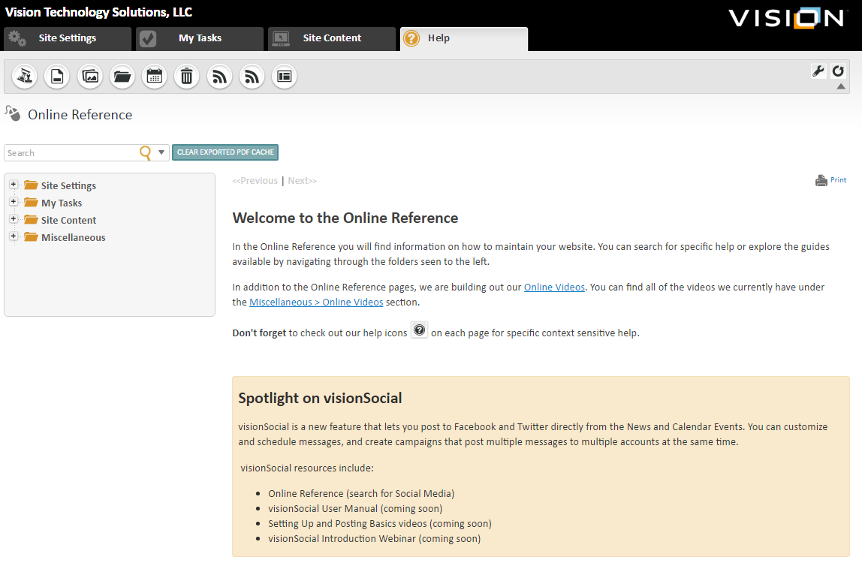
Spotlight on visionSocial in visionCMS

Slide 18
May 25th Roundtable Webinar on Using Social Media

Slide 19
Social Media eBook with Local Government Leader Advice
Key Themes
Focus your efforts
Have a plan
Make it a conversation
Commit to progress not perfection

Slide 20
visionSocial and Social Media Resources
CMS Online Reference (Help>Online Reference)
Video Overviews (Help>CMS Videos)
Social Media Webinar – Wednesday, May 25th (Using Social Media to Improve Civic Engagement)
visionSocial Power Hour – Tuesday, May 31st at 9am PDT
Social Media eBook (we will include a link in the follow-up email)
Follow Vision on social media
LinkedIn – linkedin.com/company/vision-internet
Twitter – twitter.com/visioninternet

Slide 21
Questions and Answers?
Denise Petrulis, Director of Product Management
dpetrulis@visioninternet.com
Jake Sager, Product Manager
jsager@visioninternet.com
Tom Humbarger, Product Marketing Manager
thumbarger@visioninternet.com

